Slide 1
Artist Self Portraits
Fall 2019

Slide 2
A self-portrait is a representation of an artist. They can be drawn, painted, photographed, printed or sculpted by the artist.

Slide 3
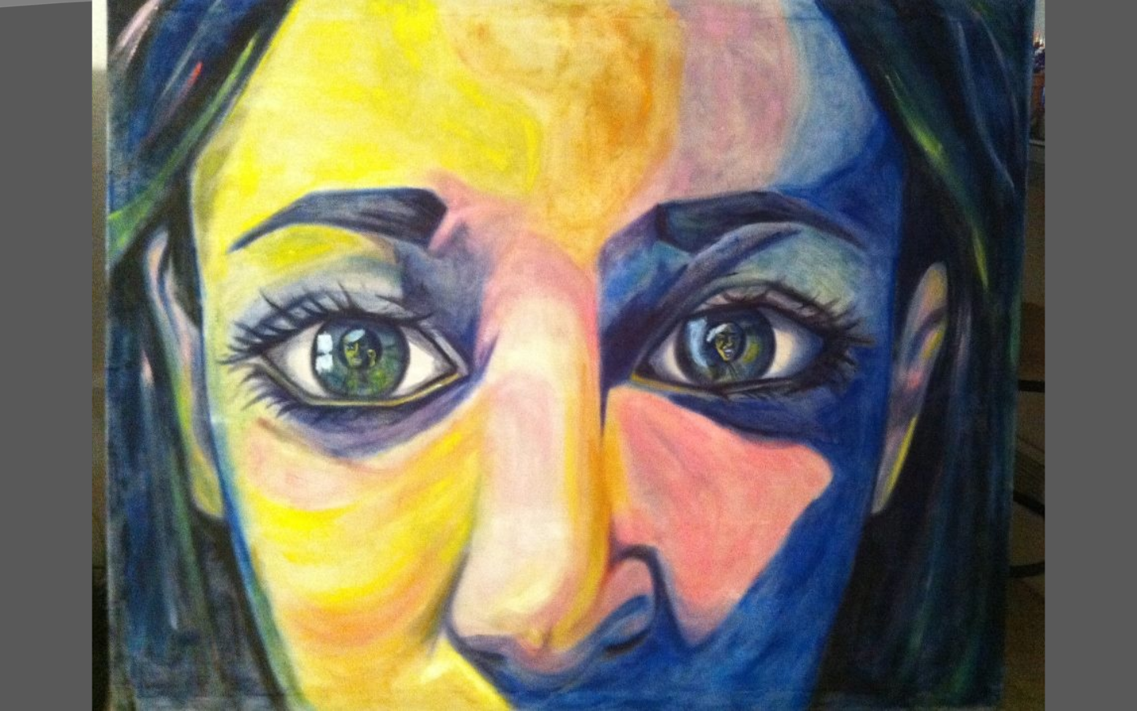

Slide 4
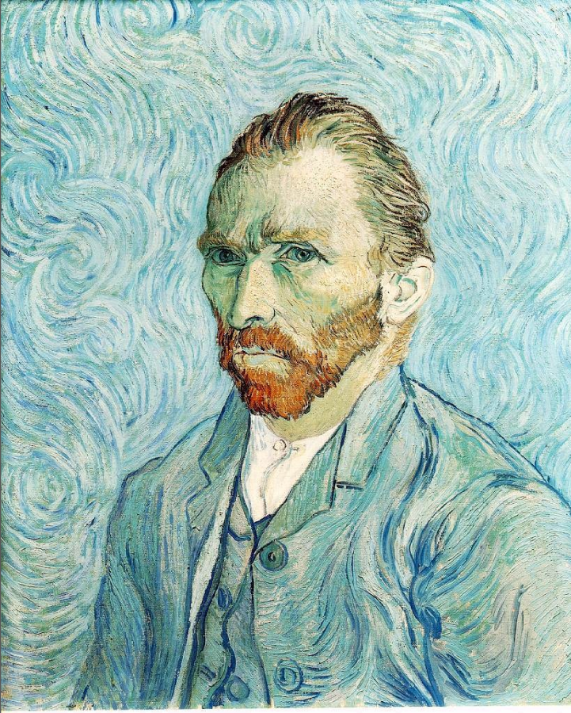

Slide 6
Step 1: Research

Slide 7
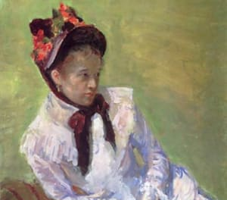
Mary Cassatt

Slide 8
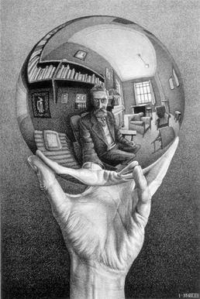
M.C. Escher

Slide 9
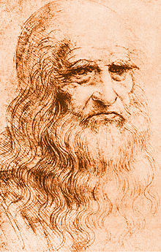
Leonardo Da Vinci

Slide 10
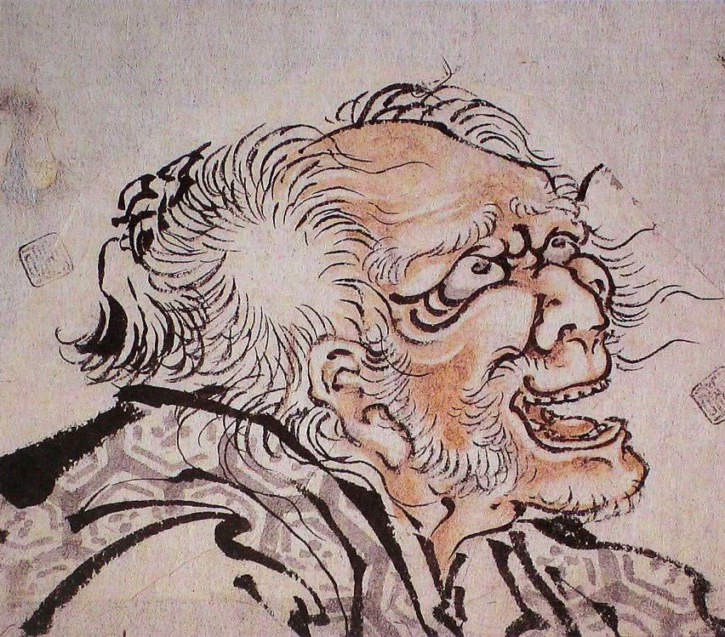
Katsushika Hokusai

Slide 11
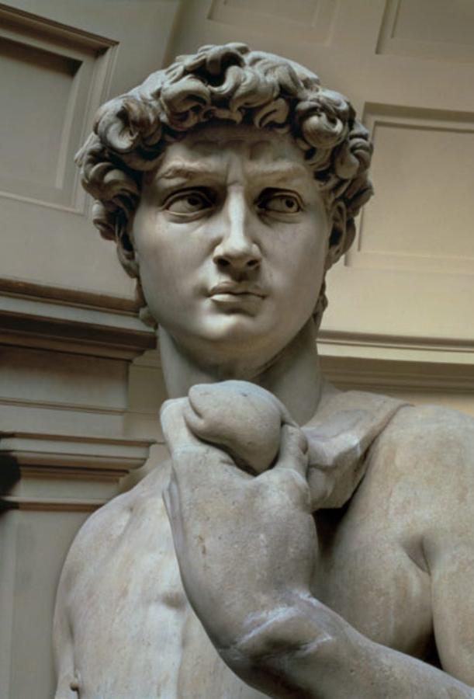
Michelangelo

Slide 12
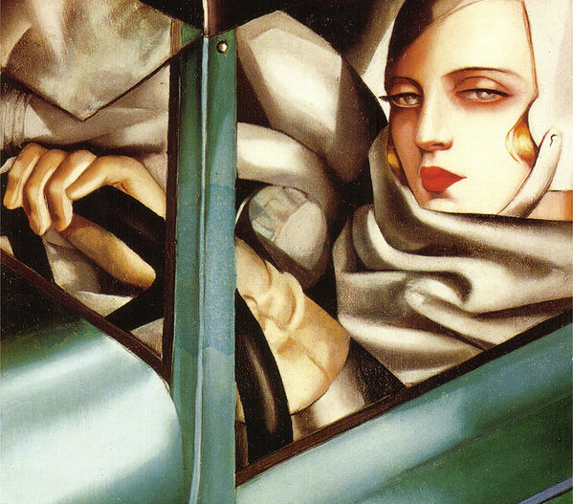
Tamera De Lempika

Slide 13
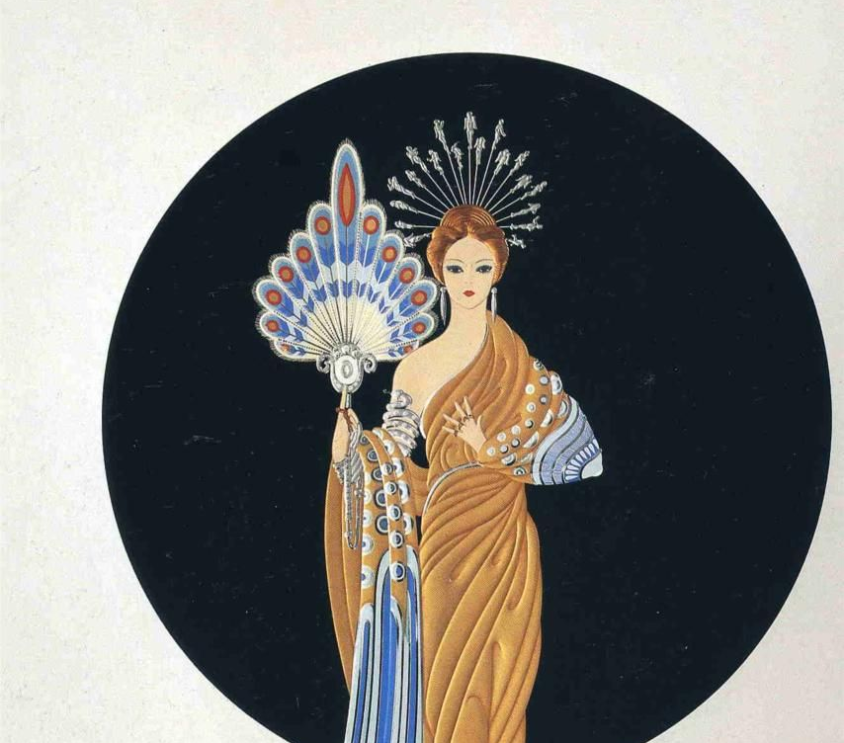
Erte

Slide 14
Alphonse Mucha

Slide 15
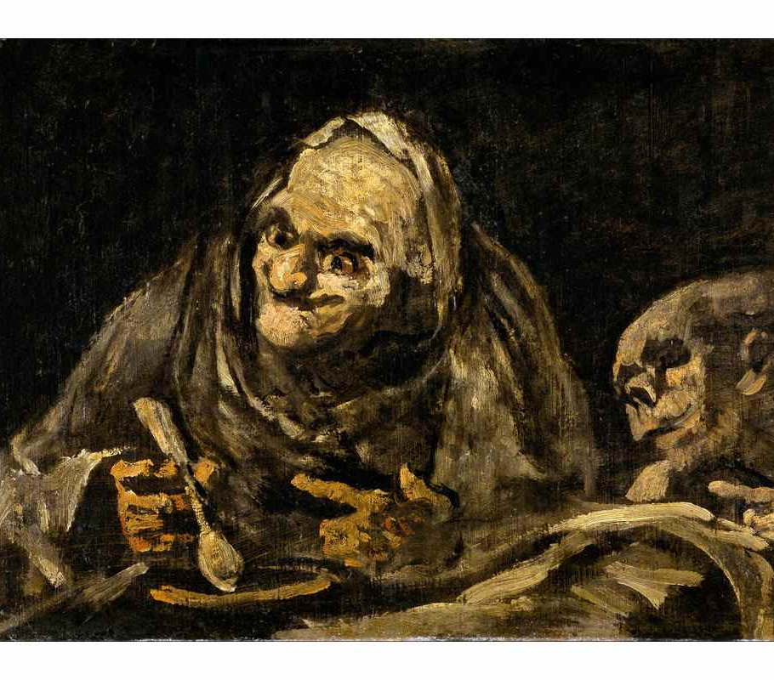
Fancisco Goya

Slide 16
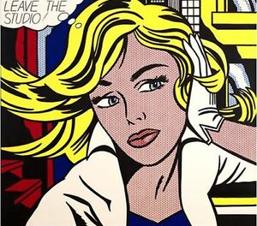
Roy Lichtenstein

Slide 17
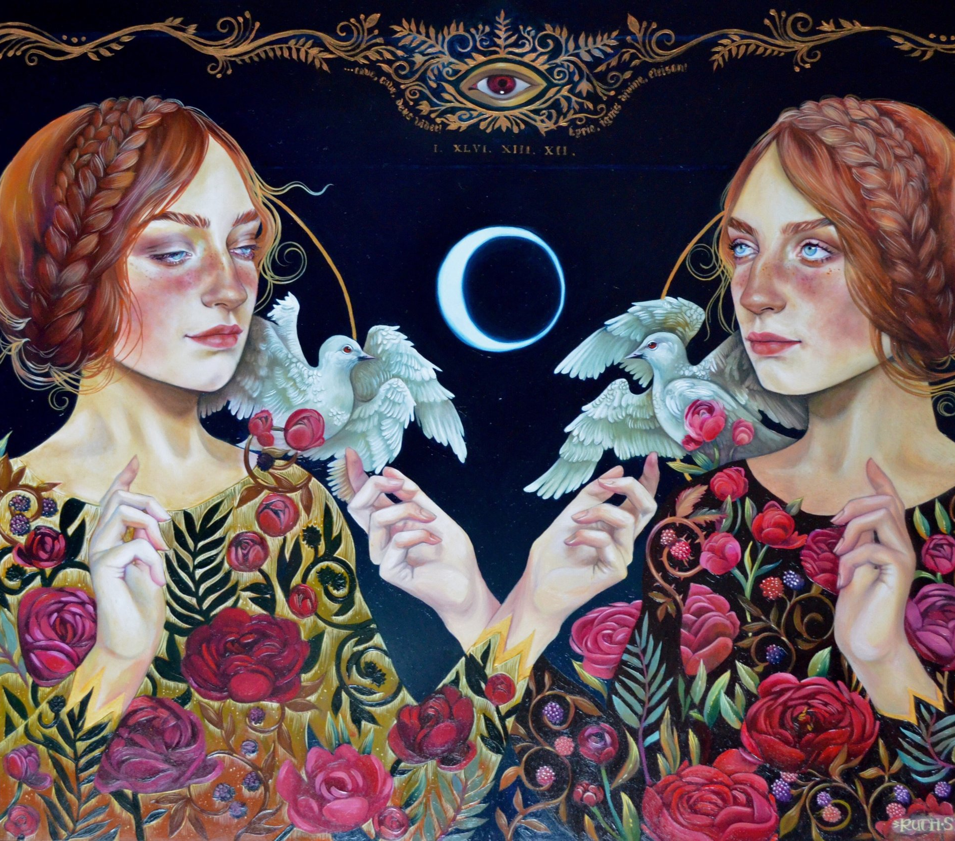
Ruth Speer

Slide 18
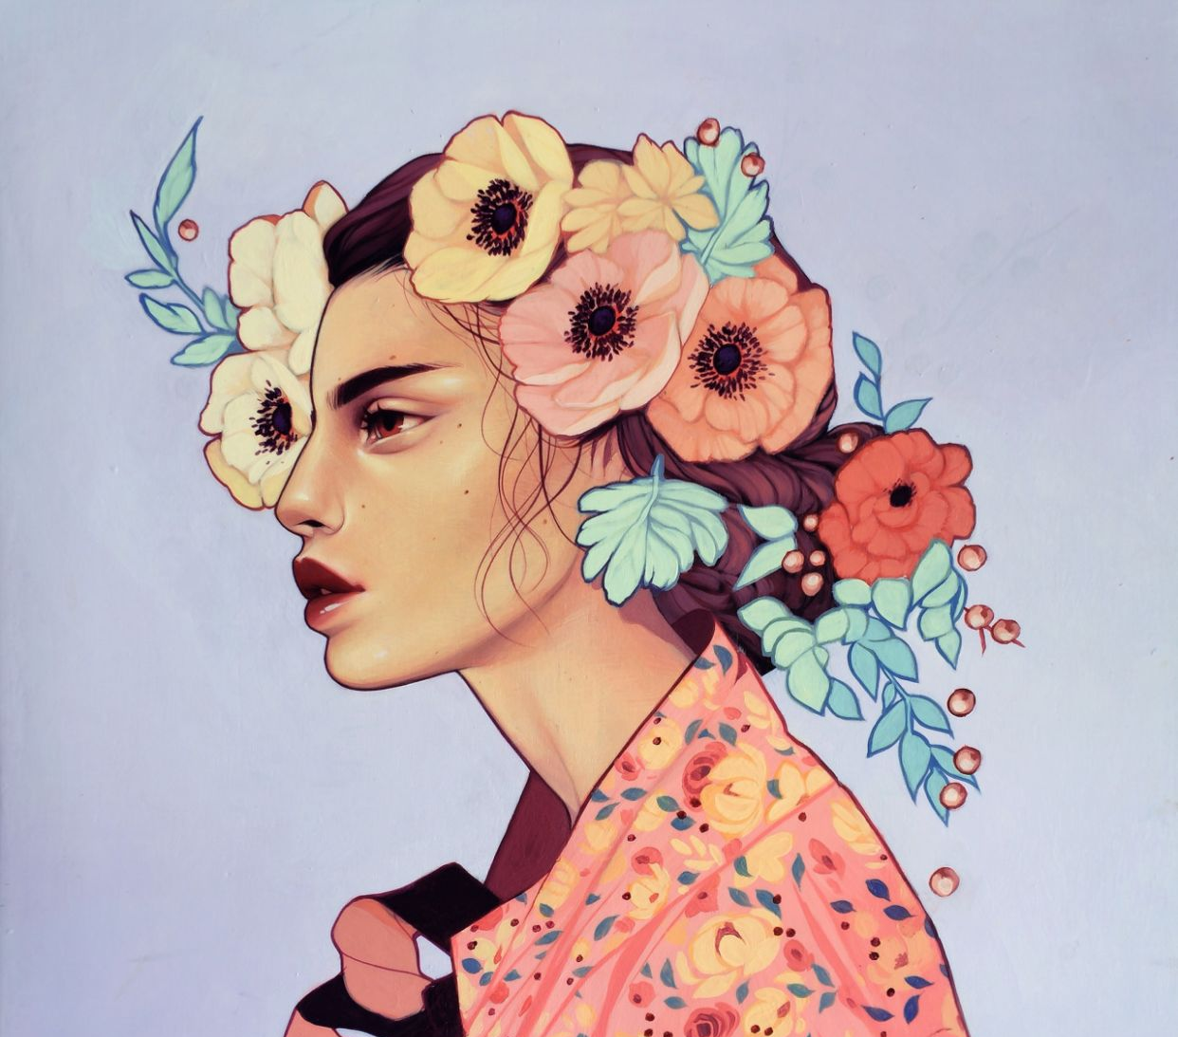
Kelsey Beckett

