Slide 1
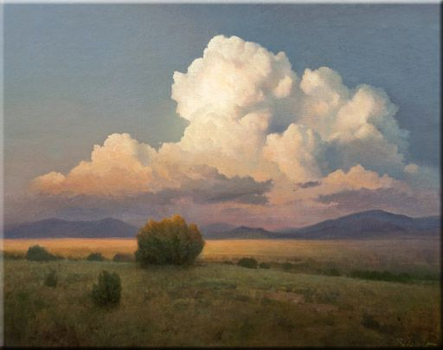
Color Theory Landscapes
Fall 2018

Slide 2
Monochromatic – having or consisting of one hue

Slide 3
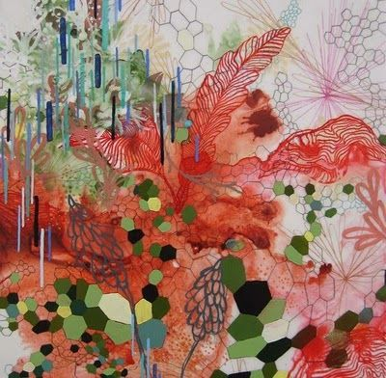
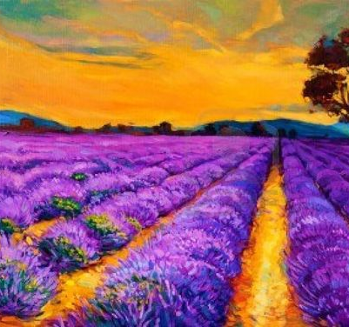
Complementary - colors directly opposite each other in the color spectrum, such as red and green or blue and orange.

Slide 4
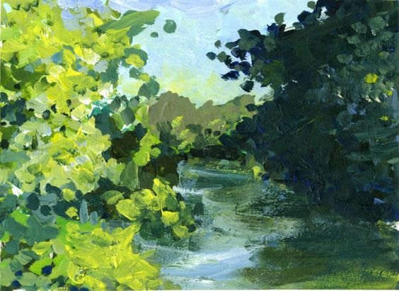
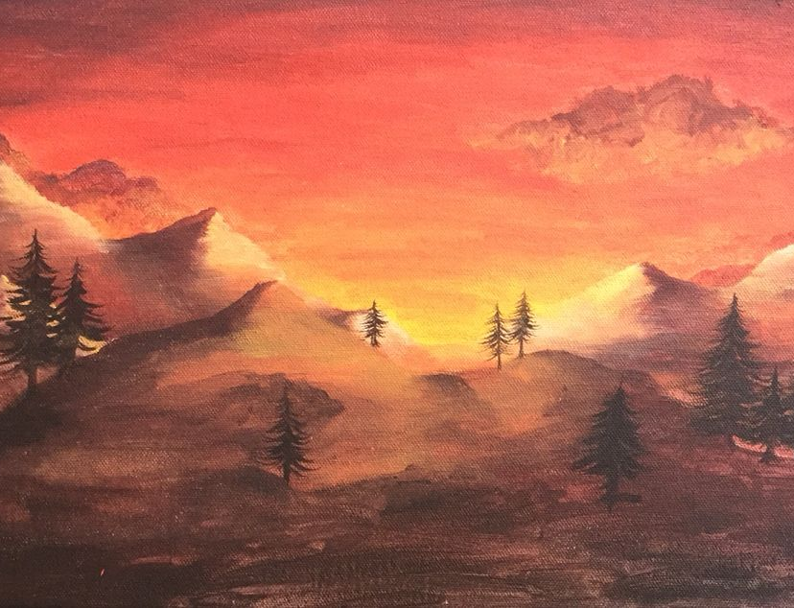
Analogous - groups of three colors that are next to each other on the color wheel, sharing a common color.

Slide 5
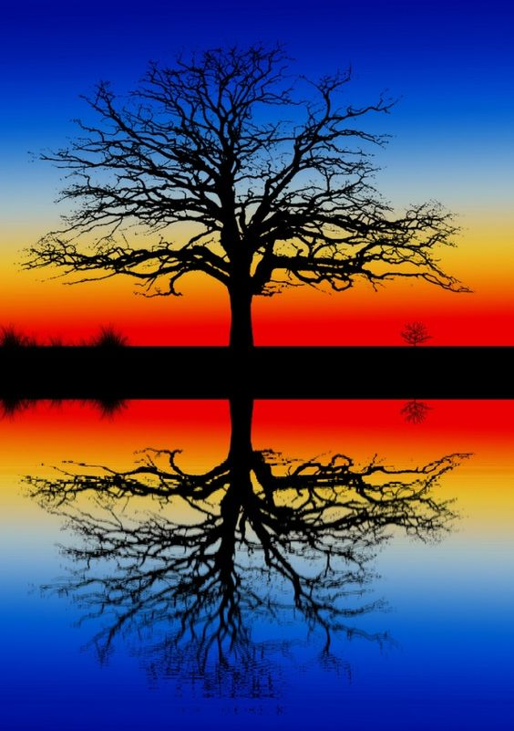
Triadic - equal distance between all colors.

Slide 7
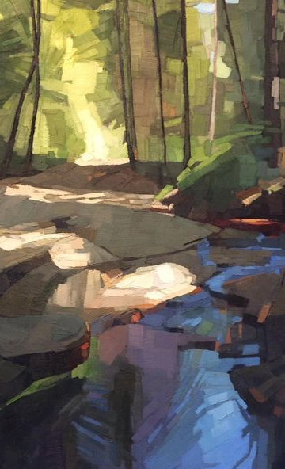
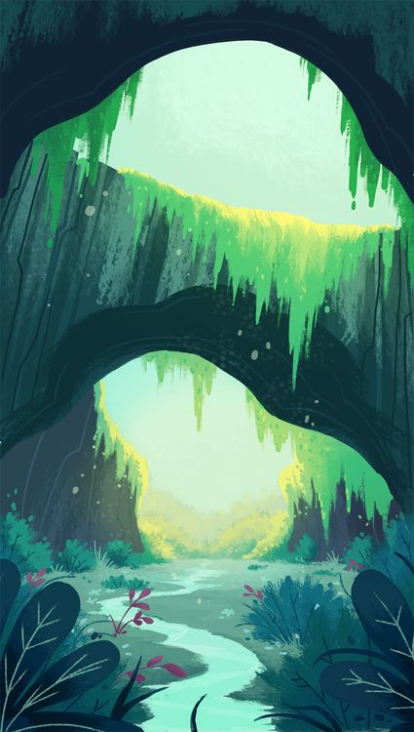
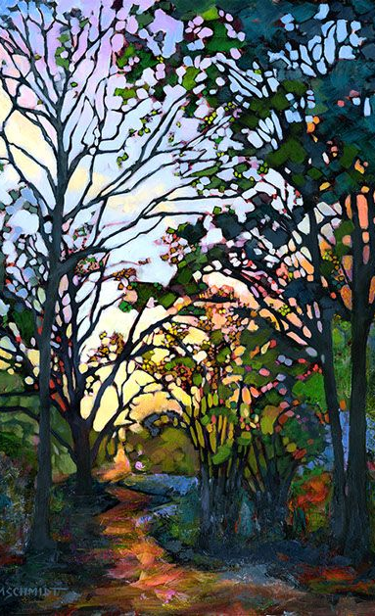

Slide 8
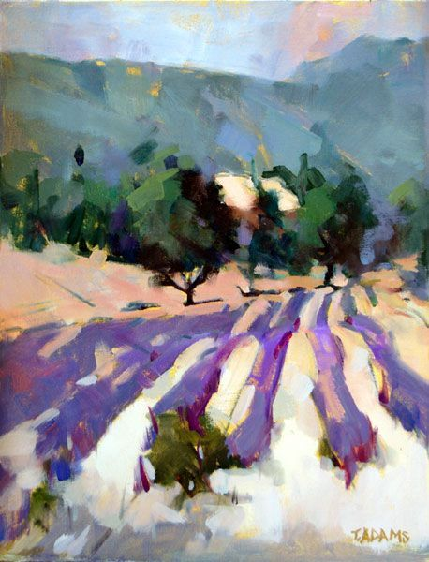

Slide 9
