Slide 1
Color Wheel Theory

Slide 2
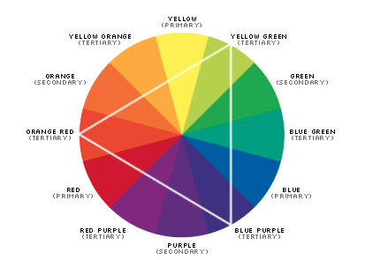
Color Theory
A body of practical guidance to color mixing and the visual impact of specific color combinations.

Slide 3
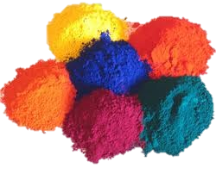
There are 3 types of Color
Pigment Color: Paints. (tempera, acrylic, oil, dyes, etc.)When we refer to pigment colors, we are referring to colors on the color wheel.

Slide 4
Light Color
Spectrum color, or light that is reflected

Slide 5
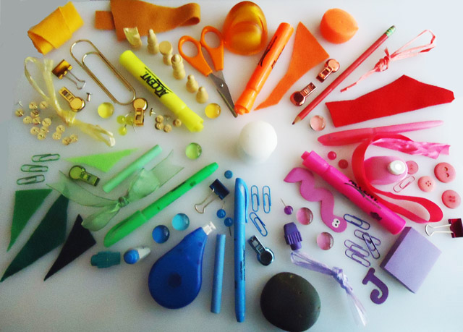
Object Color
Represents the color that an object really is.

Slide 6
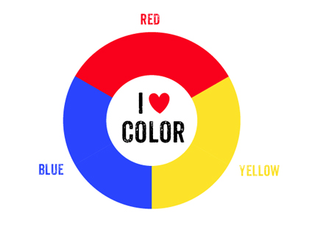
Primary Colors
These are your source colors. They make all other colors on the color wheel, but no two colors can combine to create them.

Slide 7
Secondary Colors
These Colors are created by combining two Primary colors in equal proportions.

Slide 8
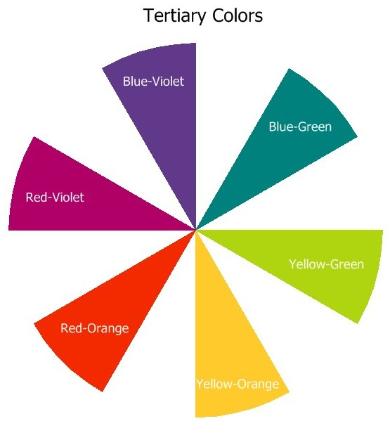
Intermediate Colors
These colors are created by mixing a primary and a neighboring secondary color.
When naming an intermediate color ALWAYS list the Primary color first.

Slide 9
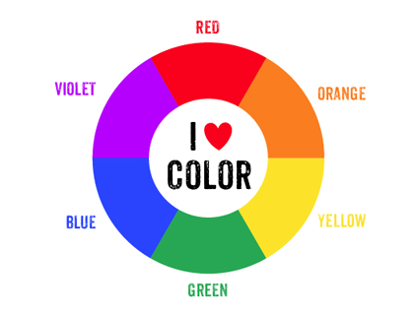
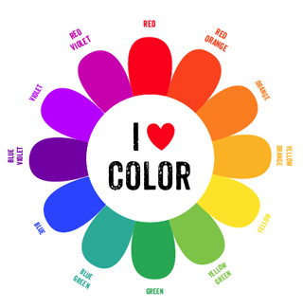

Slide 10
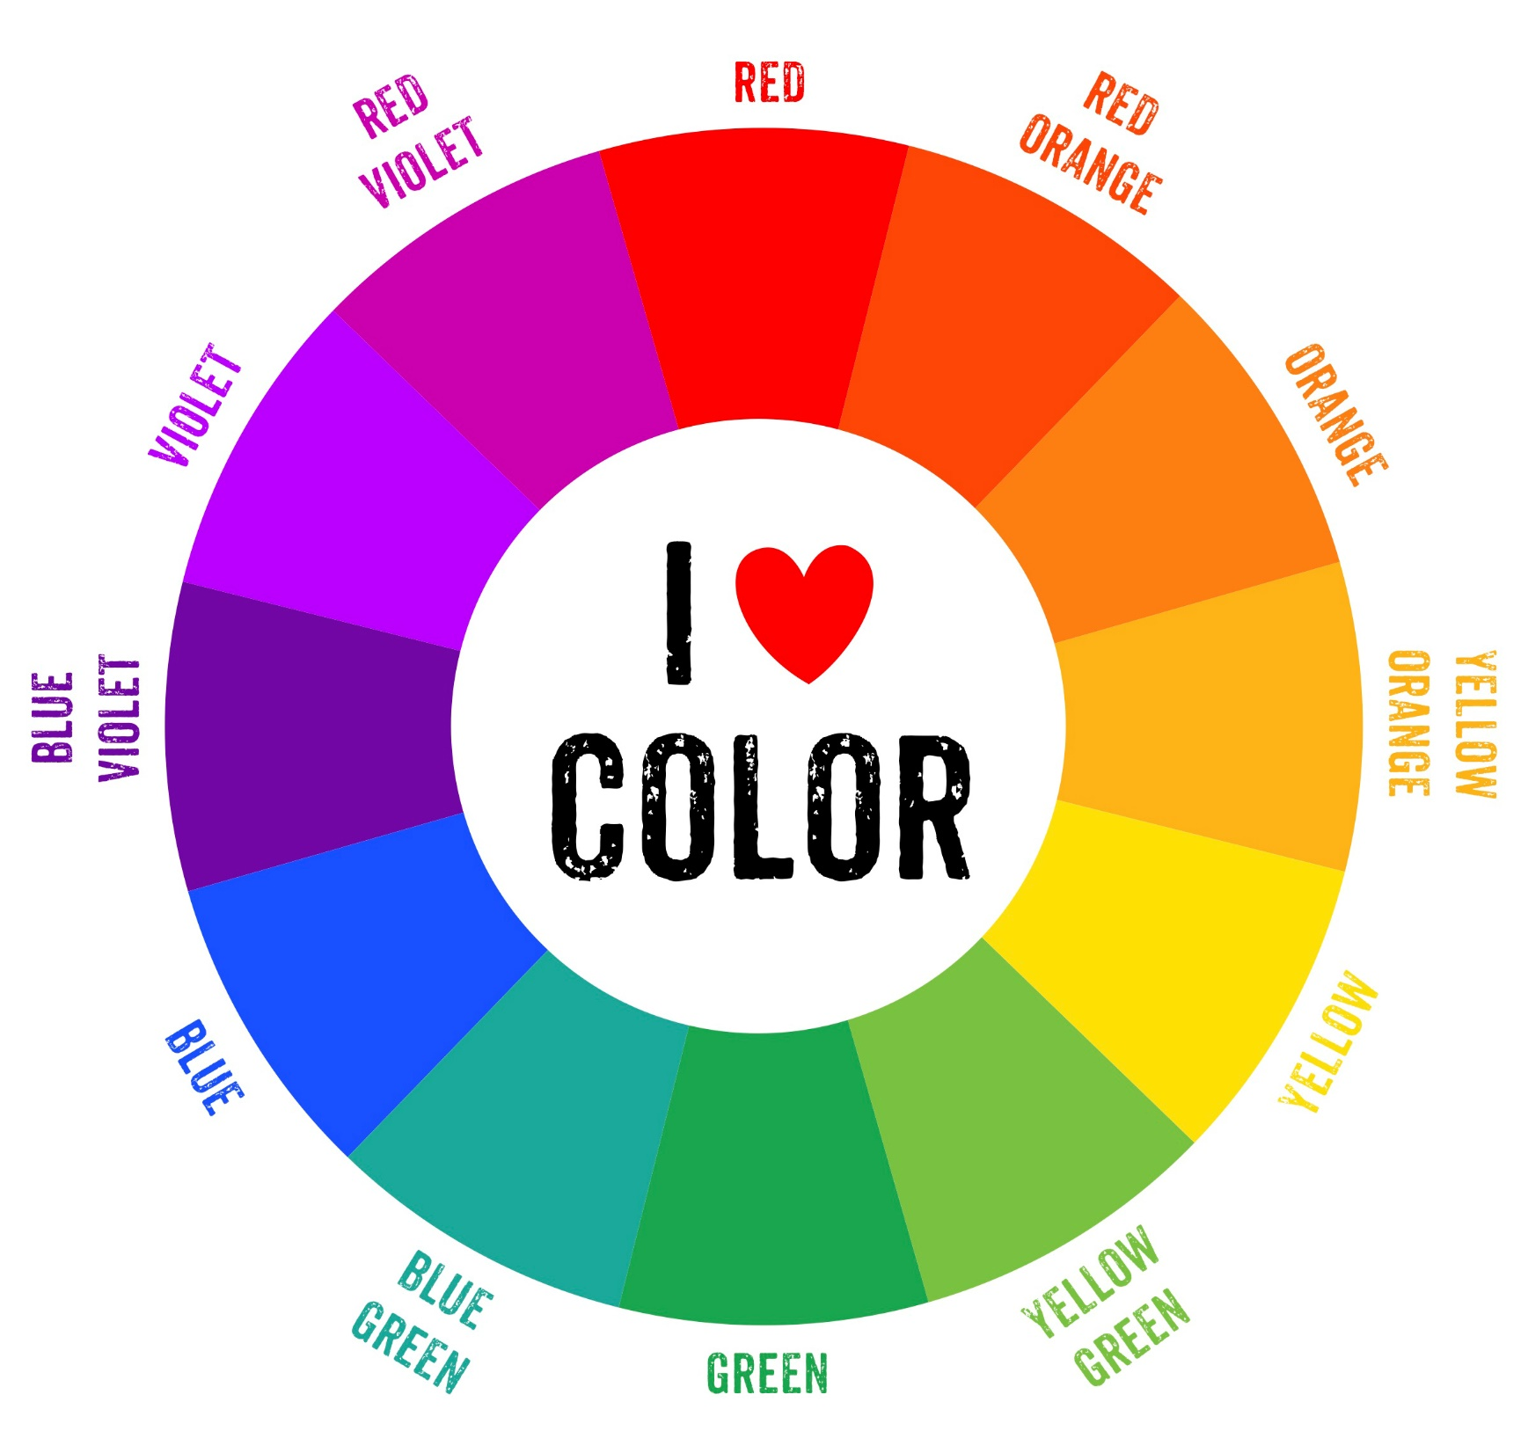

Slide 11
Value Pigments
Whites, Blacks and Grays

Slide 12
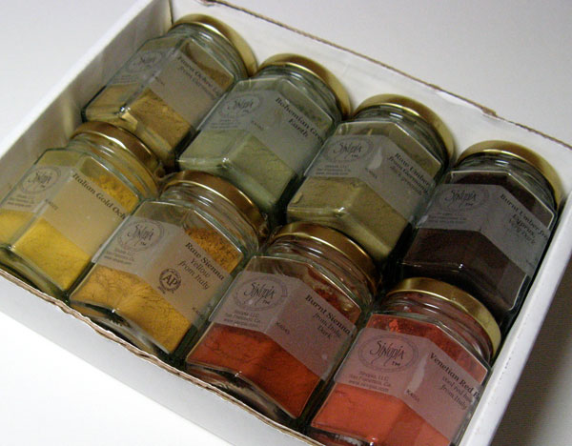
Neutral Pigments
Earth colors, browns, tans, sienna's, etc.

Slide 13
Every Color has 3 Properties:
Hue: Simply means the name of a color.

Slide 14
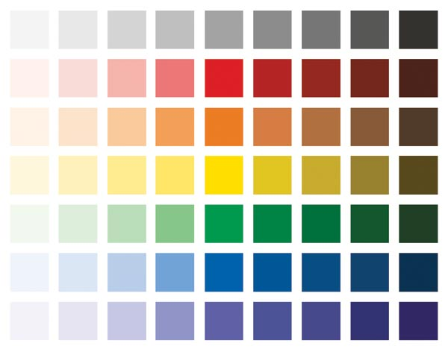
Value
Refers to the lightness or darkness of a color.

Slide 15
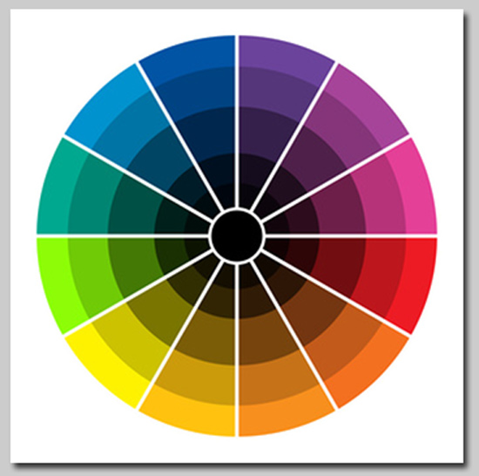
Intensity
The degree of brightness or dullness of a color.

Slide 16
Using Value Pigments
Color + White = TINT
Color + Black = SHADE
Color + Gray = TONE

Slide 17
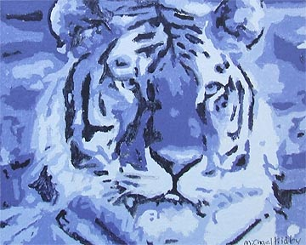
Monochromatic
A color scheme using only one color and it's tints and shades.

Slide 18
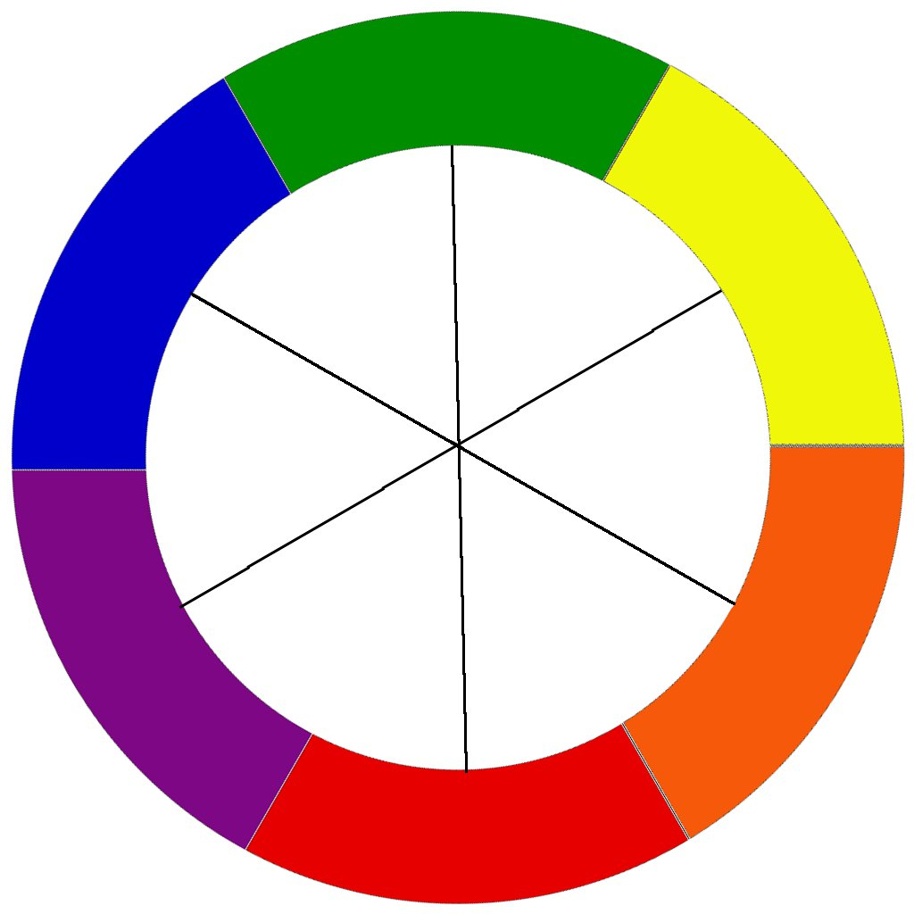
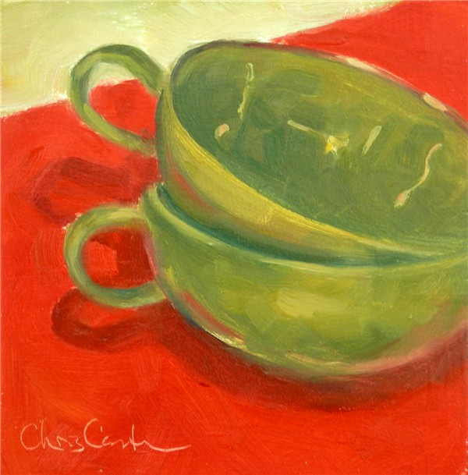
Complementary
A color scheme using two colors across from each other on the color wheel. Every color has ONE compliment.

Slide 19
Tension/Emphasis

Slide 20
How can you use colors? Contrast
Notes:
You are learning to manipulate color and paint to your advantage

Slide 21
Warm Color Scheme
These colors are associated with warmth, like Red, Yellow and Orange. They tend to advance on the picture plane.

Slide 22
Cool Color Scheme
These colors are associated with cool things; Like Blue, Violet, and green. They tend to recede on the picture plane.

Slide 23
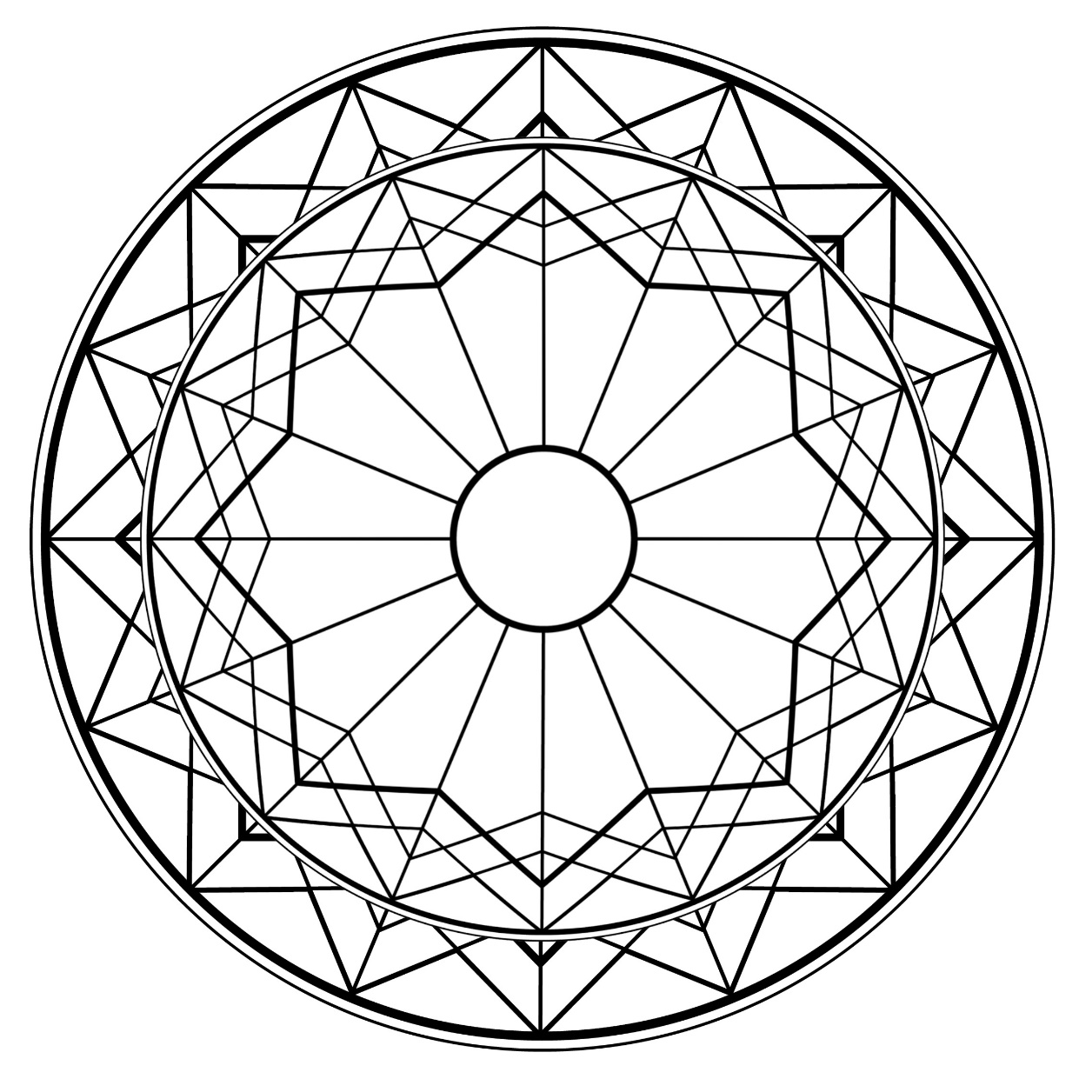

Slide 25
