Slide 1
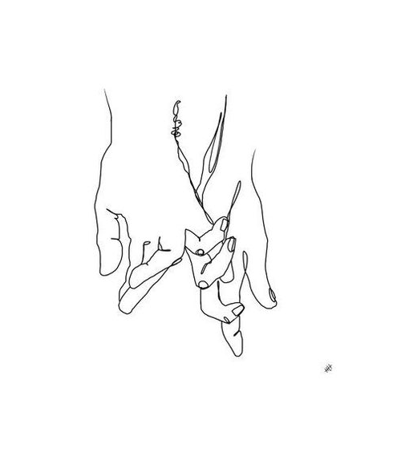
Contour Drawing
Fall 2019

Slide 2
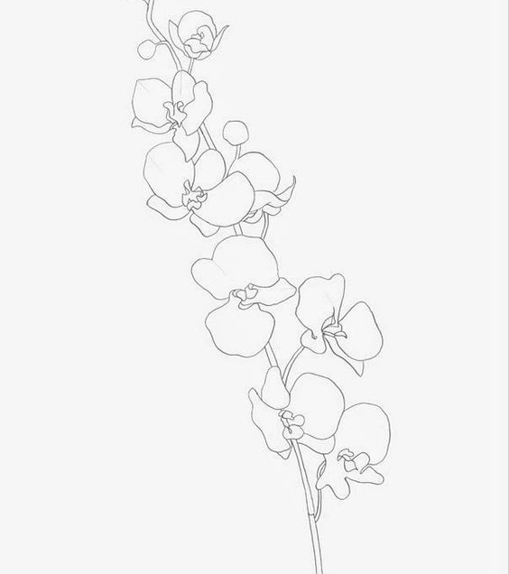
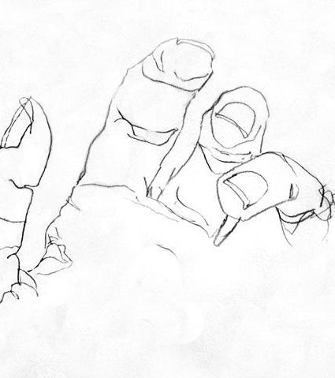
What is a contour drawing?
It is an artistic technique used in drawing where the artist draws their subject matter by creating solid, confident lines that result in what is essentially an outline.
These drawings have no value or shading

Slide 3
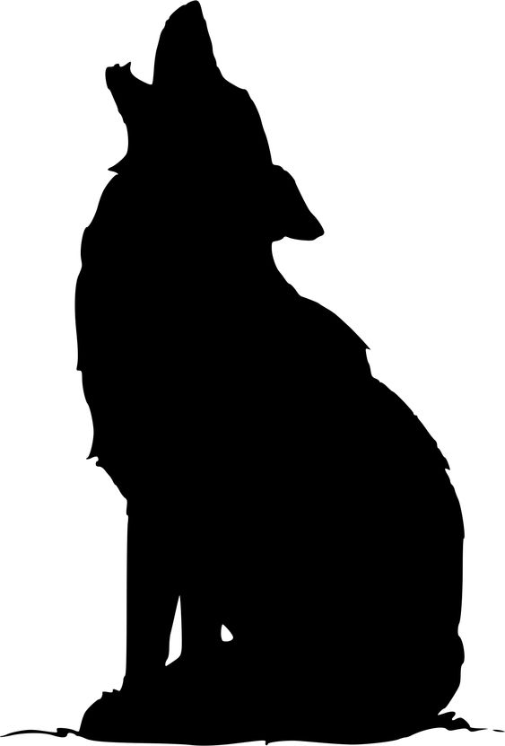
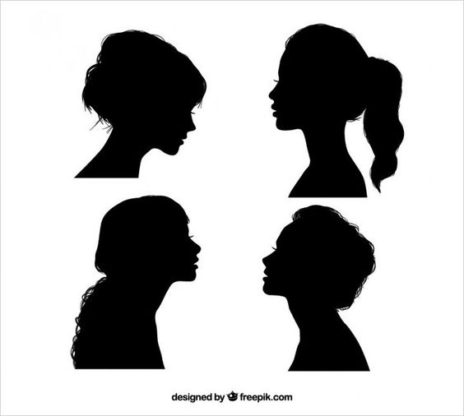
What it is not- Silhouette

Slide 4
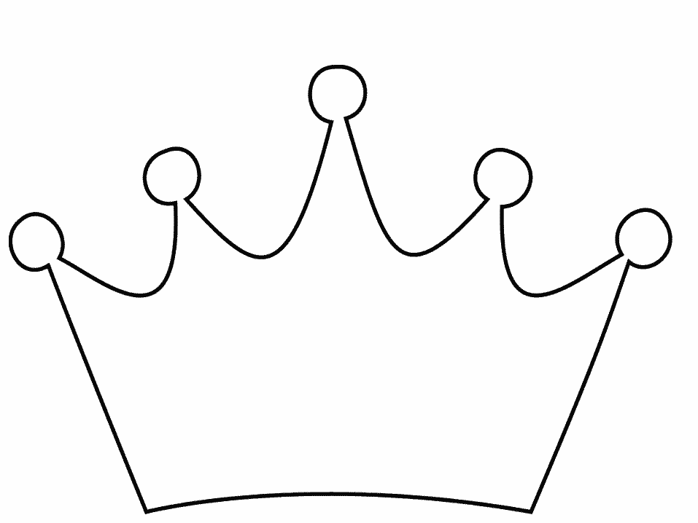
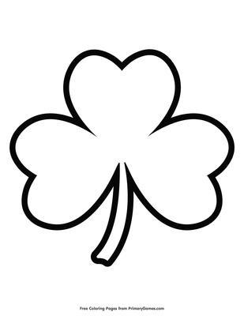
…or pure outline

Slide 5
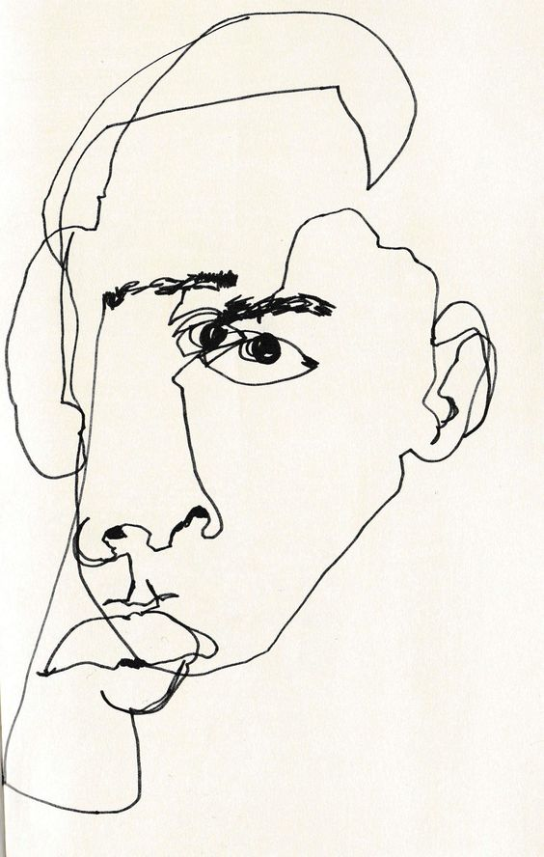
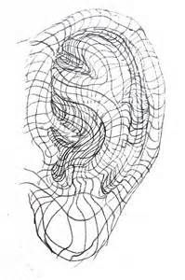
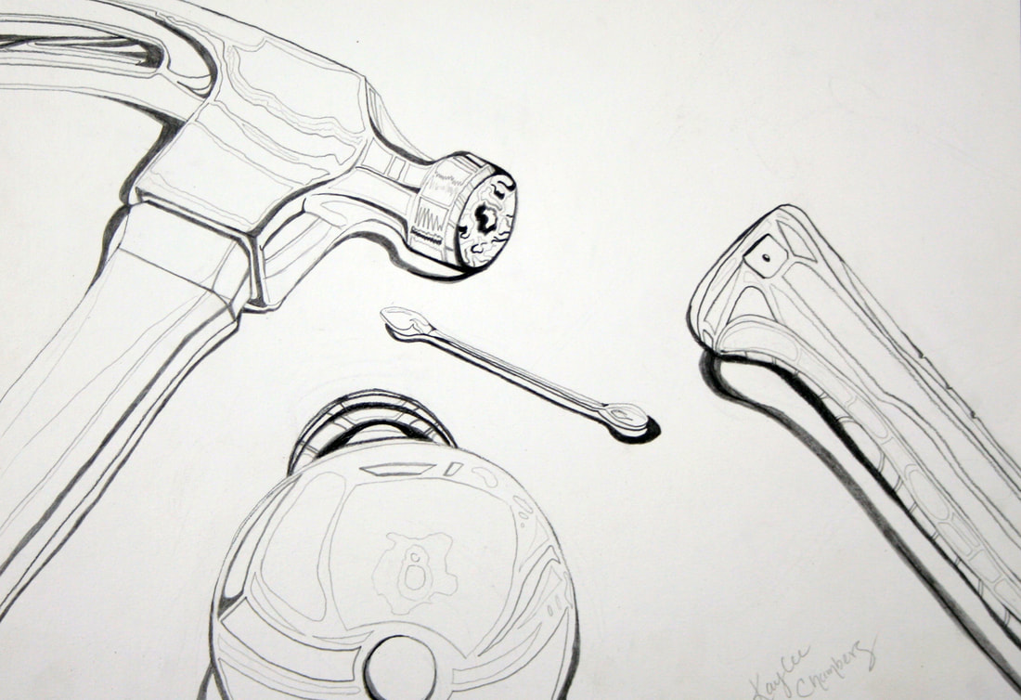
There are 3 different types of contour drawing
Blind Contour
Modified Contour
Cross Contour

Slide 6
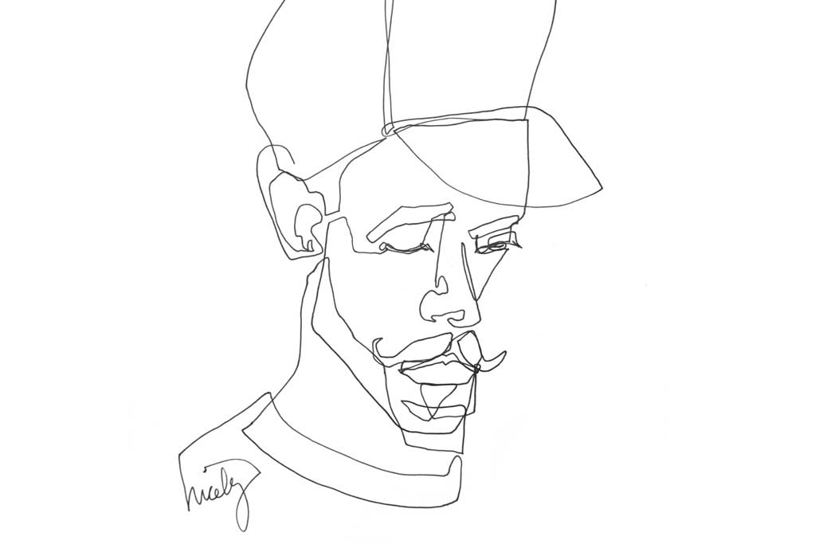
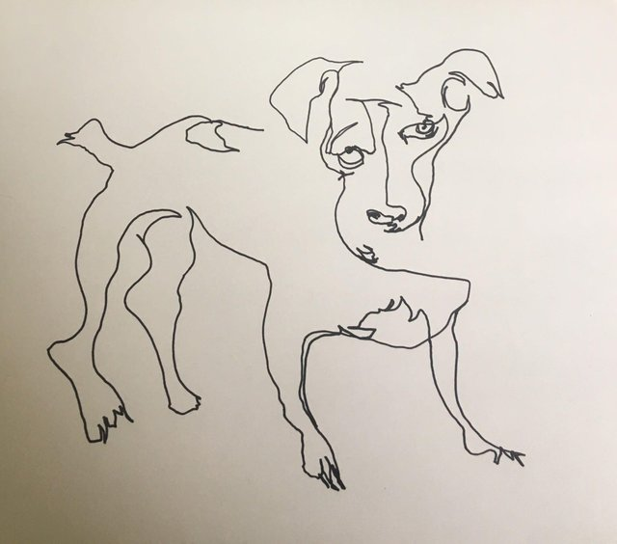
Blind contour
Blind contours are made by looking at your subject 100% of the time and never looking at your paper or lifting your pencil.
The room must be completely silent to ensure everyone is focused.
Slow, coordinated movement of the eye and hand.

Slide 7
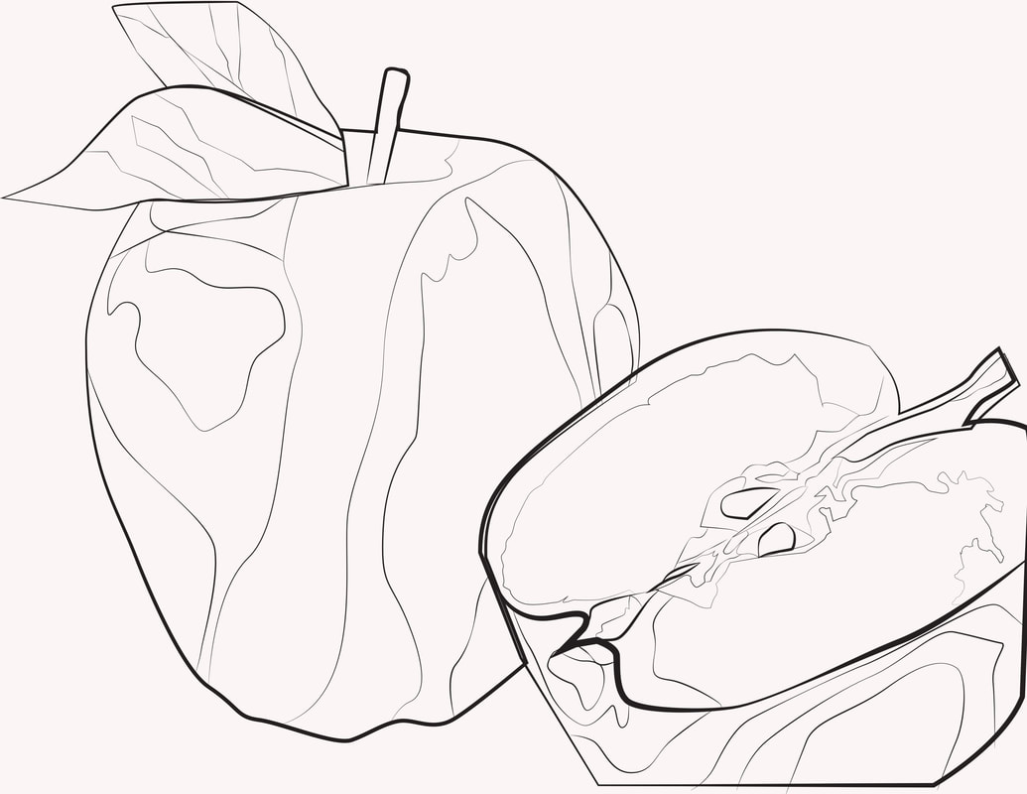
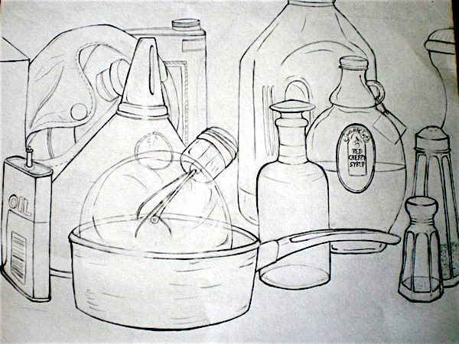
Modified COntours
You may now look at your paper 30% of the time. But you should be spending AT LEAST 70% of your time looking at the subject.
You are only looking at your paper to ensure that lines are matching up.
You may now lift your pencil.

Slide 8
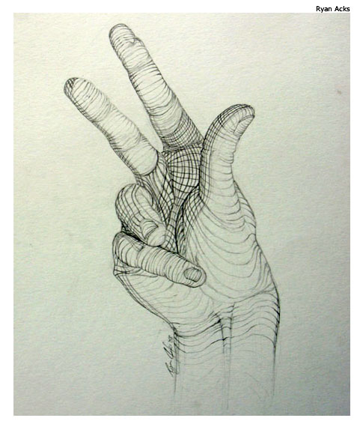
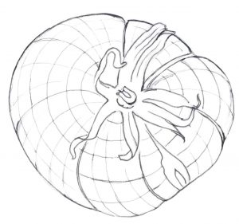
Cross COntours
Cross-contour drawings use lines that reflect the movement of your eye in and around what you see. While regular contour drawings describe edges, cross-contours describe form and volume. ... Think of a topographical map--the lines move across the terrain.

Slide 9
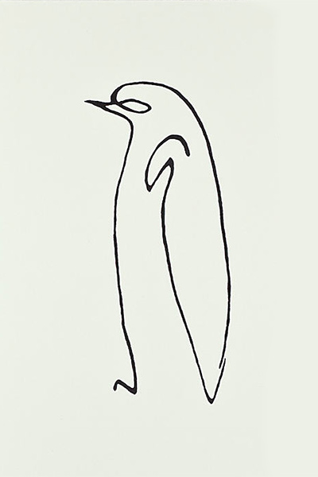
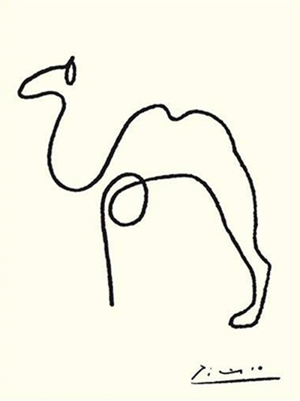
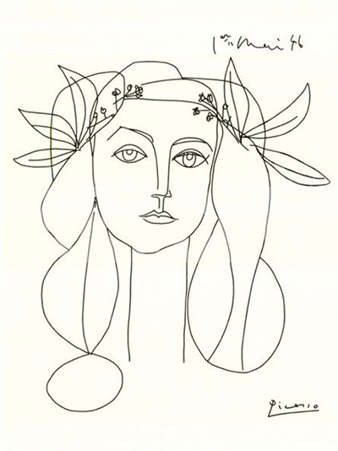
Pablo Picasso

Slide 10
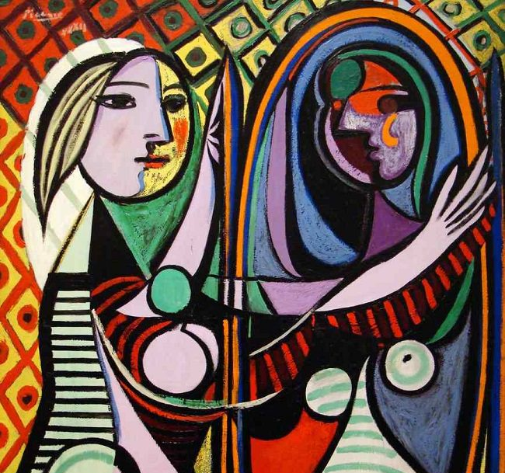

Slide 11
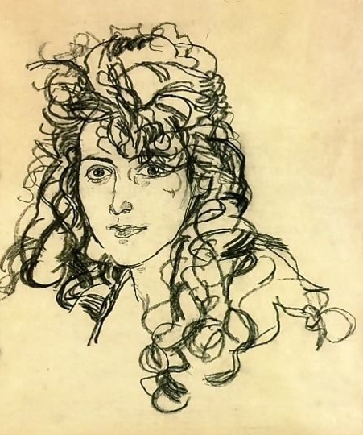
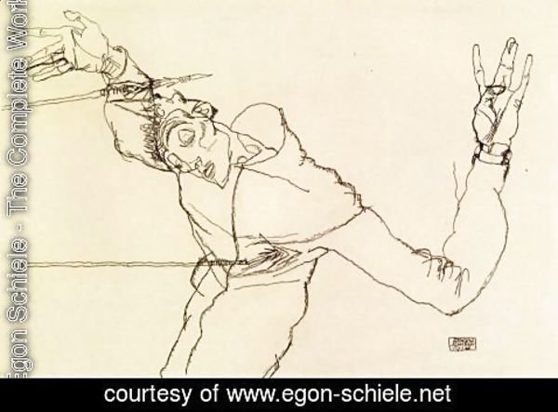
Egon Schiele

Slide 12
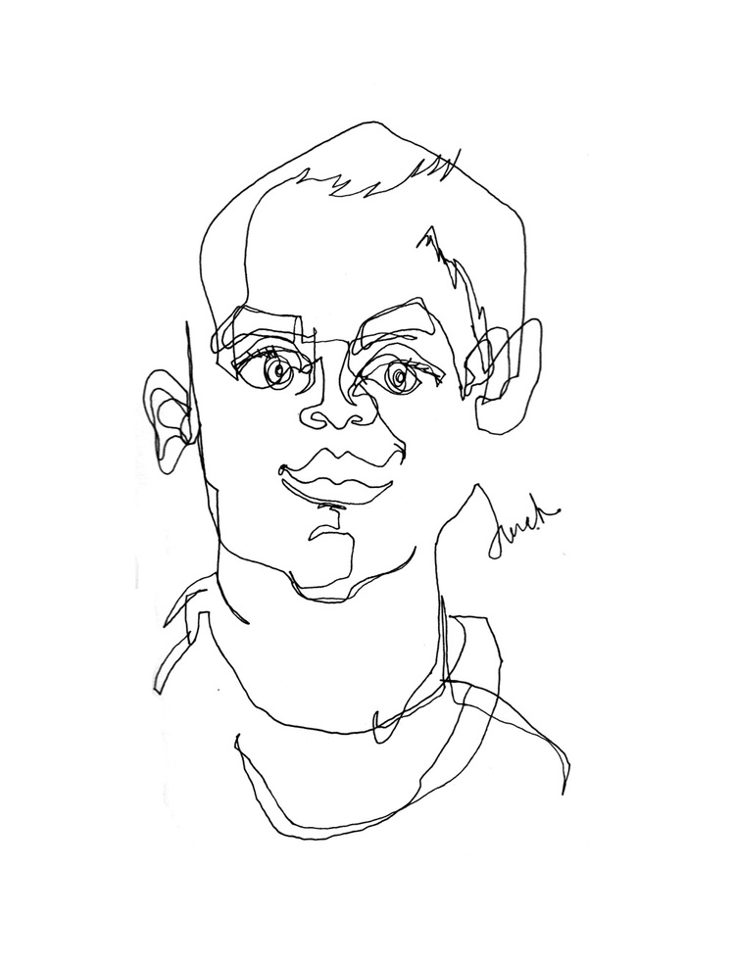
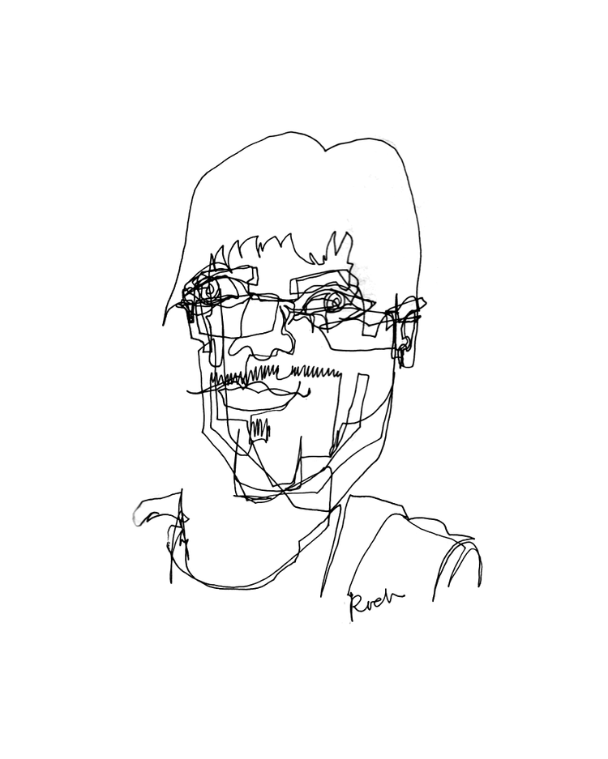
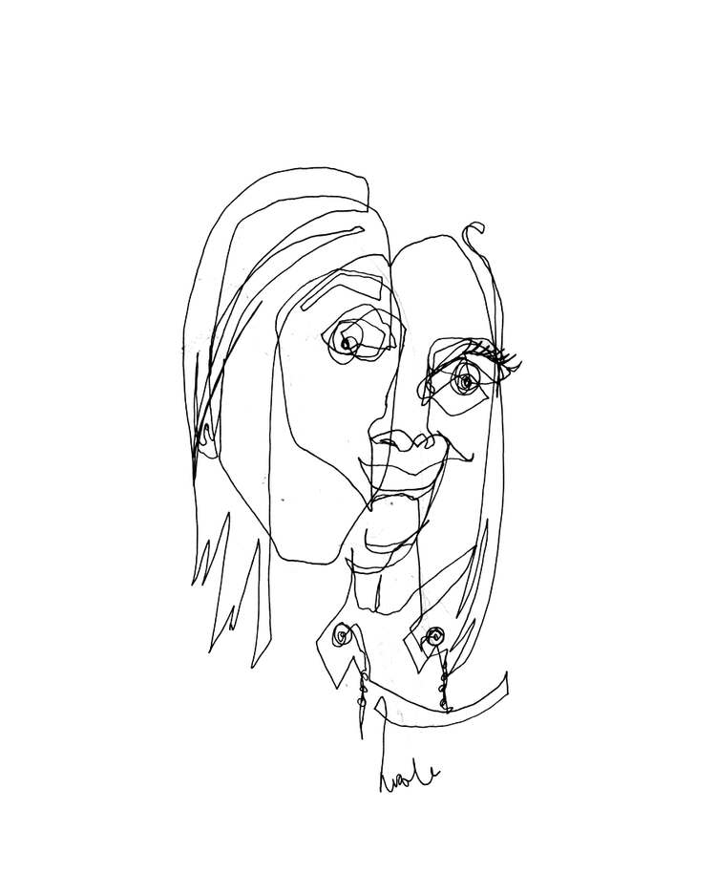
Alison Kunath

