Slide 1
Drawing and observing with charcoal

Slide 2
What is charcoal?
Charcoal is a lightweight, black residue, consisting of carbon and any remaining ash, obtained by removing water and other volatile constituents from animal and vegetation substances. Charcoal is usually produced by slow pyrolysis- the heating of wood or other substances in the absence of oxygen (see char and biochar).

Slide 3
Vine Charcoal
This type of charcoal is thinner and much lighter than that of compressed charcoal. It is great for sketching out ideas and gesturing in forms. It Is easily erased and wiped away.

Slide 4
Compressed Charcoal
Compressed charcoal is very dark and pigmented. It gives you fantastic dark values and can smudge out to create a wide range of values.
You will also have access to white compressed charcoal.

Slide 5
Charcoal Pencils
Charcoal pencils come in a range of values and can be used to create beautiful fine details in a charcoal drawing.
For this assignment, you will have access to a black and a white charcoal pencil.

Slide 6
Drawing Practice

Slide 7
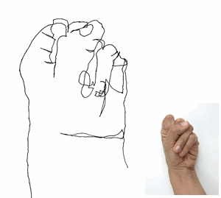
Blind Contours
Blind contours are made by looking at your subject 100% of the time and never looking at your paper or lifting your pencil.
The room must be completely silent to ensure everyone is focused.

Slide 8
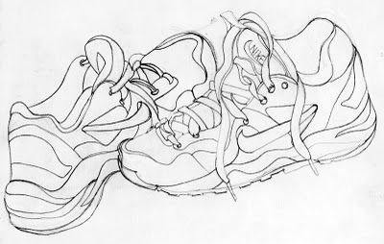
Modified Contours
You may now look at your paper 30% of the time. You should be spending 70% of your time looking at the subject.
You are only looking at your paper to ensure that lines are matching up.
You may now lift your pencil.

Slide 9
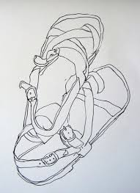
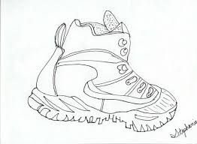
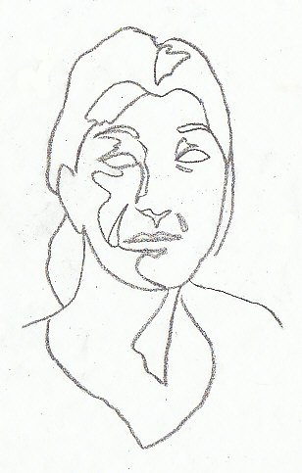
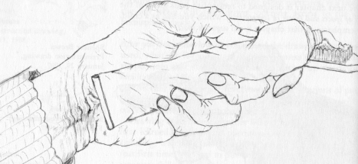
Examples

Slide 10
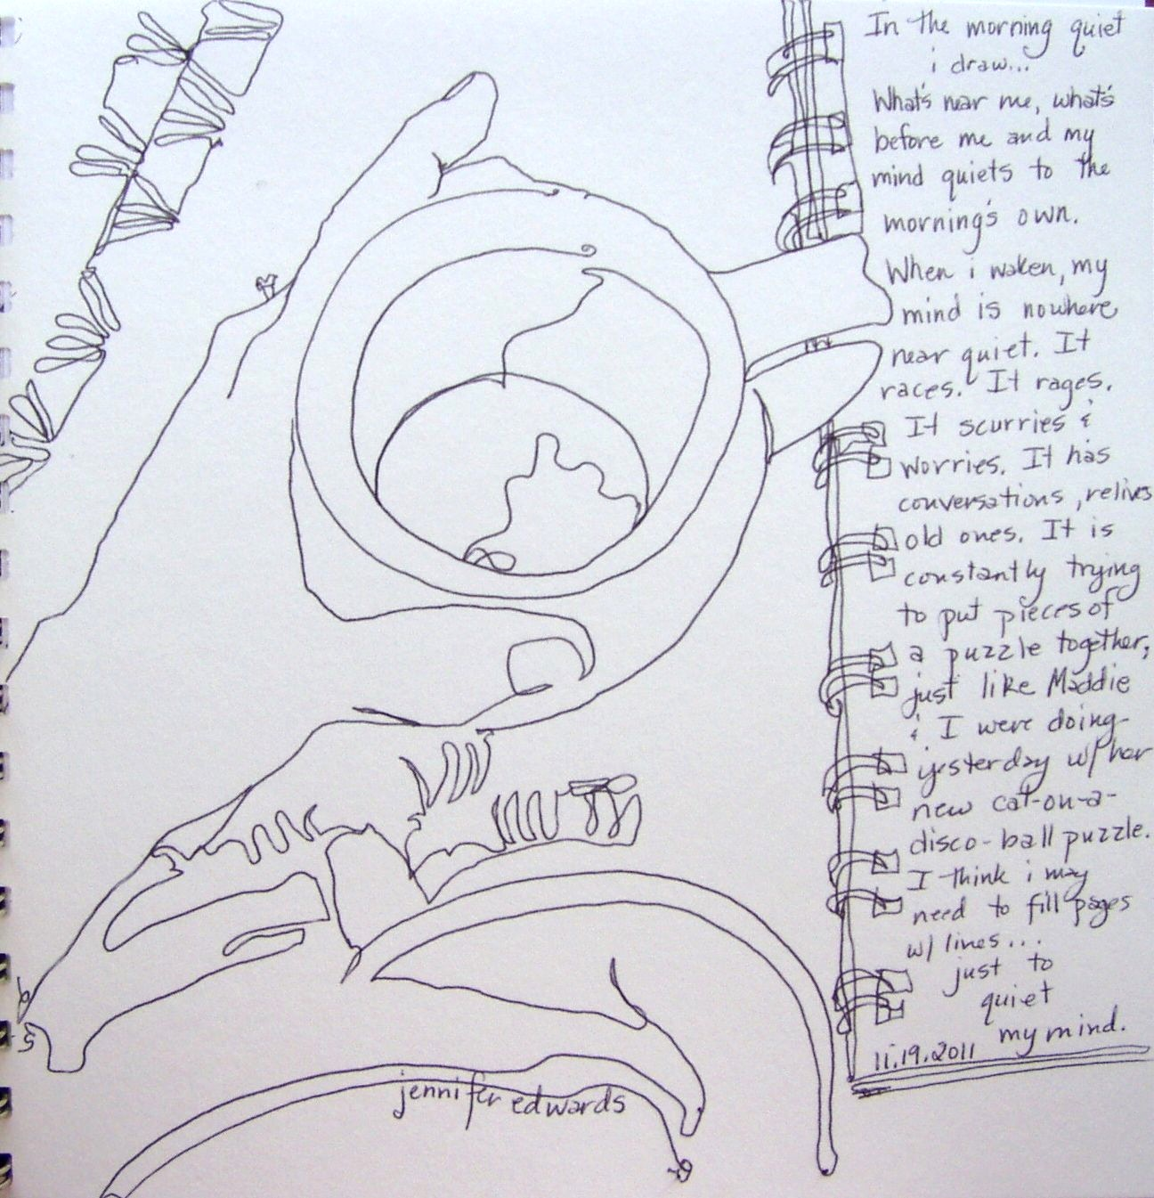

Slide 11
GESTURES…
Gesture drawing can exist on two levels - action drawing, and gesture drawing. Both involve the principle of movement. However, action drawing deals with physical movement; and gesture drawing involves not only physical movement, but a deeper concept of essential identity, as well.

Slide 12
GESTURES CONT’D…
WHEN DRAWING A GESTURE REMEMBER:
You are NOT capturing what the figure or object looks like, but what it is doing.
In action drawing, you need to study the figure very quickly
a likeness is not important in this exercise, nor is the exercise meant to result in a finished drawing
The drawings are quick—30 seconds or less.
The mark making style is fast, sketchy, has a scribble-like quality

Slide 13
CONTOUR VS. GESTURE
CONTOUR:
Slow, Careful, Painstaking
Structure, Touch Edge
Sensitive, Searching
Following the Form
(CLIMBING THE MOUNTAIN)
GESTURE:
Fast, Furious, Intense
Action, Life, Express
Entire Movement at once
Seeing the Whole Pose
(FLYING OVER THE MOUNTAIN)

Slide 14
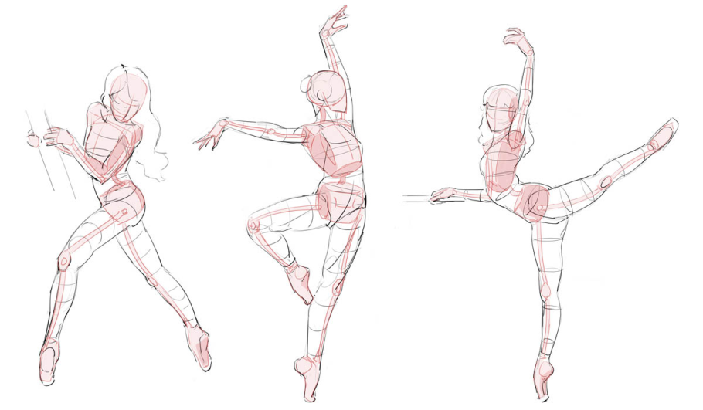
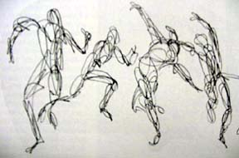
THEY ARE BOTH….
Correct Observation, Learning to see, Concentration, Learn How to draw by INCESSANTLY drawing!

Slide 15
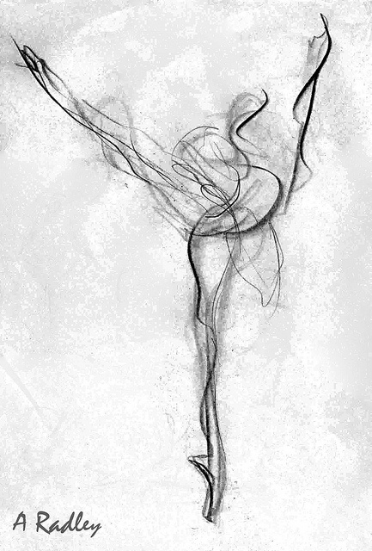
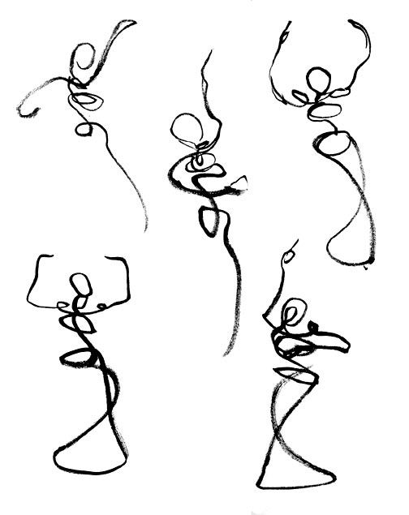
ballerina
Quick, sketchy, and fluid.

Slide 16
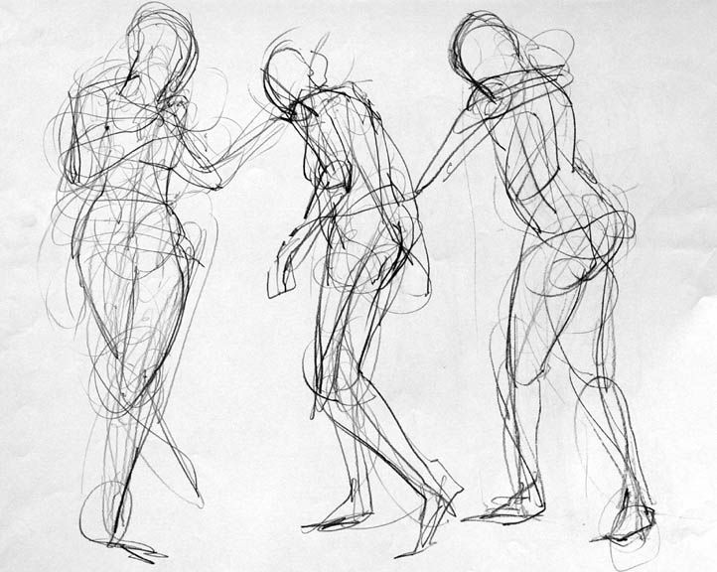
Building more of the form.

Slide 17
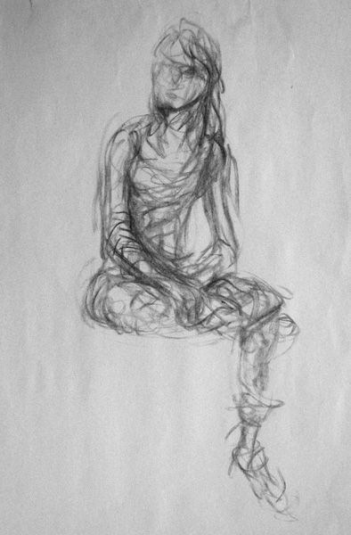
Building on the form
Searching for the form.

Slide 19
