Slide 1
GESTURE DRAWING
CAPTURING THE ESSENCE OF YOUR SUBJECT

Slide 2
CONTOUR VS. GESTURE
CONTOUR:
Slow, Careful, Painstaking
Structure, Touch Edge
Sensitive, Searching
Following the Form
(CLIMBING THE MOUNTAIN)
GESTURE:
Fast, Furious, Intense
Action, Life, Express
Entire Movement at once
Seeing the Whole Pose
(FLYING OVER THE MOUNTAIN)

Slide 3
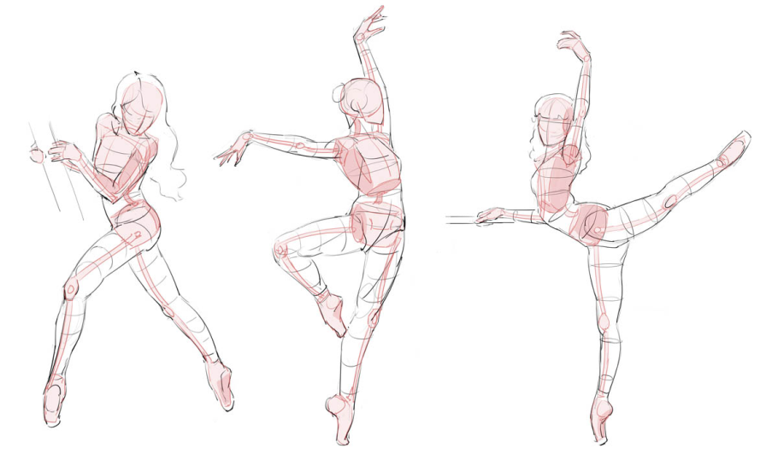
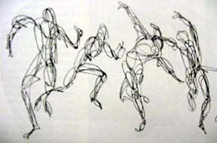
THEY ARE BOTH….
Correct Observation, Learning to see, Concentration, Learn How to draw by INCESSANTLY drawing!

Slide 4
GESTURES…
Gesture drawing can exist on two levels - action drawing, and gesture drawing. Both involve the principle of movement. However, action drawing deals with physical movement; and gesture drawing involves not only physical movement, but a deeper concept of essential identity, as well.

Slide 5
GESTURES CONT’D…
WHEN DRAWING A GESTURE REMEMBER:
You are NOT capturing what the figure or object looks like, but what it is doing.
In action drawing, you need to study the figure very quickly
a likeness is not important in this exercise, nor is the exercise meant to result in a finished drawing
The drawings are quick—30 seconds or less.
The mark making style is fast, sketchy, has a scribble-like quality

Slide 6
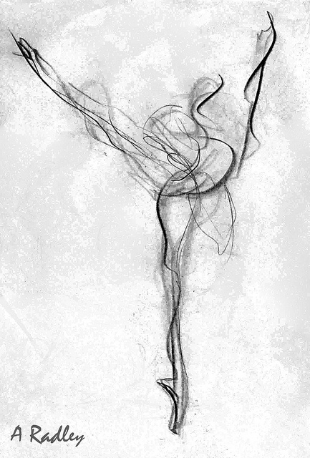
ballerina
Quick, sketchy, and fluid.

Slide 7
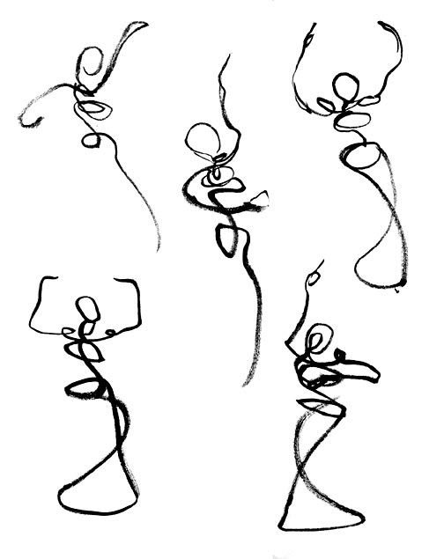
Remember you are not trying to capture the details or the likeness of the person, but the ESSENCE of their movement.

Slide 8
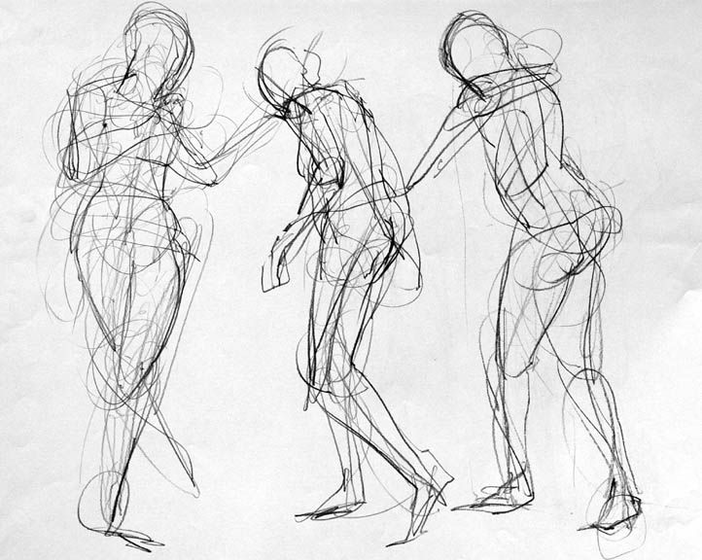
Building more of the form.

Slide 9
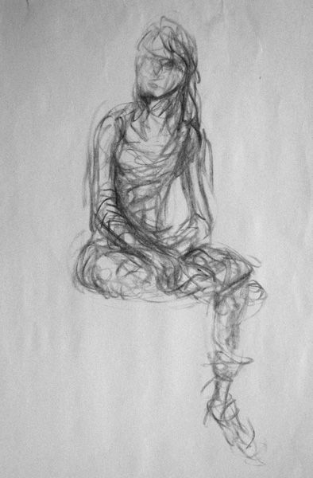
Searching for the form.

