Slide 1
Greek Architectural relief

Slide 2
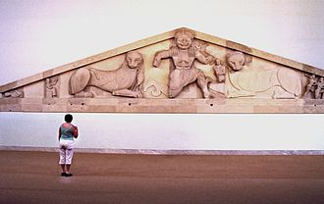
pediment
the triangular upper part of the front of a building in classical style, typically surmounting a portico of columns.
West Pediment from the temple of Artemis

Slide 3
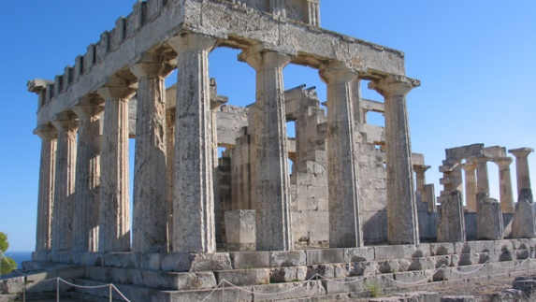
Temple of Aphaia

Slide 4
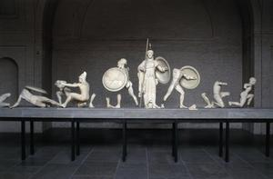
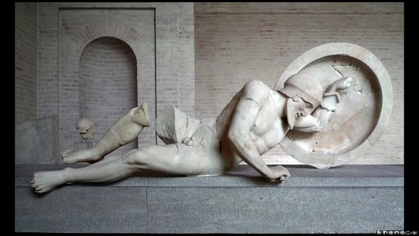
Dying warrior from the east pediment
West Pediment, Temple of Aphaia

Slide 5
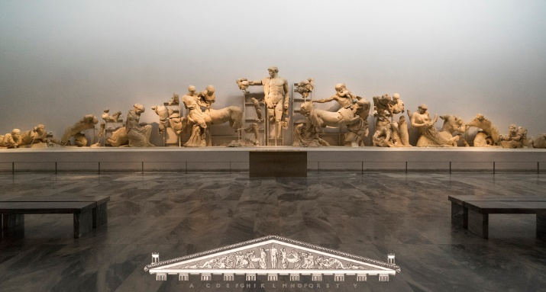
East pediment temple of Zeus

Slide 6
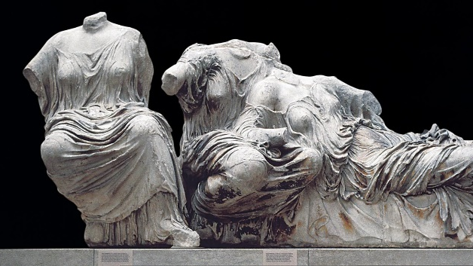
Three goddesses from the east pediment of the Parthenon

Slide 7
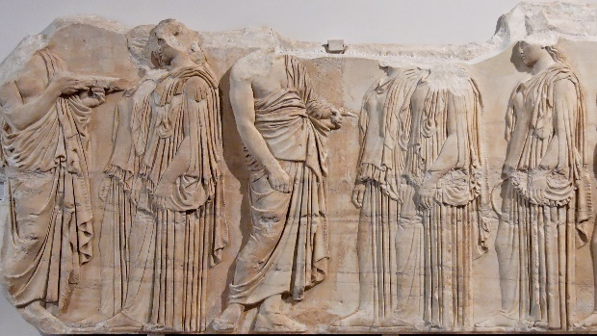
Frieze
a broad horizontal band of sculpted or painted decoration, especially on a wall near the ceiling.
Details of the Panathenaic Festival procession frieze, Parthenon

Slide 8
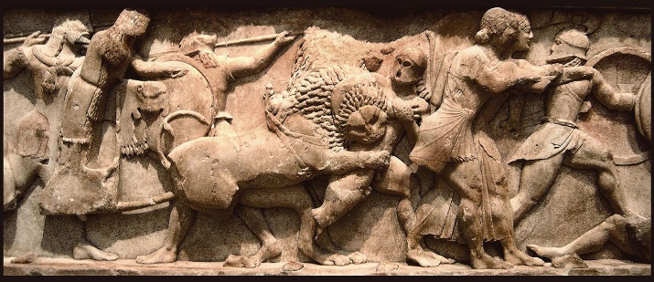
gigantomachy
(in Greek mythology) the struggle between the gods and the giants.
Detail of the north frieze of the Siphnian Treasury

Slide 9
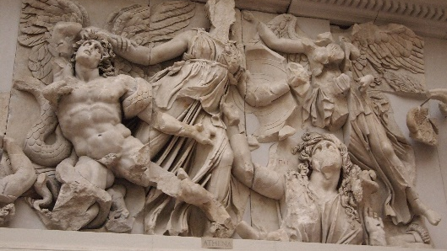
Athena battling Alkyoneos, Altar of Zeus

Slide 10
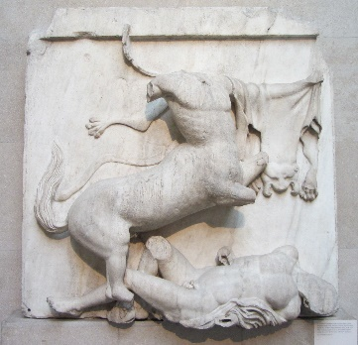
metope
In classical architecture, a metope is a rectangular architectural element that fills the space between two triglyphs in a Doric frieze, which is a decorative band of alternating triglyphs and metopes above the architrave of a building of the Doric order.
Lapith vs. Centaur, south side of the Parthenon

Slide 11
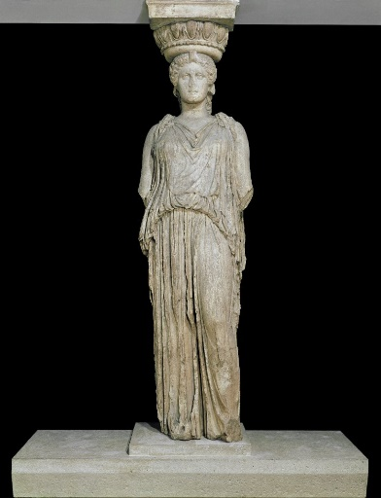
caryatid
A stone carving of a draped female figure, used as a pillar to support the entablature of a Greek or Greek-style building.
South porch of the Erechtheion, Acropolis

