Slide 1
Greek black figure pottery

Slide 2
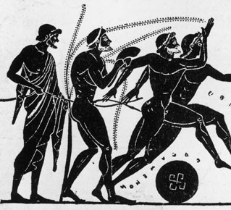
The first Olympics
- “A sound mind in a sound body.”
- The Greeks valued a balance of intellectual and physical discipline.

Slide 3
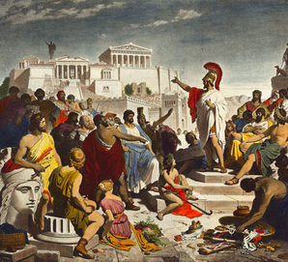
Democracy
Rule by the people.
Still was not ideal, mostly run by rich white men.
Women were absolutely not considered equals and slavery was an accepted and almost celebrated concept.

Slide 4
Geometric Art

Slide 5
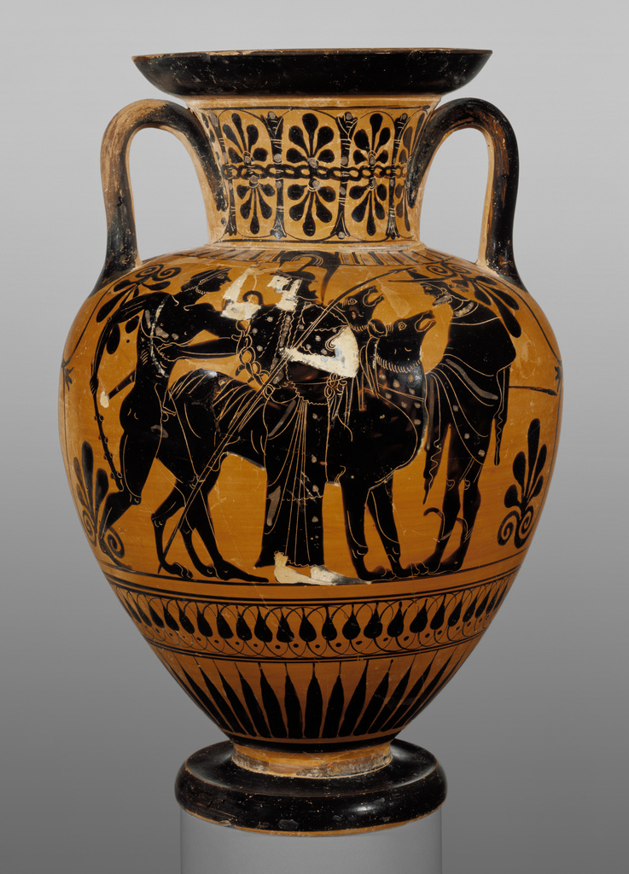
Greek black figure pottery
The Greeks perfected the practice of black figure painting.
They used a finely sifted clay that turned velvety black in the firing process.
They would paint a solid black figure and then scratch back details into the black “glaze”.
This technique was very graphic and bold. It was extremely popular in trading.

Slide 6
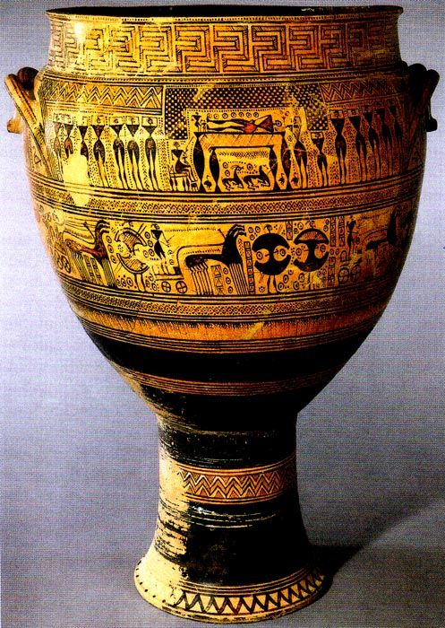
Geometric Krater
Marked the grave of a man who died in 740 BCE.
It is open on the top and bottom, possibly for visitors to pour libations in honor of the dead.
A little over 3 feet tall.
Much of the krater is covered in precisely painted abstract angular motifs in horizontal bands.
Most early Greek painters painter’s decorated vases exclusively with abstract motifs.
This vase is different, because the middle two bands have figures and the scene of the deceased’s funeral.

Slide 7
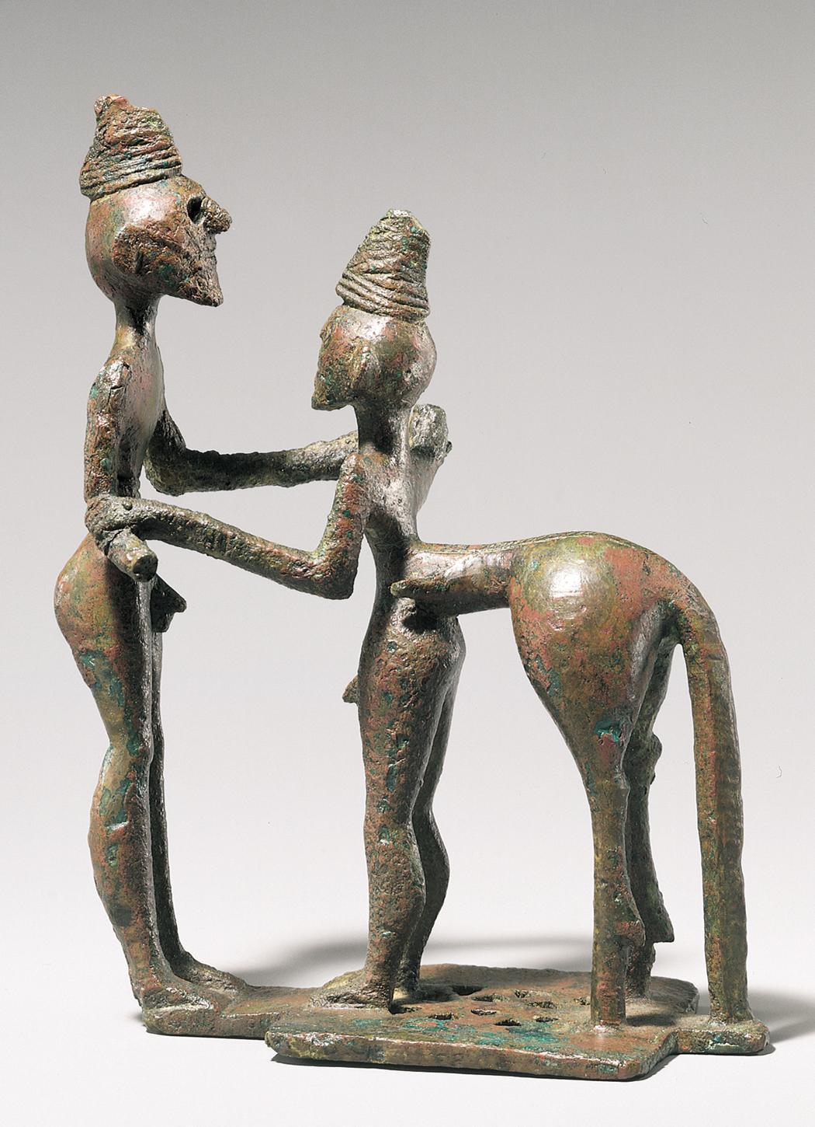
Herakles and Nessos
Solid cast bronze sculpture.
2 characters locked in hand to hand struggle.
Most likely the hero Herakles and the centaur Nessos.
Nessos had agreed to carry Herakles bride across a river then assaulted her.
Composite monsters were very popular and the centaur itself was a purely Greek invention.

Slide 8
Orientalizing Art

Slide 9
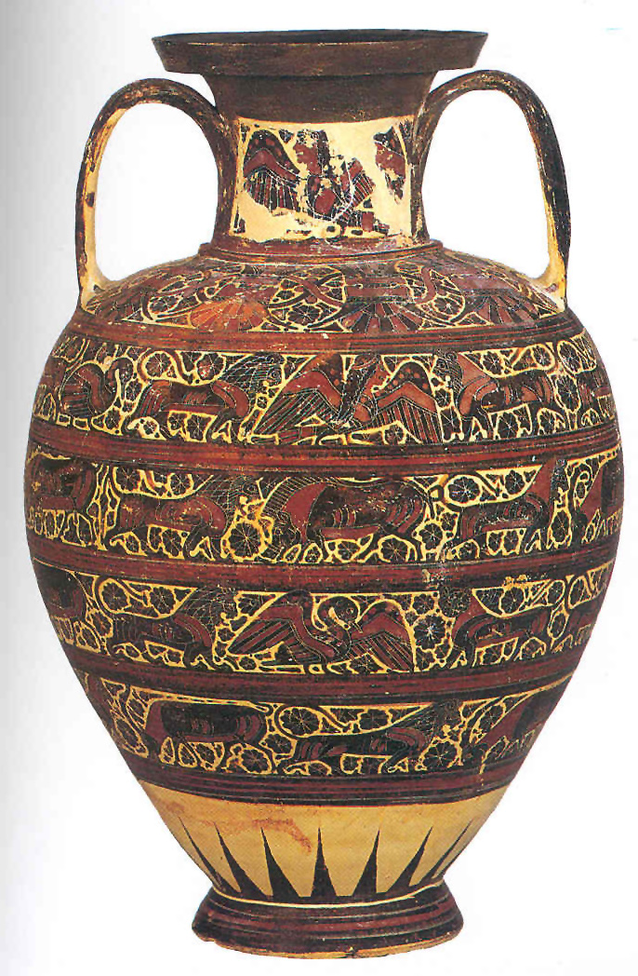
Corinthian black-figure amphora with animal friezes
As the Greeks moved into the Orientalizing period, the paintings moved away from the geometric patterns and began depicting various animals on its registers.
Some were real and some were composite creatures.
A siren (a bird with the head of a woman) is depicted prominently on the neck of this vase.

Slide 10
Archaic period

Slide 11
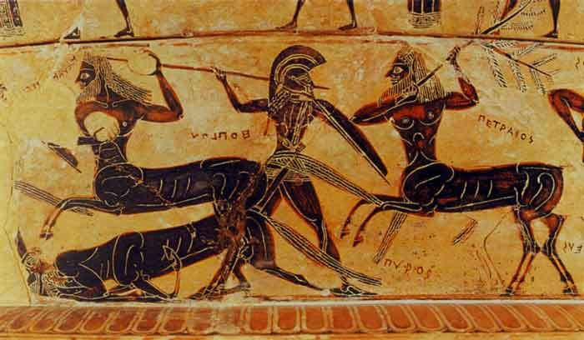
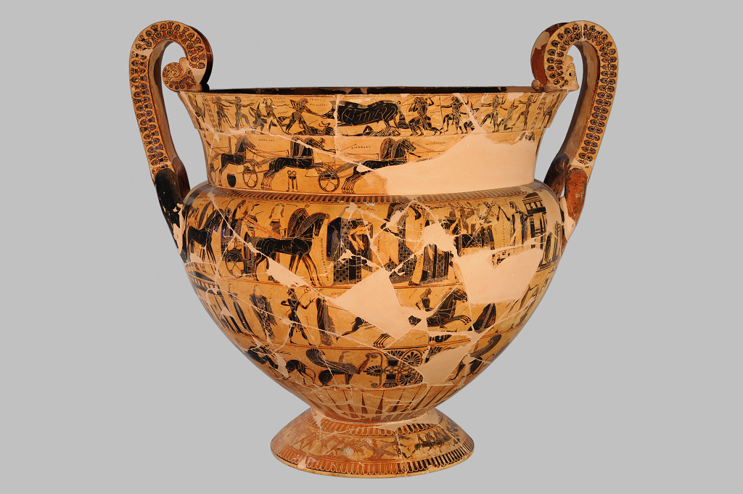
Francois Vase
- In the archaic period the paintings got more detailed and began depicting scenes from many different myths.
- This vase has more than 200 mythological figures.
- It is signed by the artist and the potter, and has written labels all over it.

Slide 12
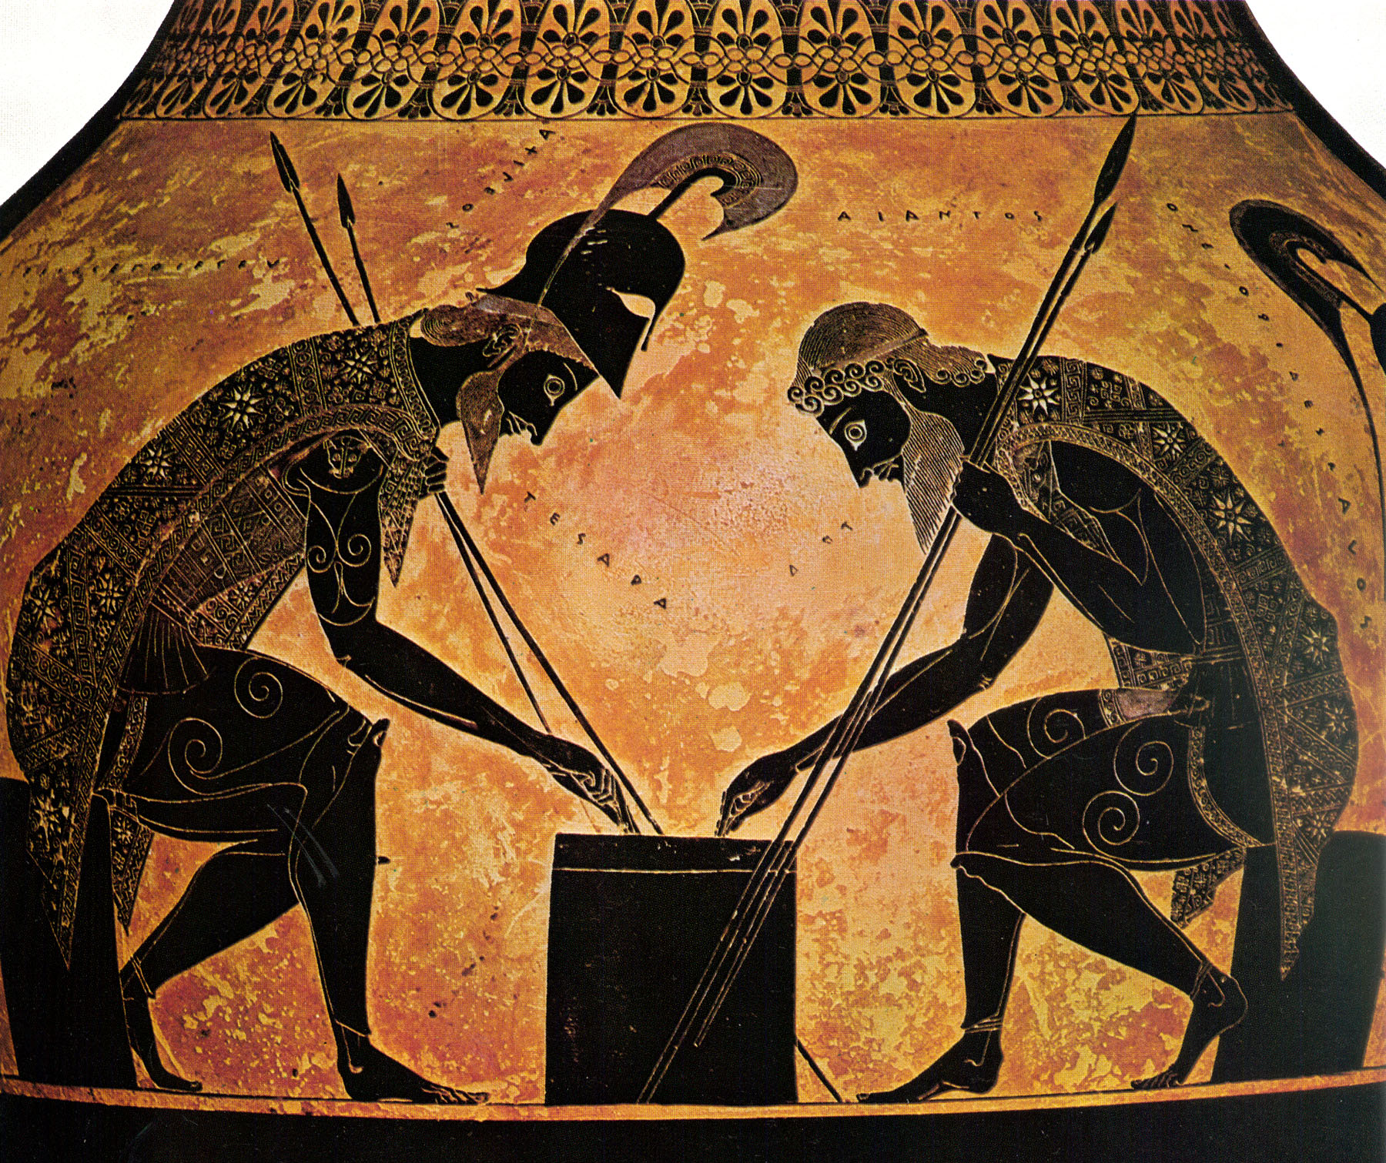
Exekais
Exekais was the acknowledged master of black figure painting.
His works were widely exported and often copied.
His works are not divided into horizontal bands but instead prominently display one scene.
His work is known for the amount of detail he put into the paintings.
Achilles and Ajax playing dice.

Slide 13
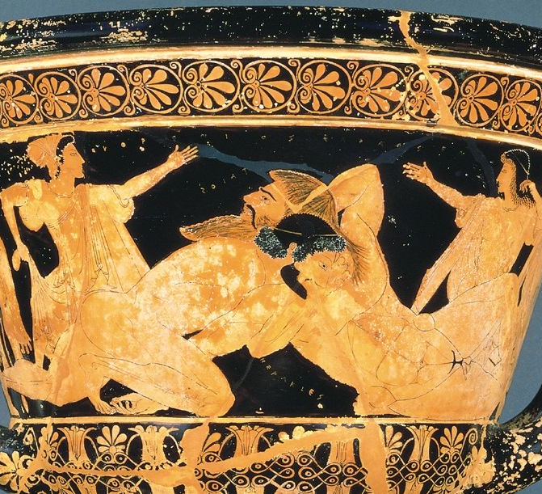
Euphronios
Euphronios was another well known black figure painter.
His paintings begun to have more movement in the scenes.
He also used diluted glazes to a variation of values.
Herakles wrestling Antaios.
Antonios was a giant who gained his power from the Earth. To defeat him Herakles had to defeat him wile his body was fully off the ground.

