Slide 1
Charcoal Half TOne

Slide 2
What is charcoal?
Charcoal is a lightweight, black residue, consisting of carbon and any remaining ash, obtained by removing water and other volatile constituents from animal and vegetation substances. Charcoal is usually produced by slow pyrolysis- the heating of wood or other substances in the absence of oxygen (see char and biochar).

Slide 3
Vine Charcoal
This type of charcoal is thinner and much lighter than that of compressed charcoal. It is great for sketching out ideas and gesturing in forms. It Is easily erased and wiped away.

Slide 4
Compressed Charcoal
Compressed charcoal is very dark and pigmented. It gives you fantastic dark values and can smudge out to create a wide range of values.
You will also have access to white compressed charcoal.

Slide 5
Charcoal Pencils
Charcoal pencils come in a range of values and can be used to create beautiful fine details in a charcoal drawing.
For this assignment, you will have a black and a white charcoal pencil.

Slide 6
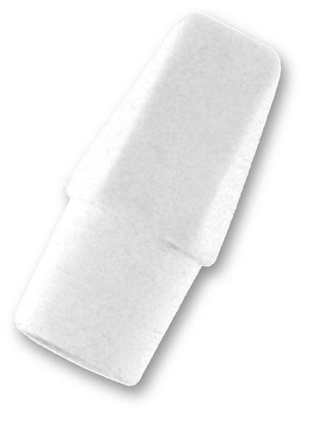
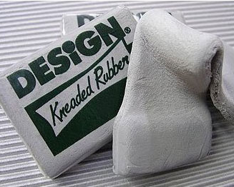
Erasers
Erasers can be just as helpful a drawing tool as your charcoal can be.
Just as in Foundations, the kneaded eraser can help pull back values in a tonal (smooth transition) and slowly pick up your values. It can also be “sculpted” to erase small precise areas.
Your white eraser and/or end cap erasers can help erase large areas of charcoal. This eraser cuts through to help get areas to a whiter white.
These erasers help get strong graded (sharp) transitions between values.

Slide 7
Half tone
This technique involves using whatever material you are using (in this case charcoal) to shade your entire paper (or parts of it) to a 40 – 50% grey tone.
This technique allows you to use both your charcoal materials and your erasers to draw into your work. Your erasers will create highlights, while your charcoal products will create shadows.

Slide 8
references
Your reference images should be a personal photo or compilation of online resources.
The main purpose is to have an original and creative piece.

Slide 9
Jitter

Slide 10
Flip

Slide 11
Pieces

Slide 12
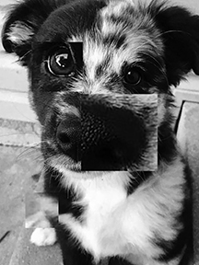
Enlarge

