Slide 1
Create your dream residence in the afterlife
multi-view architectural drawings

Slide 2
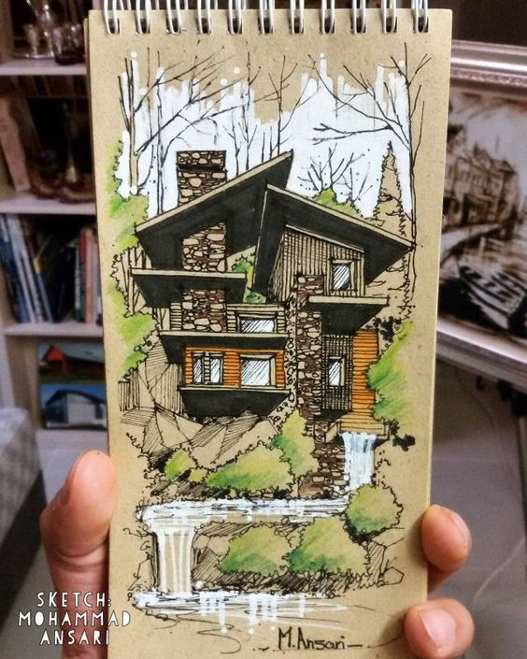
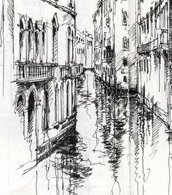
What are architectural drawings?
An architectural drawing or architect's drawing is a technical drawing of a building (or building project) that falls within the definition of architecture.

Slide 3
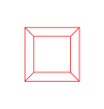
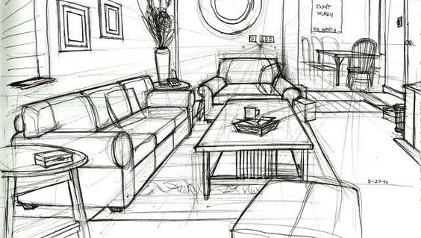
1 Point Perspective
One-point perspective
A drawing has one-point perspective when it contains only one vanishing point on the horizon line.
A drawing has 1 point perspective when it contains only one vanishing point on the horizon line.

Slide 4
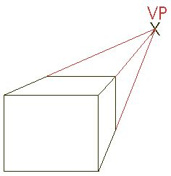

Slide 5
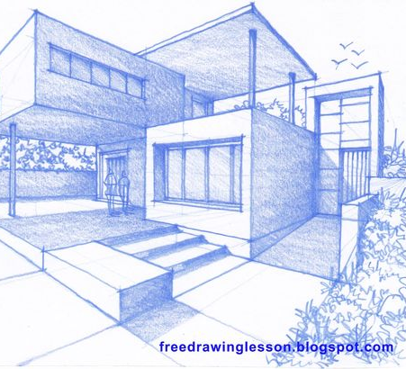
2 point perspective
A drawing has two-point perspective when it contains two vanishing points on the horizon line.

Slide 6
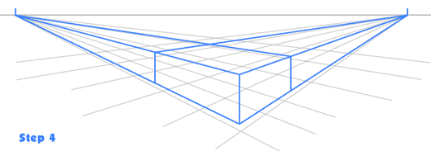

Slide 7
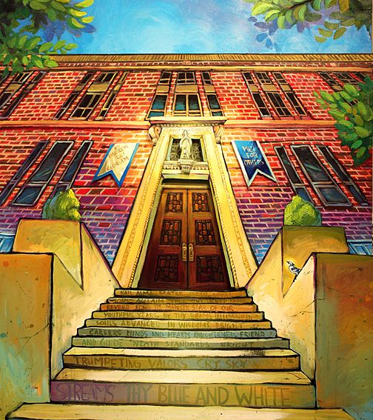
3 point perspective
Three-point perspective is often used for buildings seen from above (or below). In addition to the two vanishing points from before, one for each wall, there is now one for how the vertical lines of the walls recede. For an object seen from above, this third vanishing point is below the ground. For an object seen from below, as when the viewer looks up at a tall building, the third vanishing point is high in space.

Slide 8
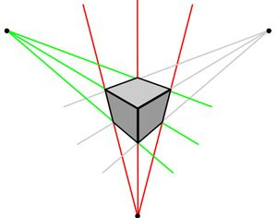

Slide 9
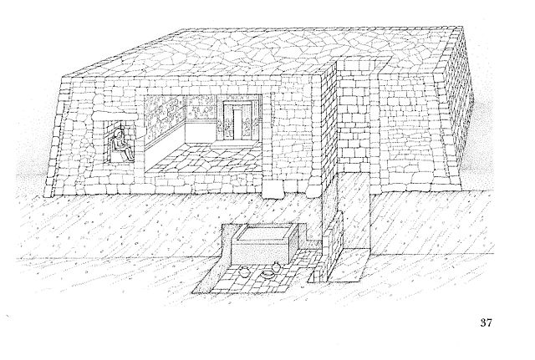
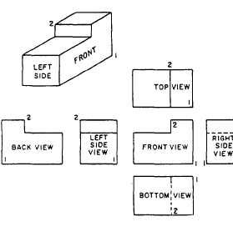
Simplistic drawings

Slide 10
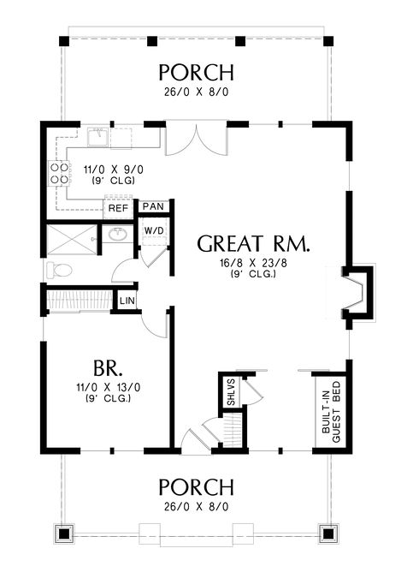
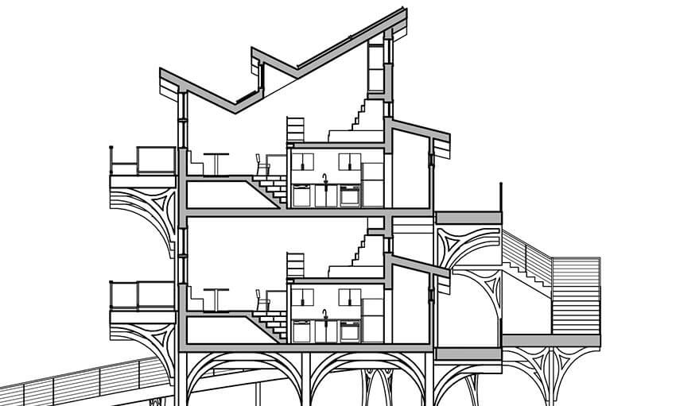

Slide 11
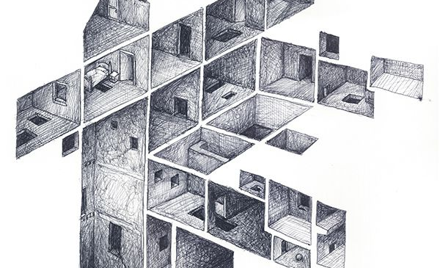
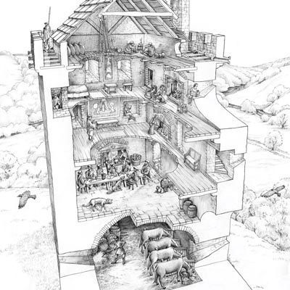
More detailed drawings

Slide 12
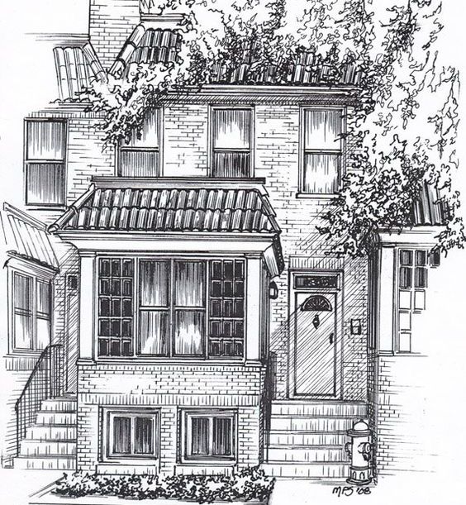
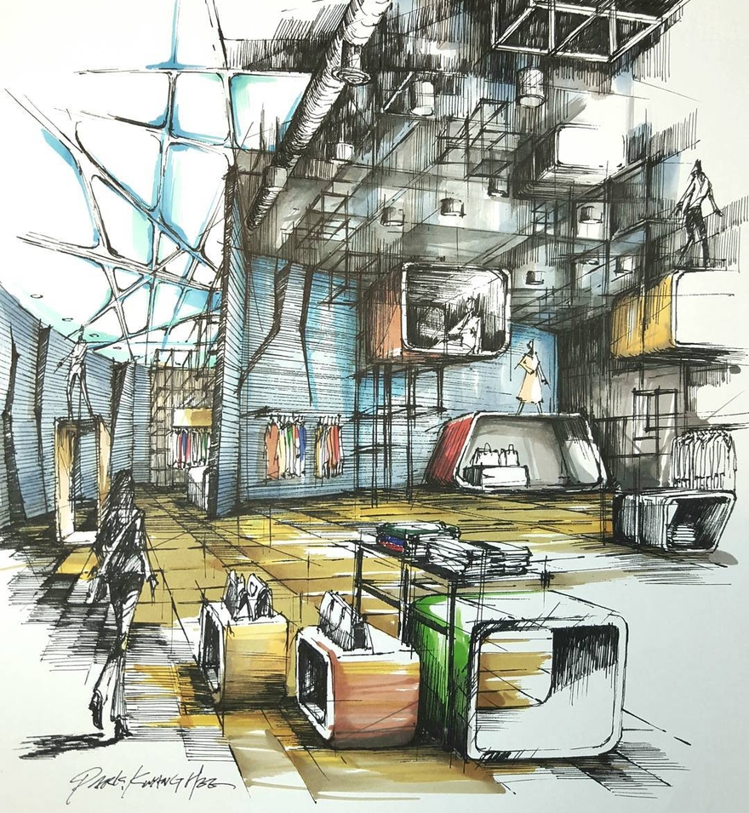

Slide 13
