Slide 1
Negative Space
Negative space is the area of an image not occupied by shapes or forms.
negative space helps to define the boundaries of positive space and brings balance to a composition.

Slide 2
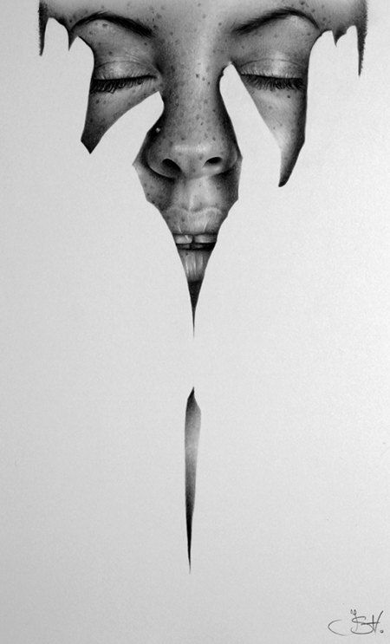

Slide 3
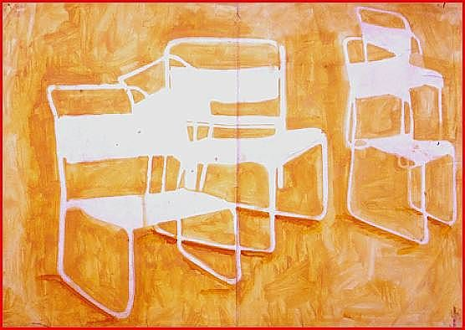

Slide 4
