Slide 1
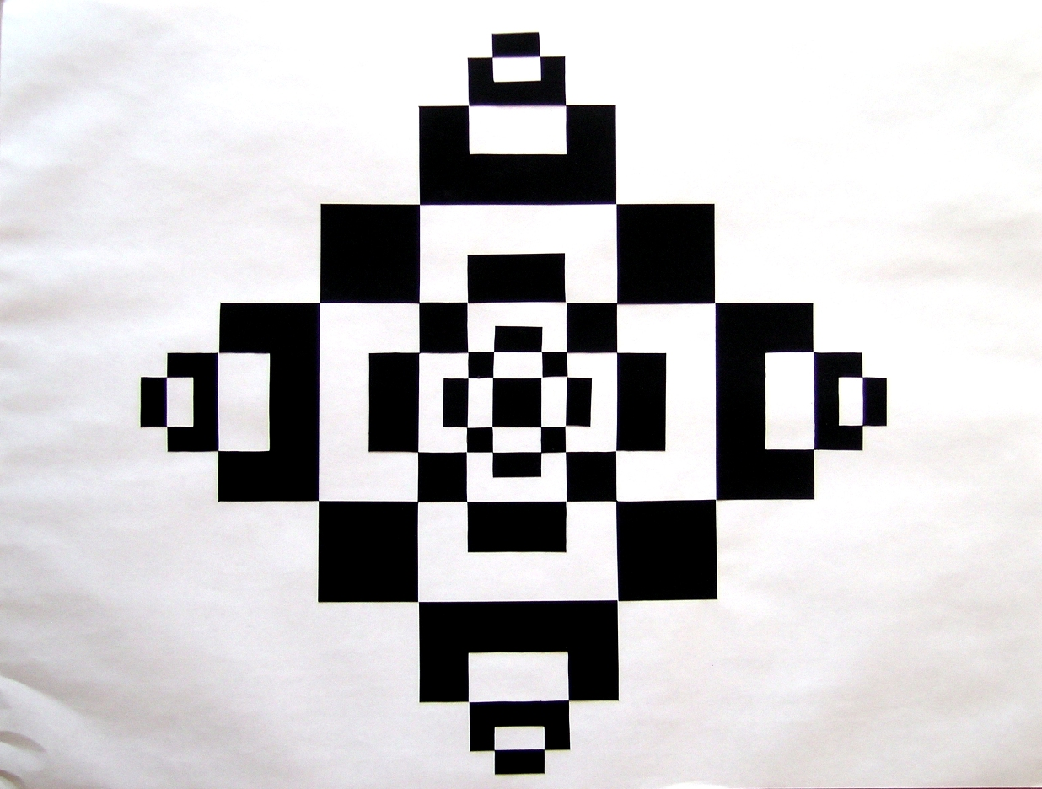
Notan
The play and placement of light and dark

Slide 2
COMPOSITION

Slide 3
Composition
Is the arrangement and placement of objects within the frame.
What do I mean when I say frame?

Slide 4
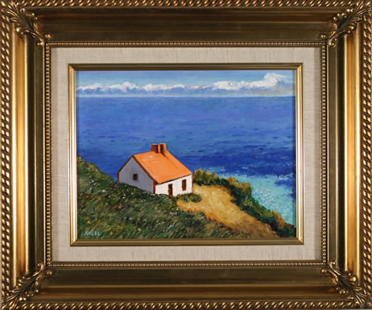
Frame
The entire space you are creating in. This can be any shape or size, but generally is a rectangular space.

Slide 5
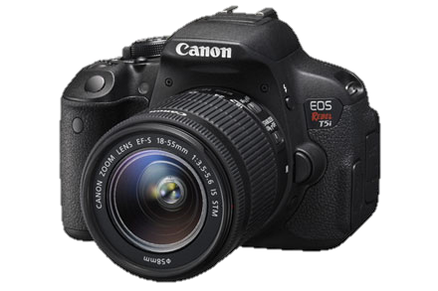

Slide 6
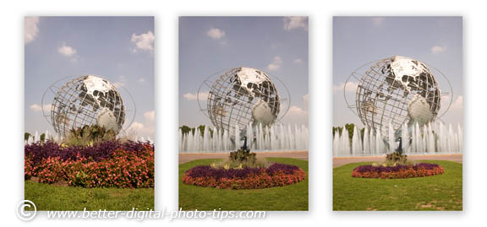

Slide 7
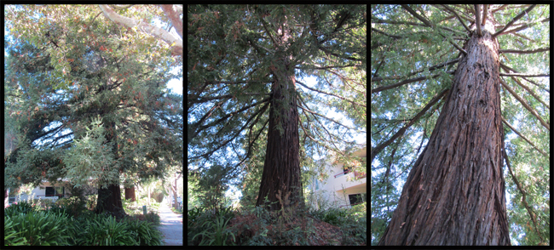

Slide 8
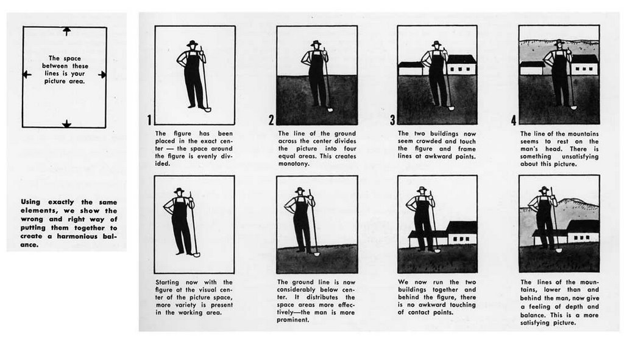

Slide 10
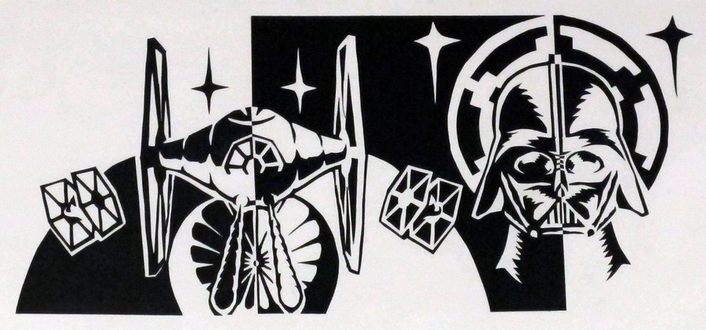

Slide 15
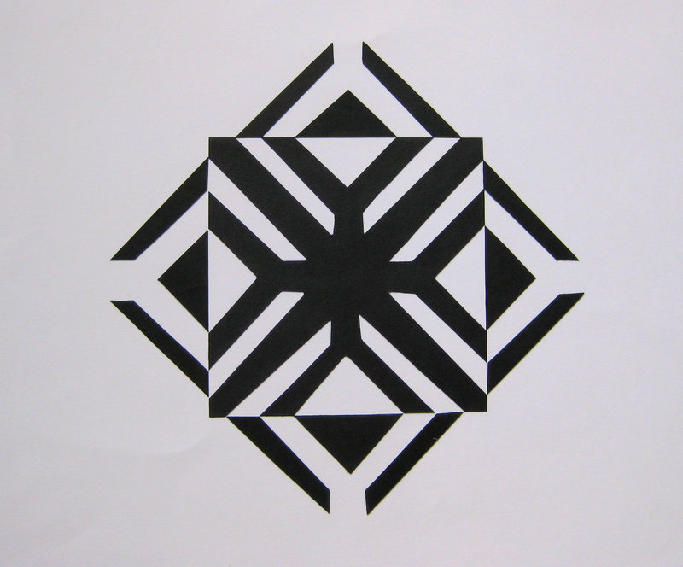

Slide 16
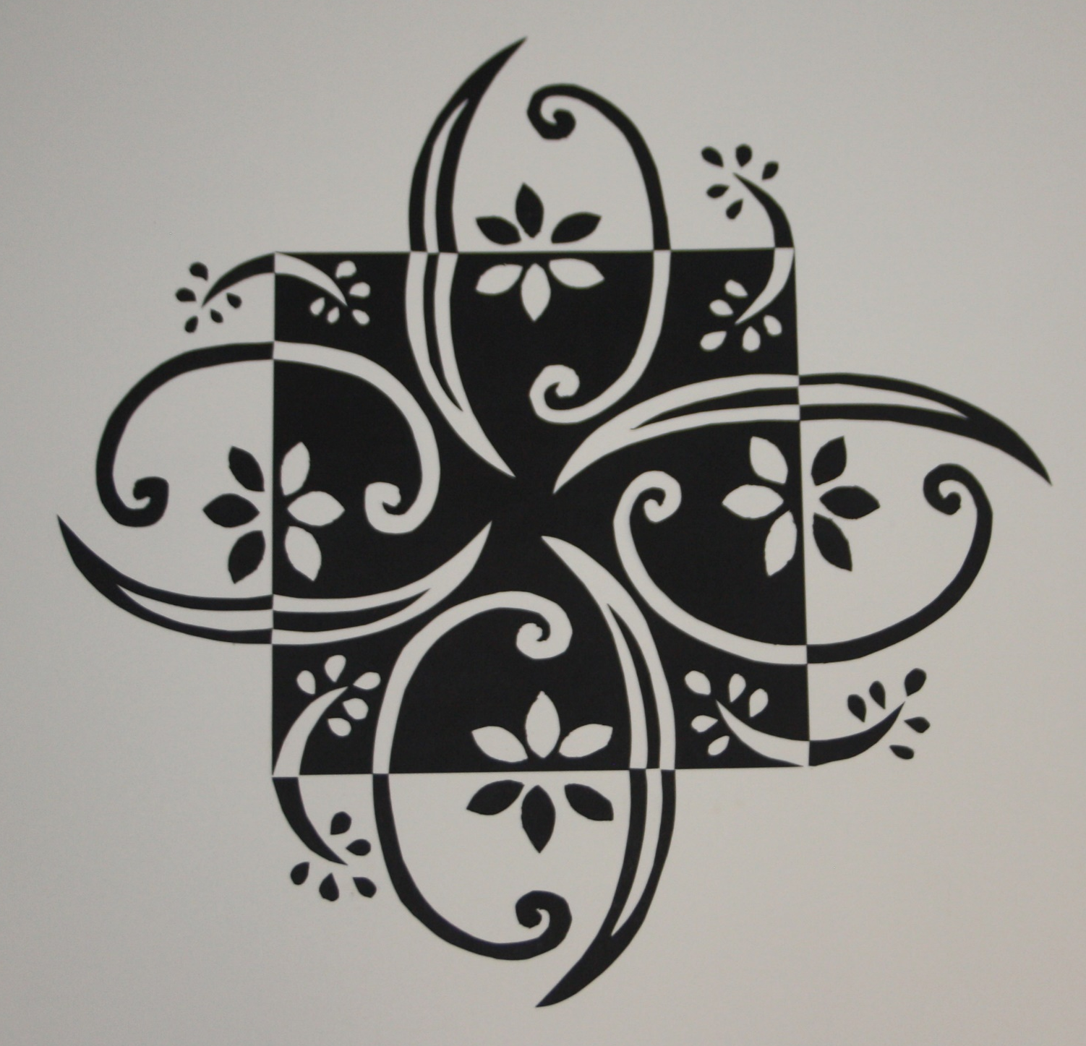

Slide 18
FAQ
Generally where do people lose points?
Design or craftsmanship
Design: too much back space, too simple, or not enough pieces flipping back in
What are my objectives?
Balance and design
Refer to rubric

Slide 19
How do I start Planning?
Divide your square into sections
Freehand
Stay on the same edge
Enhance
Lightly shade in the background to better understand your design
Clump all “lines” into a shape

