Slide 1
Clay Portals

Slide 2
What is a Portal?
A doorway, gate, or other entrance, especially a large and elaborate one.
Synonyms: doorway, gateway, entrance, exit, opening

Slide 3
Learning Targets I will be able to…
Use multiple brainstorming techniques and thumbnail sketches to develop my ideas into a cohesive, unified composition

Slide 4
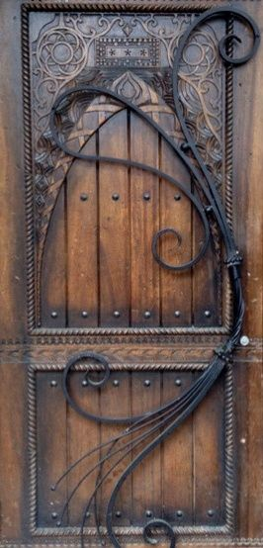
Where Do I start? Success Criteria…

Slide 5
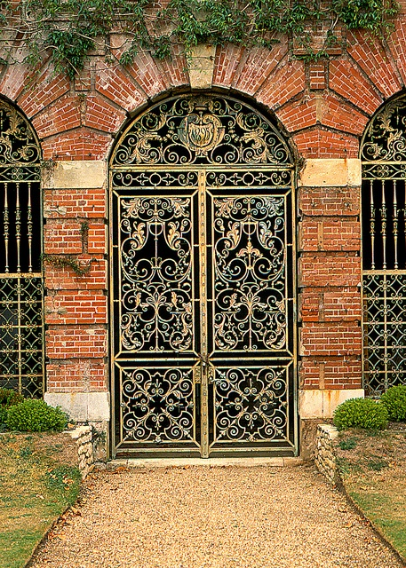
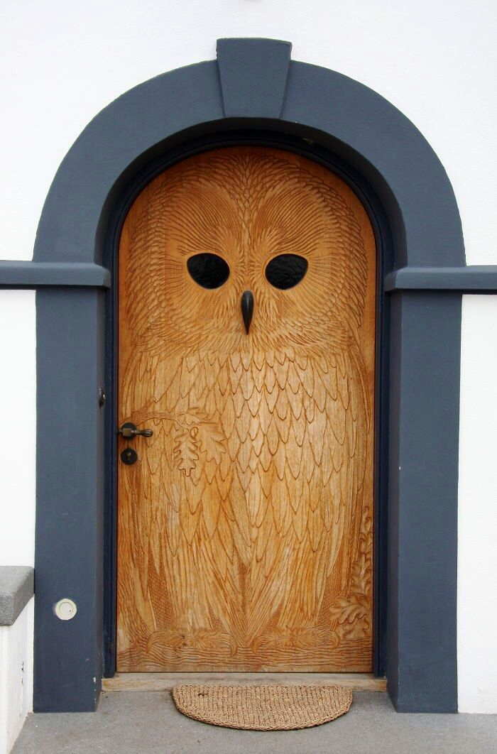
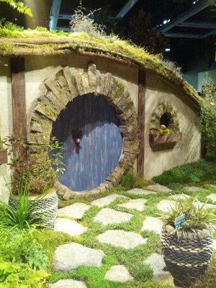

Slide 6
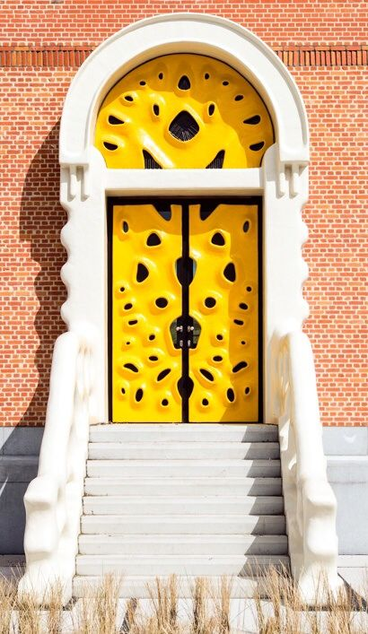
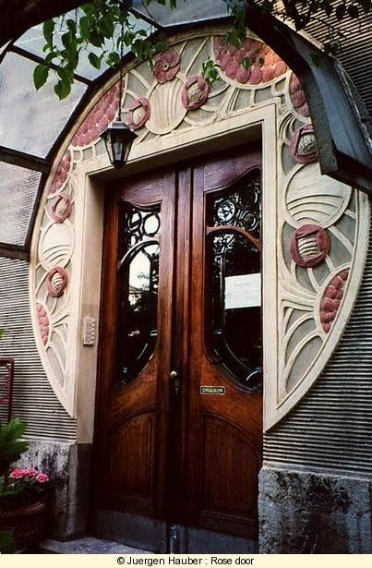

Slide 7
FAQ’s:
Q: Do I HAVE to do the brainstorming?
A: YES! Good planning is a vital part of a successful clay project, especially a symbolic project like this!
***It is worth a separate, 30 point grade, so keep ALL of your planning—even your discarded ideas.***
Q: Can I build up my portal so that areas become more 3D?
A: ABSOLUTELY! Again, be creative—the portal is just your jumping off point.
Q: How many days will I have to complete this?
A: Your tile MUST be finished and drying by April 25th! Unfinished projects will be uncovered to dry as is.
THIS GIVES YOU 3 DAYS TO CREATE YOUR PROJECT. YOU MAY NEED TO COME IN OUTSIDE OF CLASS TO FINISH.

Slide 8
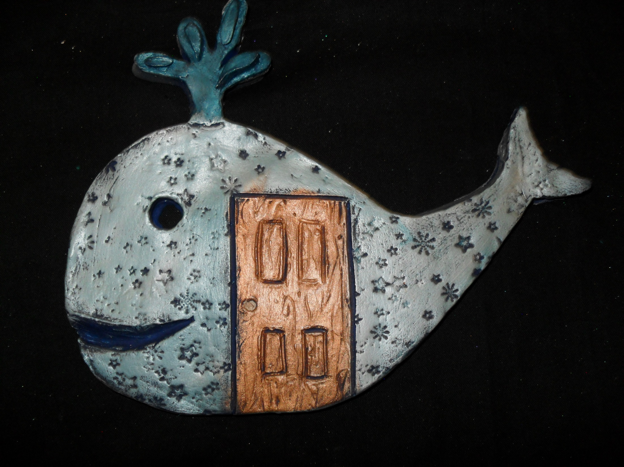
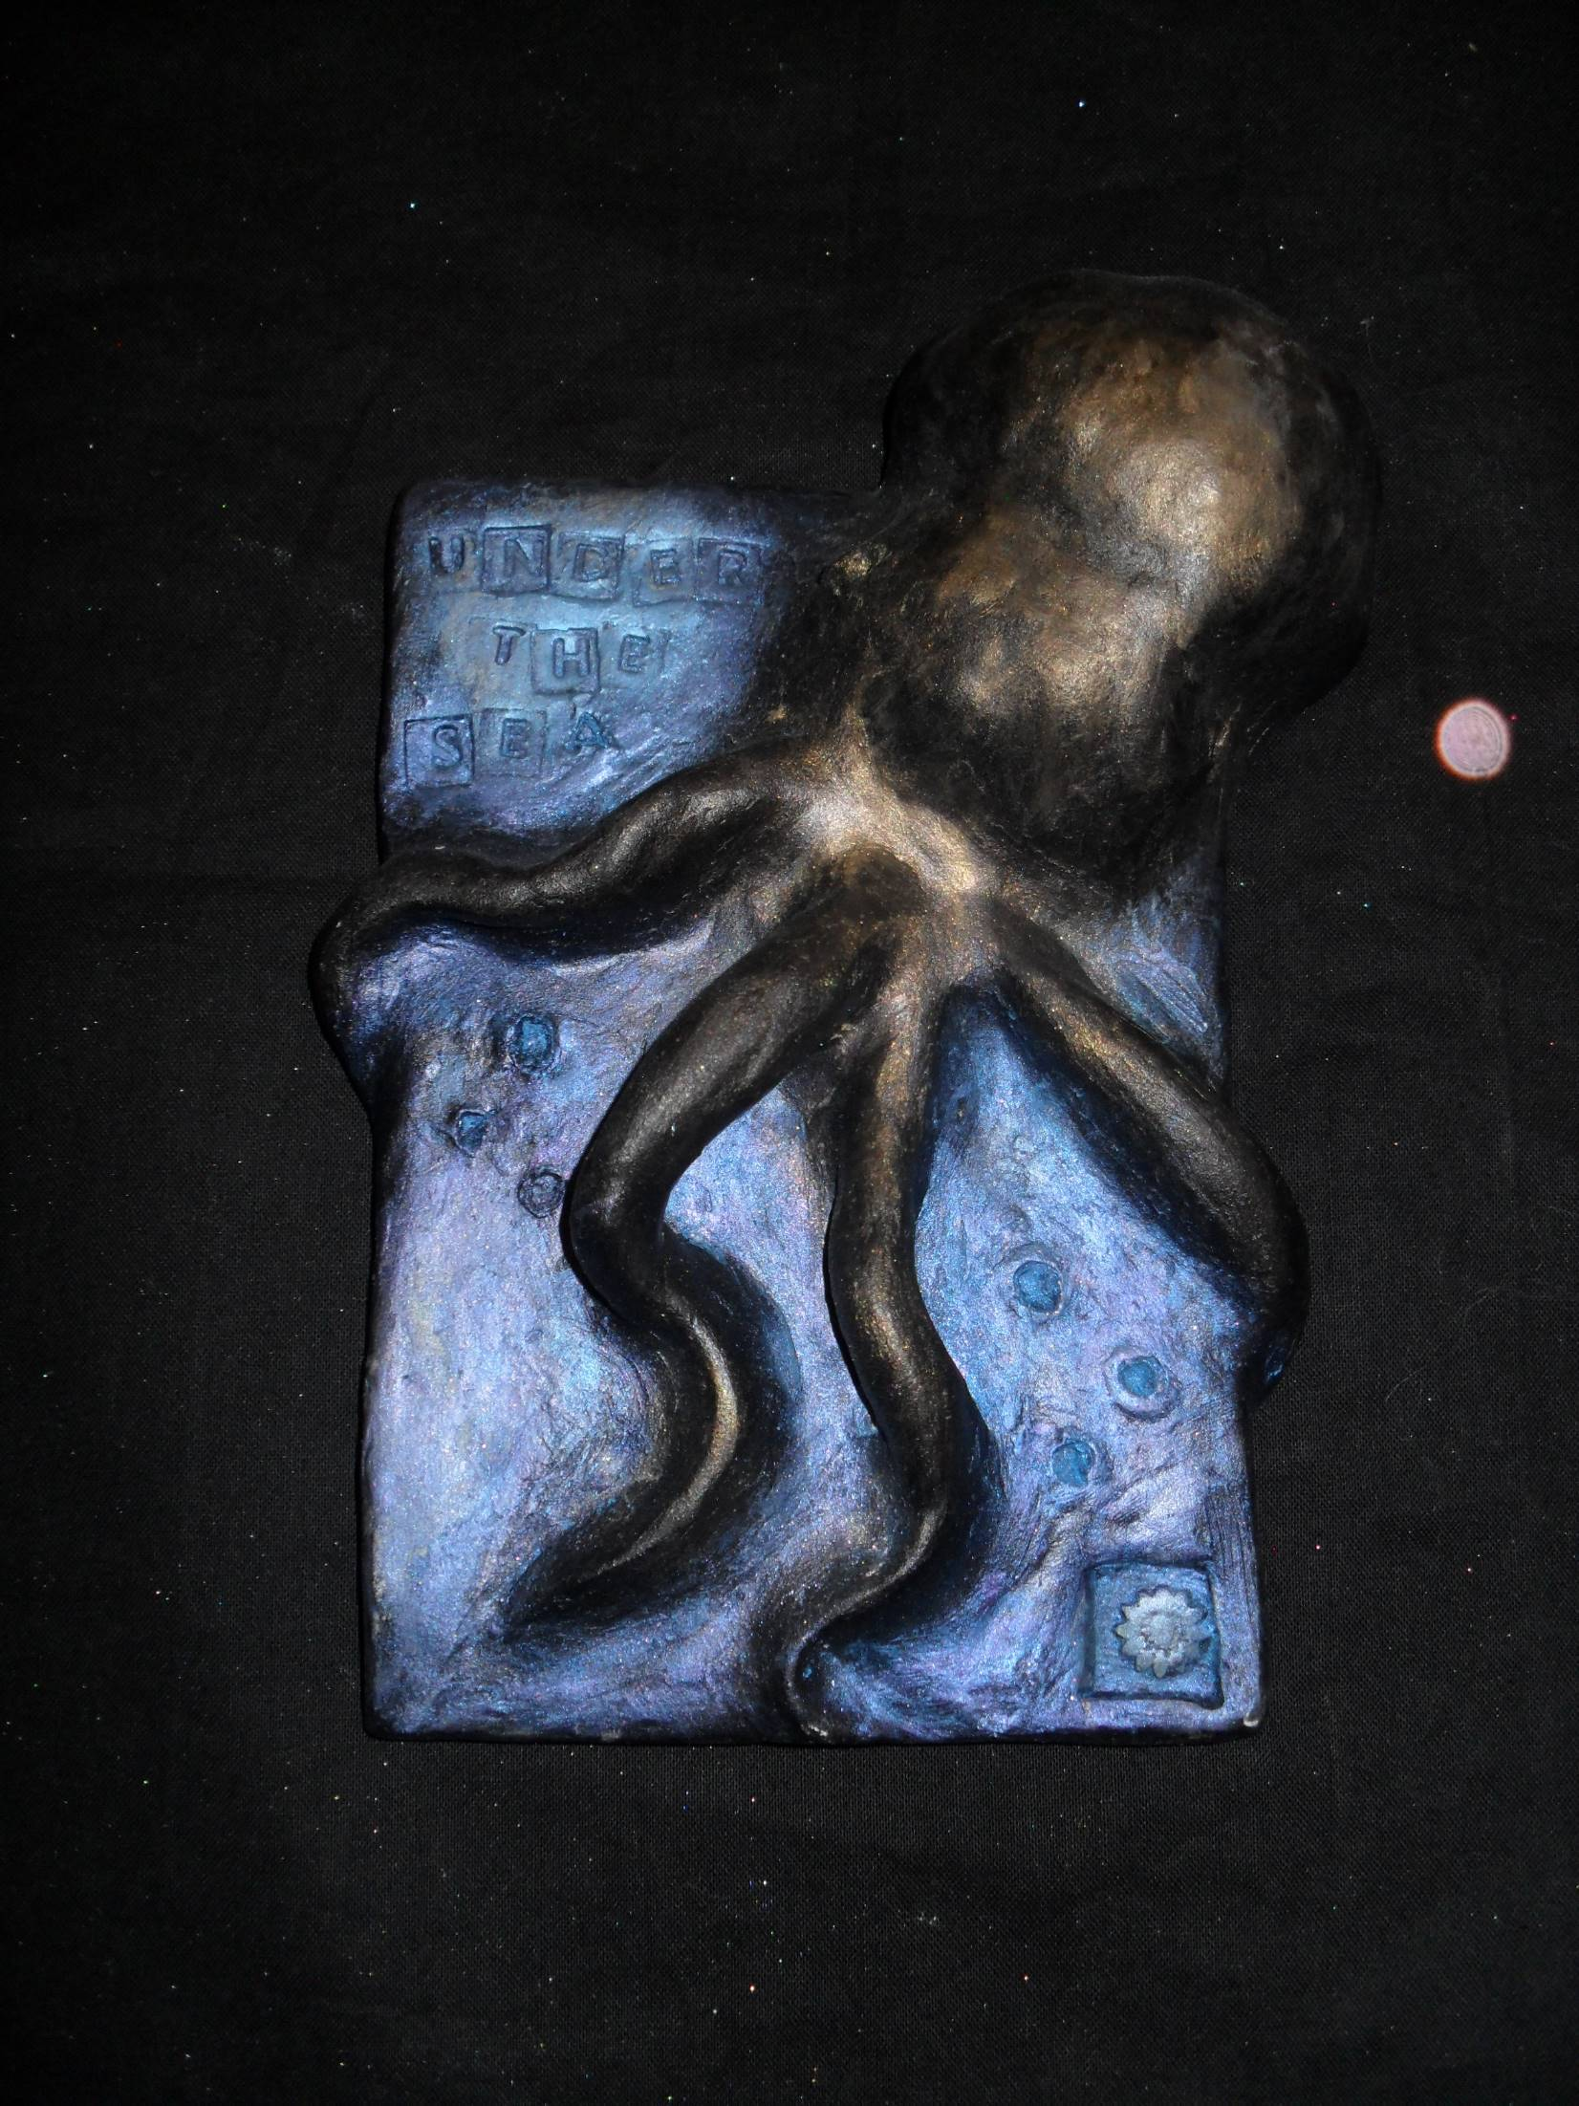
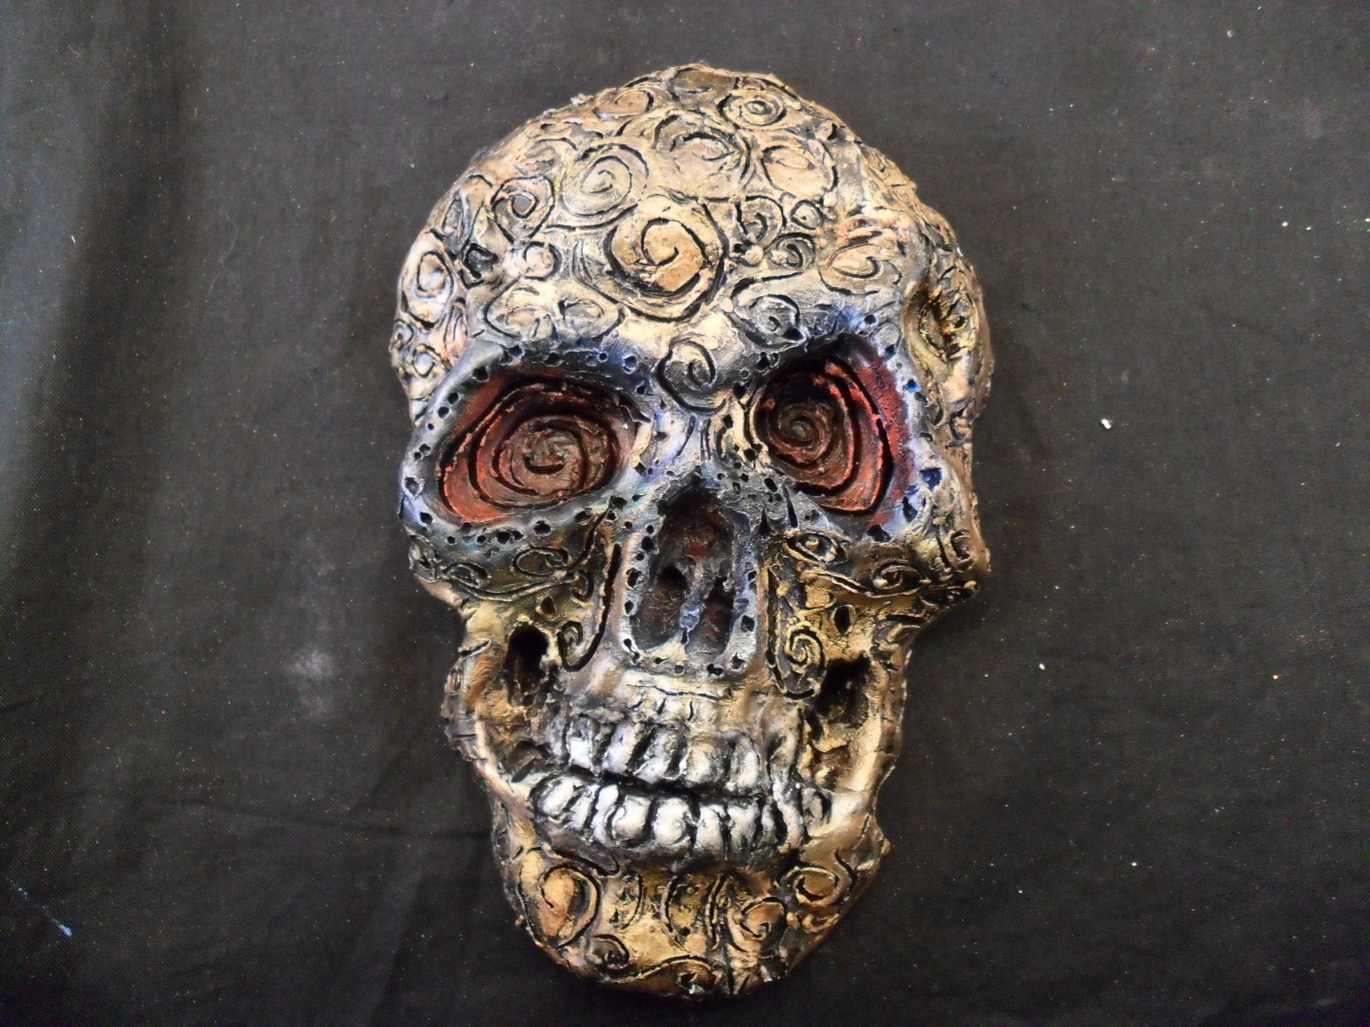

Slide 9
