Slide 1
Prehistoric/Paleolithic Art
Fall 2018

Slide 3
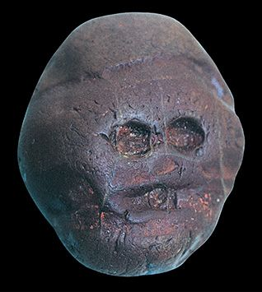
Waterworn pebble resembling a human face Makapansgat, South Africa. 3,000,000 BCE. Reddish Brown Jasperite
This stone was found in a prehistoric shelter, and it is clear someone found it and realized it resembled a human face.
Humankind began in Africa some 3 million years ago. We can not consider something art (especially prehistoric art) unless humans have intentionally altered a material beyond mere selection.)

Slide 4
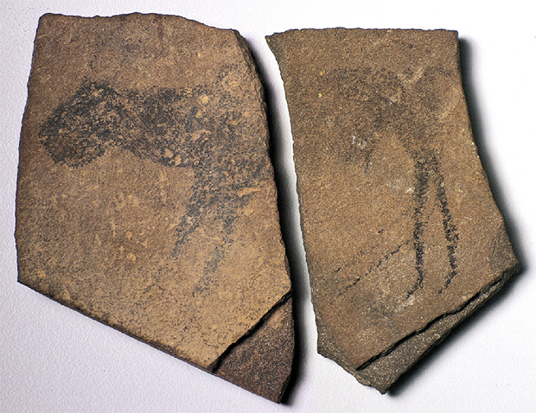
Animal Facing left from the Apollo 11 Cave Nambia ca. 23,000 BCE Charcoal on stone
Like most other paintings for thousands of years, this very early example from Africa shows an animal in strict profile so that all parts of the creature are shown.

Slide 5
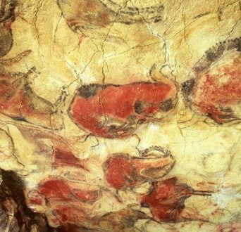
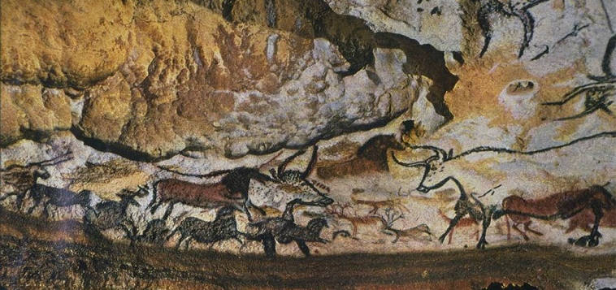
Cave Paintings Altamira and Lascaux Spain and France 11,000 – 15,000 BCE
The best known Paleolithic cave is in Lascaux France. There is a huge amount of painted surfaces.
Hall of the Bulls demonstrates the idea of twisted perspective. Heads in profile, but horns up front.
Bringing animals under their control.

Slide 6
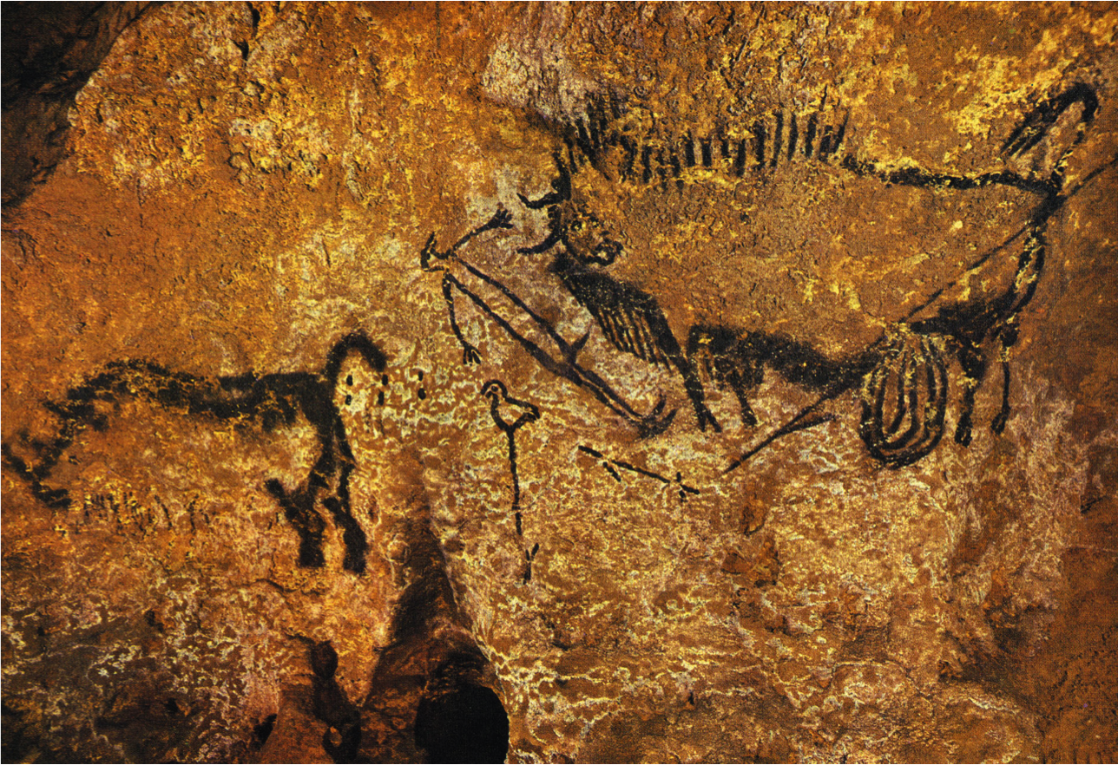
Rhinoceros, wounded man, and disemboweled bison Lascaux, France. Ca. 15,000 – 13,000
If this painting truly depicts a hunting scene, they constitute the earliest example of narrative art ever discovered.

Slide 7
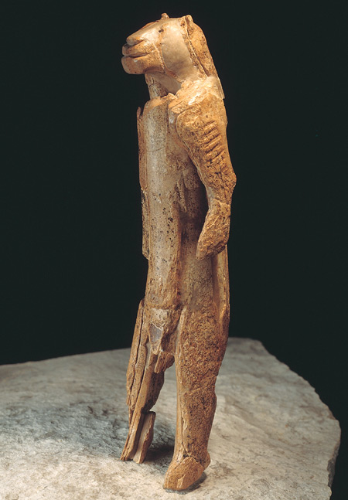
Hohlenstein-Stadel Germany, ca. 30,000 – 28,000 BCE Mammoth Ivory
This is one of the oldest known sculptures and is nearly a foot tall.
Depicts a human with a feline head.
Purely the artists imagination? A sorcerer or magician wearing a mask? Humans dressing up as animals?
Important to the creator because of how much time and effort it would have taken

Slide 8
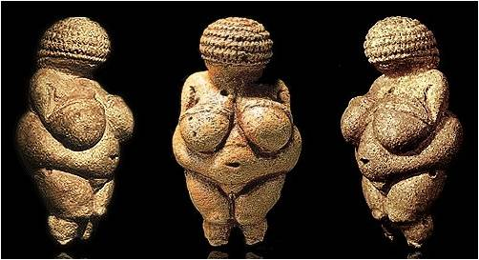
Venus of Willendorf Willendorf, Austria. ca. 28,000 – 25,000 BCE Limestone
Demonstrates exaggerated proportions.
Childbearing capabilities of women ensured the continued survival of the species.
Maybe the point of view is of woman laying or looking down which could be responsible for the exaggerated proportions.

Slide 9
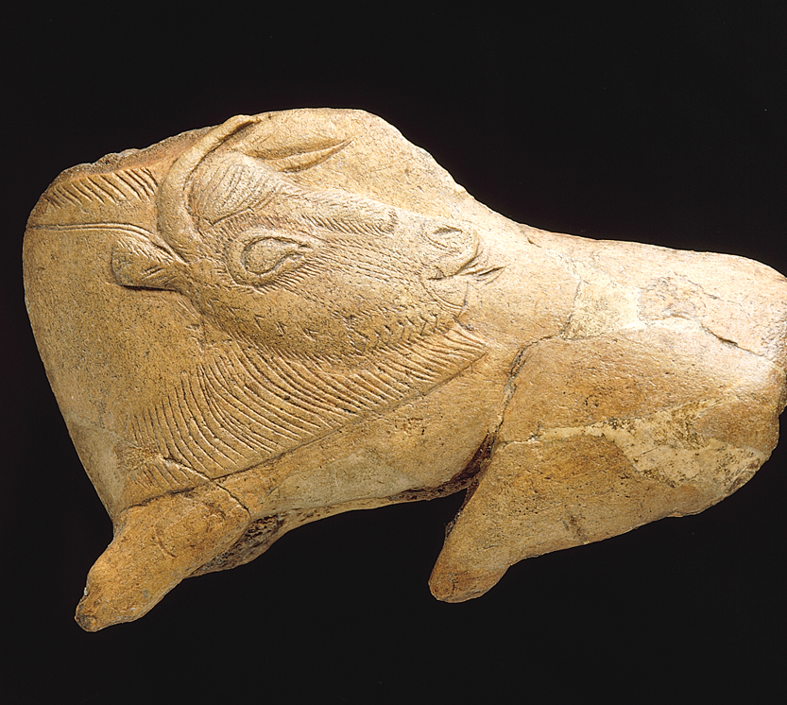
Bison with Turned Head La Madeline, France. Ca. 12,000 BCE Reindeer Horn
The sculpture is only about 4 inches long but includes incredible detail.
Is the head turned because of the space available or as an intentional artistic choice?

Slide 10
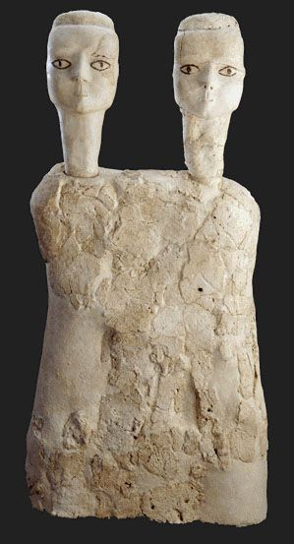
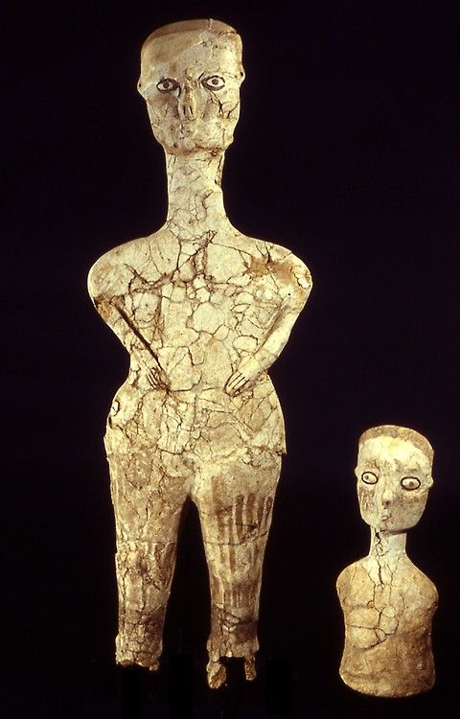
Human Figure Ain Ghazal, Jordan. ca. 6,750 – 6,250 BCE. Plaster
3 foot 5 inches tall
Found with dozens of white plaster statuettes, some with 2 heads and details added in paint.
Some of the earliest large sculptures known.

