Slide 1
Pyramids, Mummies, and the Afterlife
“Concerning Egypt itself I shall extend my remarks to a great length, because there is no country that possesses so many wonders, nor any that has such a number of works that defy description.”
-Ancient Greek historian Herodotus

Slide 2
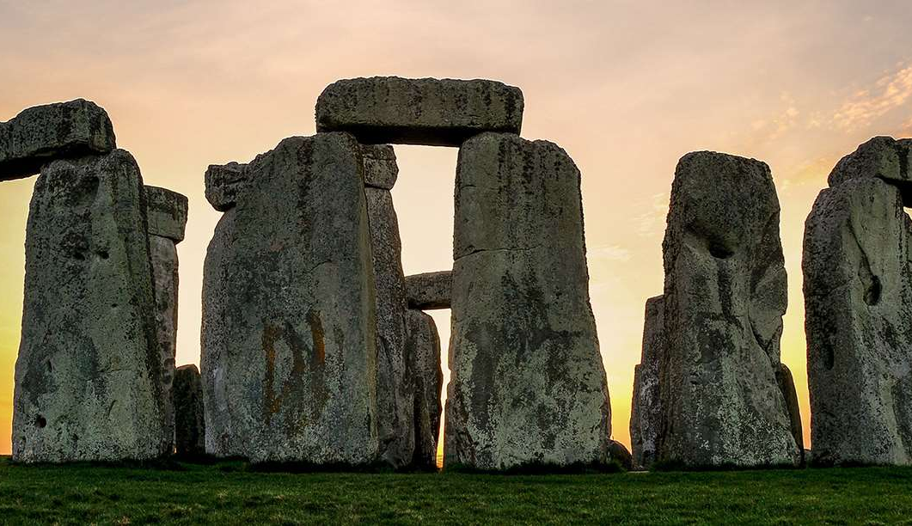
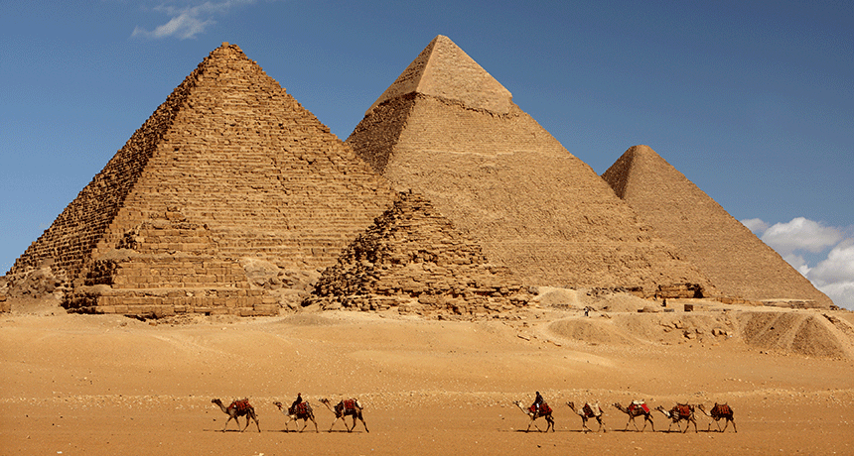
From Stonehenge to the Great Pyramids
z
Stonehenge is a giant stone creation that was found in England and dates back to the prehistoric times. To this day, it’s creation and meaning remains a mystery.
Similarly, the Great Pyramids of Giza and their creation have baffled and astounded humans for centuries.

Slide 3
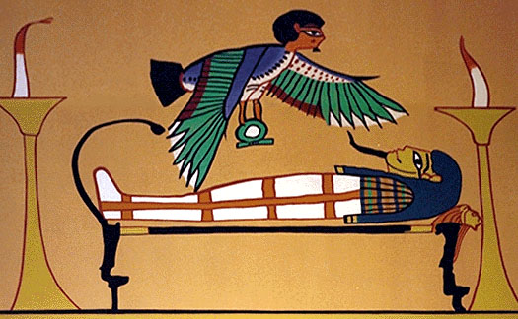
Ka – a humans life force
z
The Egyptians did not make a sharp distinction between body and soul, but believed that from birth a person was accompanied by a kind of other self.
Upon the death of the body the Ka could inhabit the corpse and live on.
For the corpse to live securely the body had to remain as intact as possible.
Hence………

Slide 4
MUMMIES!!!!
z
z

Slide 5
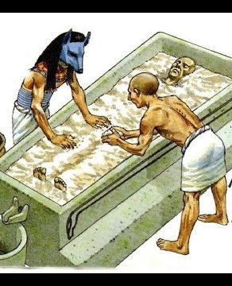
Mummification Process
z
It was a 70 day process.
Step 1: Surgical removal of the lungs, liver, stomach, and intestines through a small incision.
These were placed in jars to later be buried with the corpse.

Slide 6
The brain was extracted through the nostrils and discarded. They placed no special significance to the brain.
z
z

Slide 7
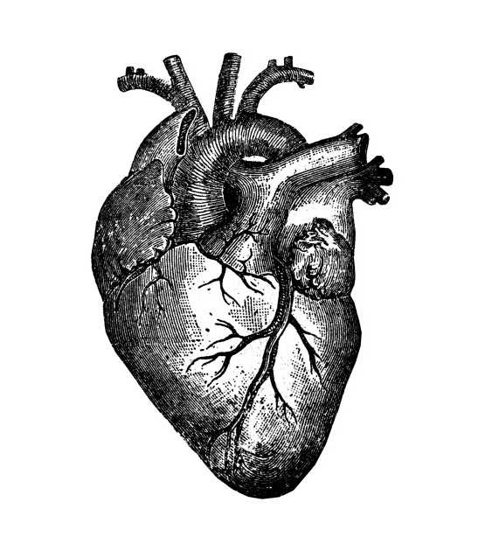
z
But they left the heart as it was seen as necessary for life and regarded as the seat of intelligence.

Slide 8
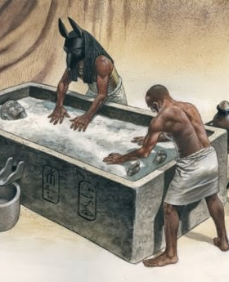
z
Next the body was coated for 40 days in natron (naturally occurring salt compound) to dehydrate the body.
It was then filled with resin soaked linens, and the incision was closed and covered with the eye of Horus. (A device to ward off evil and promote rebirth)

Slide 9
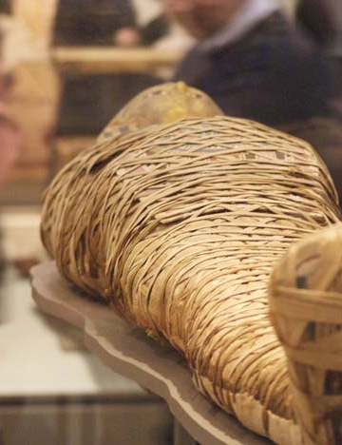
z
Finally, the body was treated with lotions and resins then wrapped tightly with hundreds of yards of linen bandages to maintain the shape.
This practice endured for thousands of years, even under Greek and Roman rule.
The care with which mummies were created and treated varied widely depending on the wealth and status of the deceased.

Slide 10
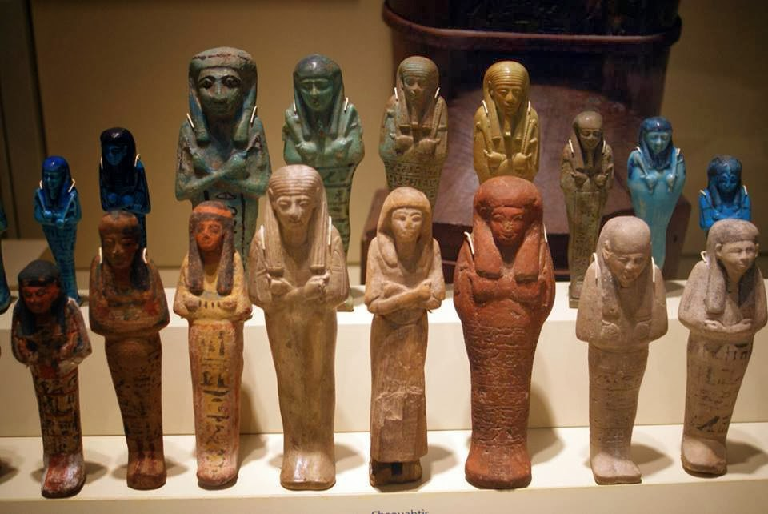
Ushabtis - Answerers
z
These figurines were placed in the tomb with the deceased, and preformed any labor required of the deceased in the afterlife, answering whenever his or her name was called.
They also began placing statues of the deceased in the tombs to guarantee the permanence of the person’s identity.

Slide 11
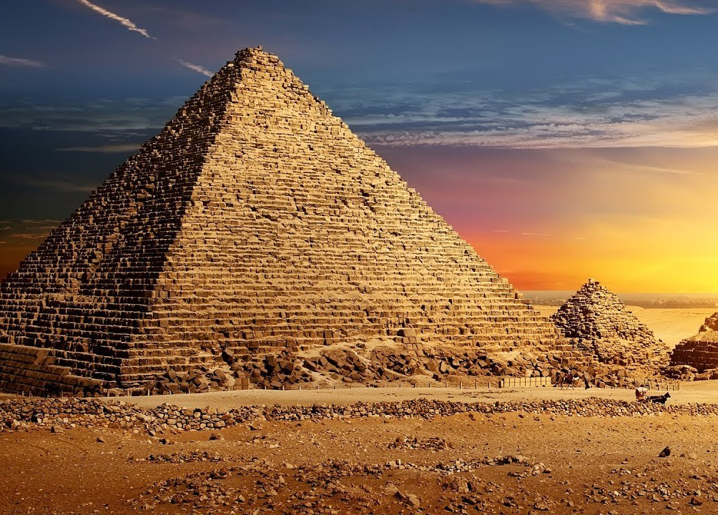
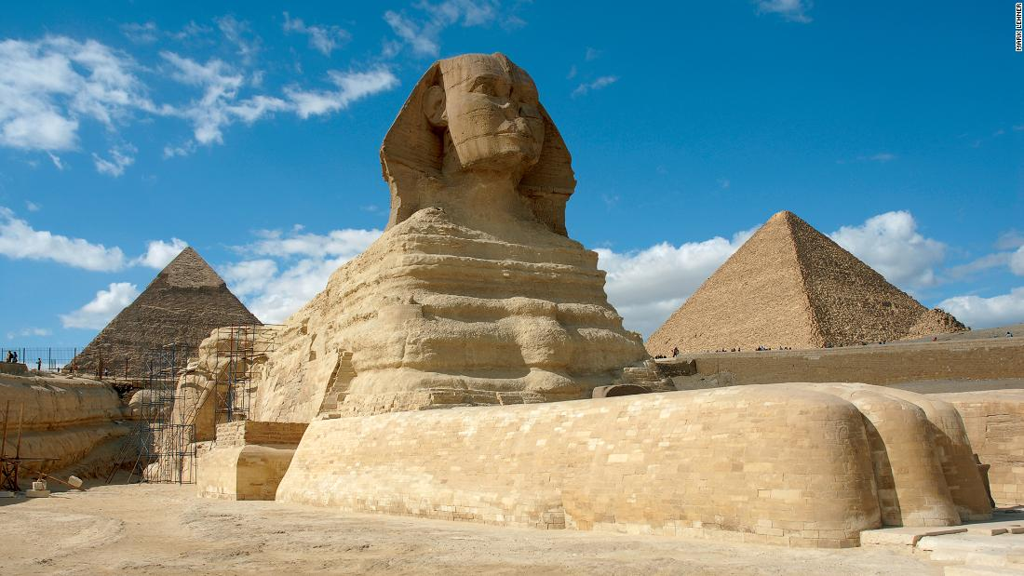
Architecture
z
The majority of monuments the Egyptians left behind were dedicated to ensuring safety and happiness in the next life.

Slide 12
Mastaba (Arabic for bench)
z
z
A rectangular brick or stone sculpture with sloping sides built over an undergrown burial chamber. (Probably remenisint of the earthen mounds of even earlier burial sites.)
Originally housed single burials, but later accommodated multiple family burials and became more complex.

Slide 13
An interior view of a single burial mastaba
z
z

Slide 14
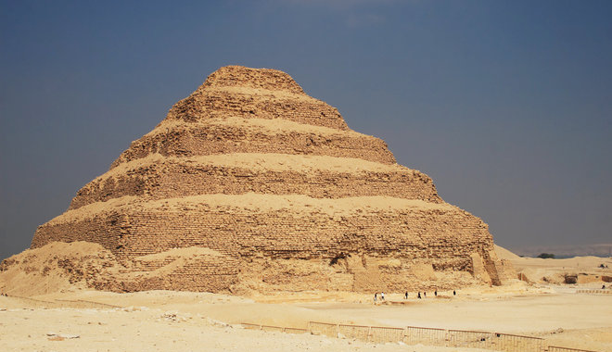
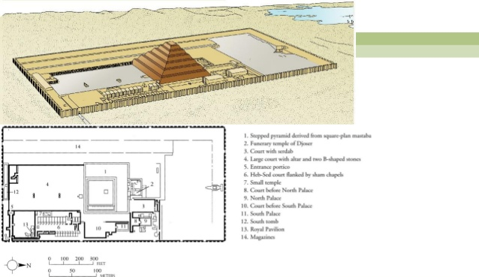
Stepped Pyramid of Djoser
z
Built by Imhotep, the first recorded name of an artist in history!
Basically a precursor to the pyramids.
Basically mastabas stacked on top of each other.
Beneath the pyramid was a network of several hundred underground rooms and galleries.
Was meant to both protect and house his wealth and be his palace in the afterlife.
Enclosed in a giant complex showing his stature and importance.

Slide 15
Great Pyramids of Gizeh
z
z
The pharaohs of the Kingdom accrued great wealth and spent it on grandiose projects. The most spectacular were the Great Pyramids of Gizeh which were built over about 75 years.
One of the oldest of the seven wonders of the world.

Slide 16
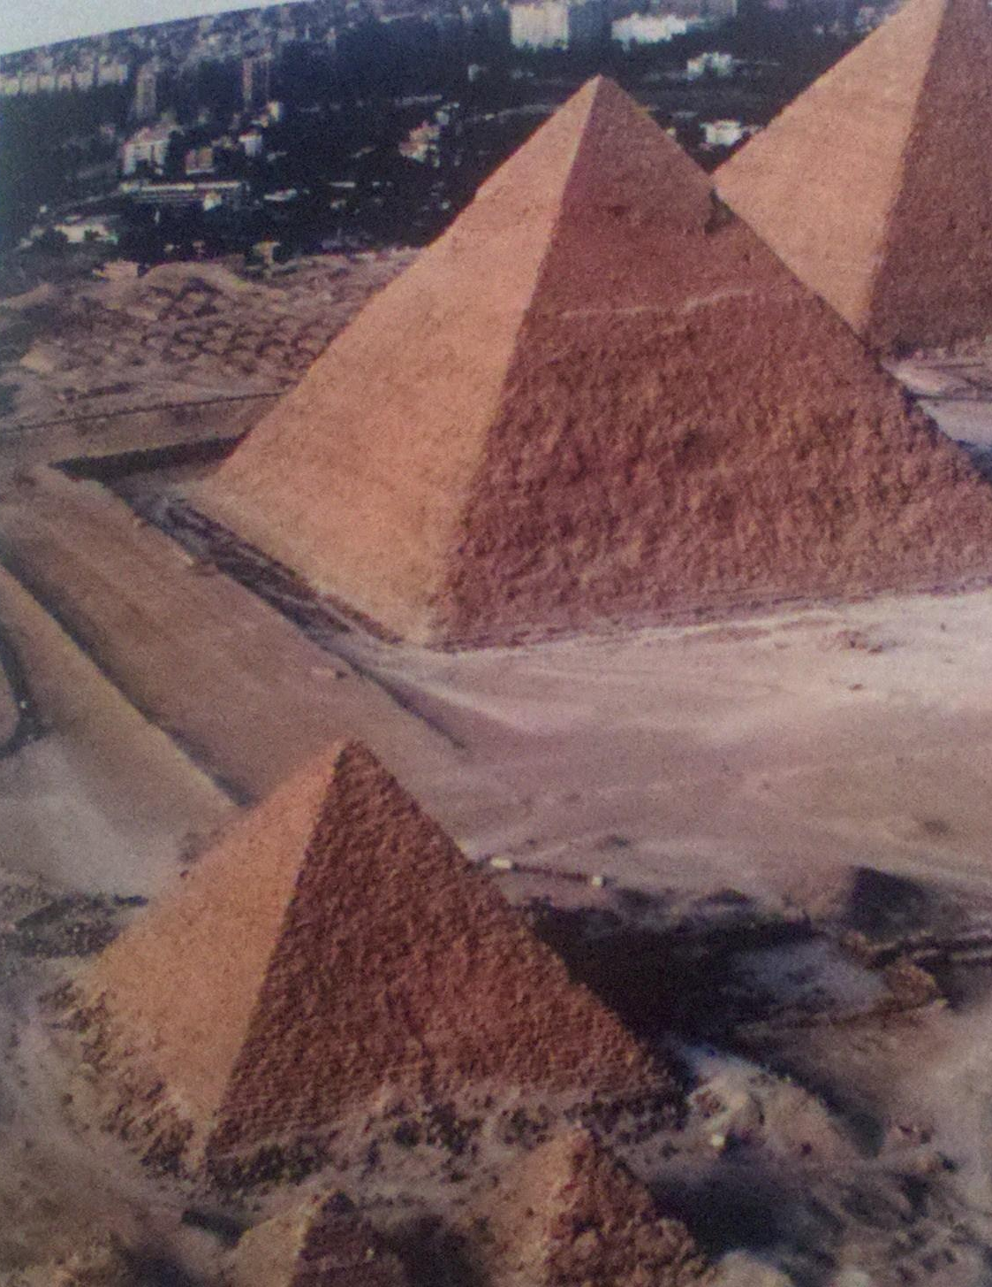
z
Built for the three pharaohs; Khafre (background), Khufu (middle/tallest), and Menkaure (front)
They represent the culmination of the architectural evolution that began with the mastaba.
This final form is situated to the four cardinal directions, and were symbols of the sun.
The suns rays are the ramp the pharaoh uses to ascend to the heavens.

Slide 17
The Sphinx
z
In front of the valley temple of Khafre .
Most likely portrays Khafre, with the pharaohs ceremonial beard and headdress.
Suggests that the pharaoh possesses both knowledge and great strength, as well as authority over beasts.

