Slide 1
Still Life and Composition
Digital Drawing and Painting
Fall 2017

Slide 2
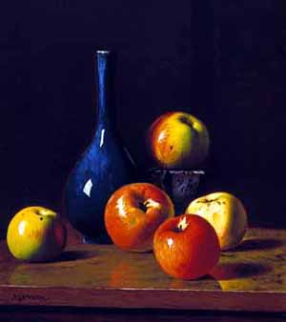
Still Life
A painting or drawing of an arrangement of objects, typically including fruit and flowers and objects contrasting with these in texture, such as bowls and glassware.

Slide 3
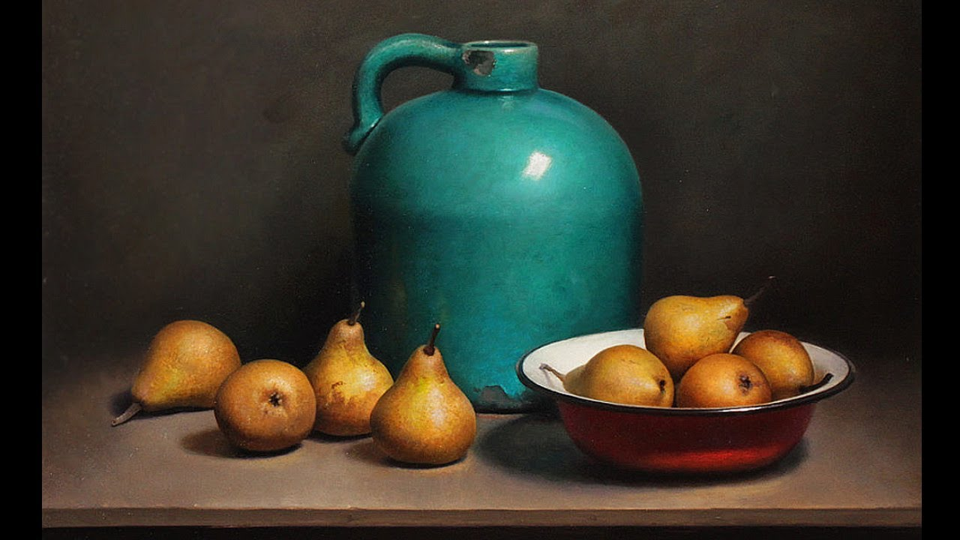
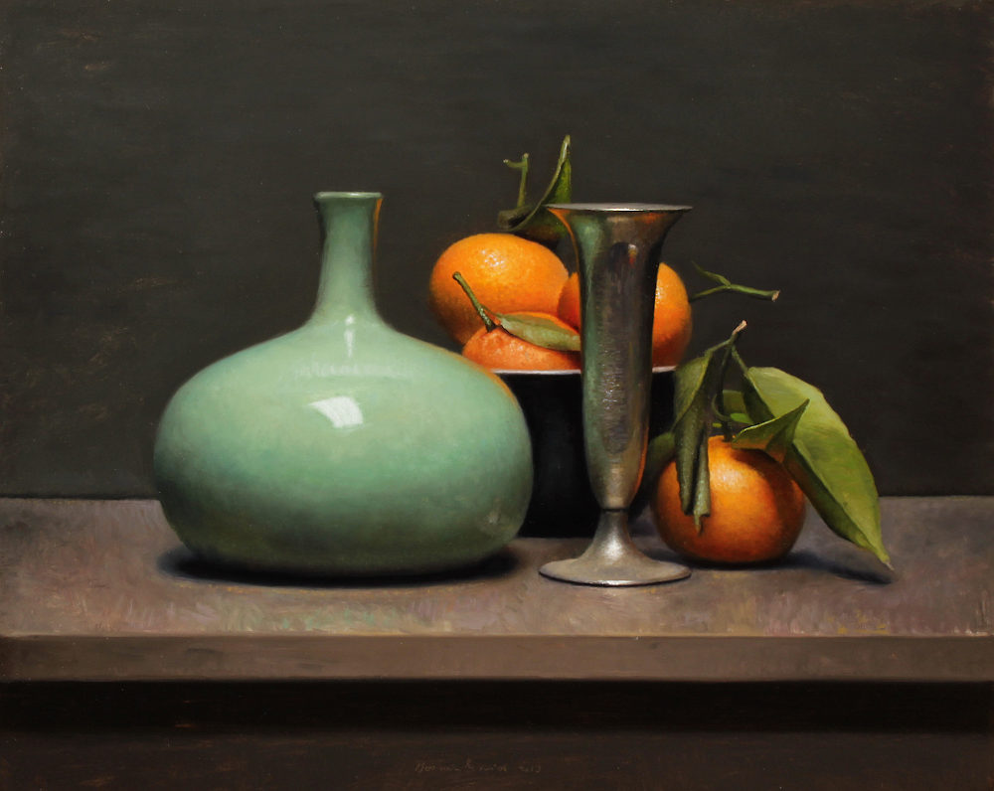

Slide 4
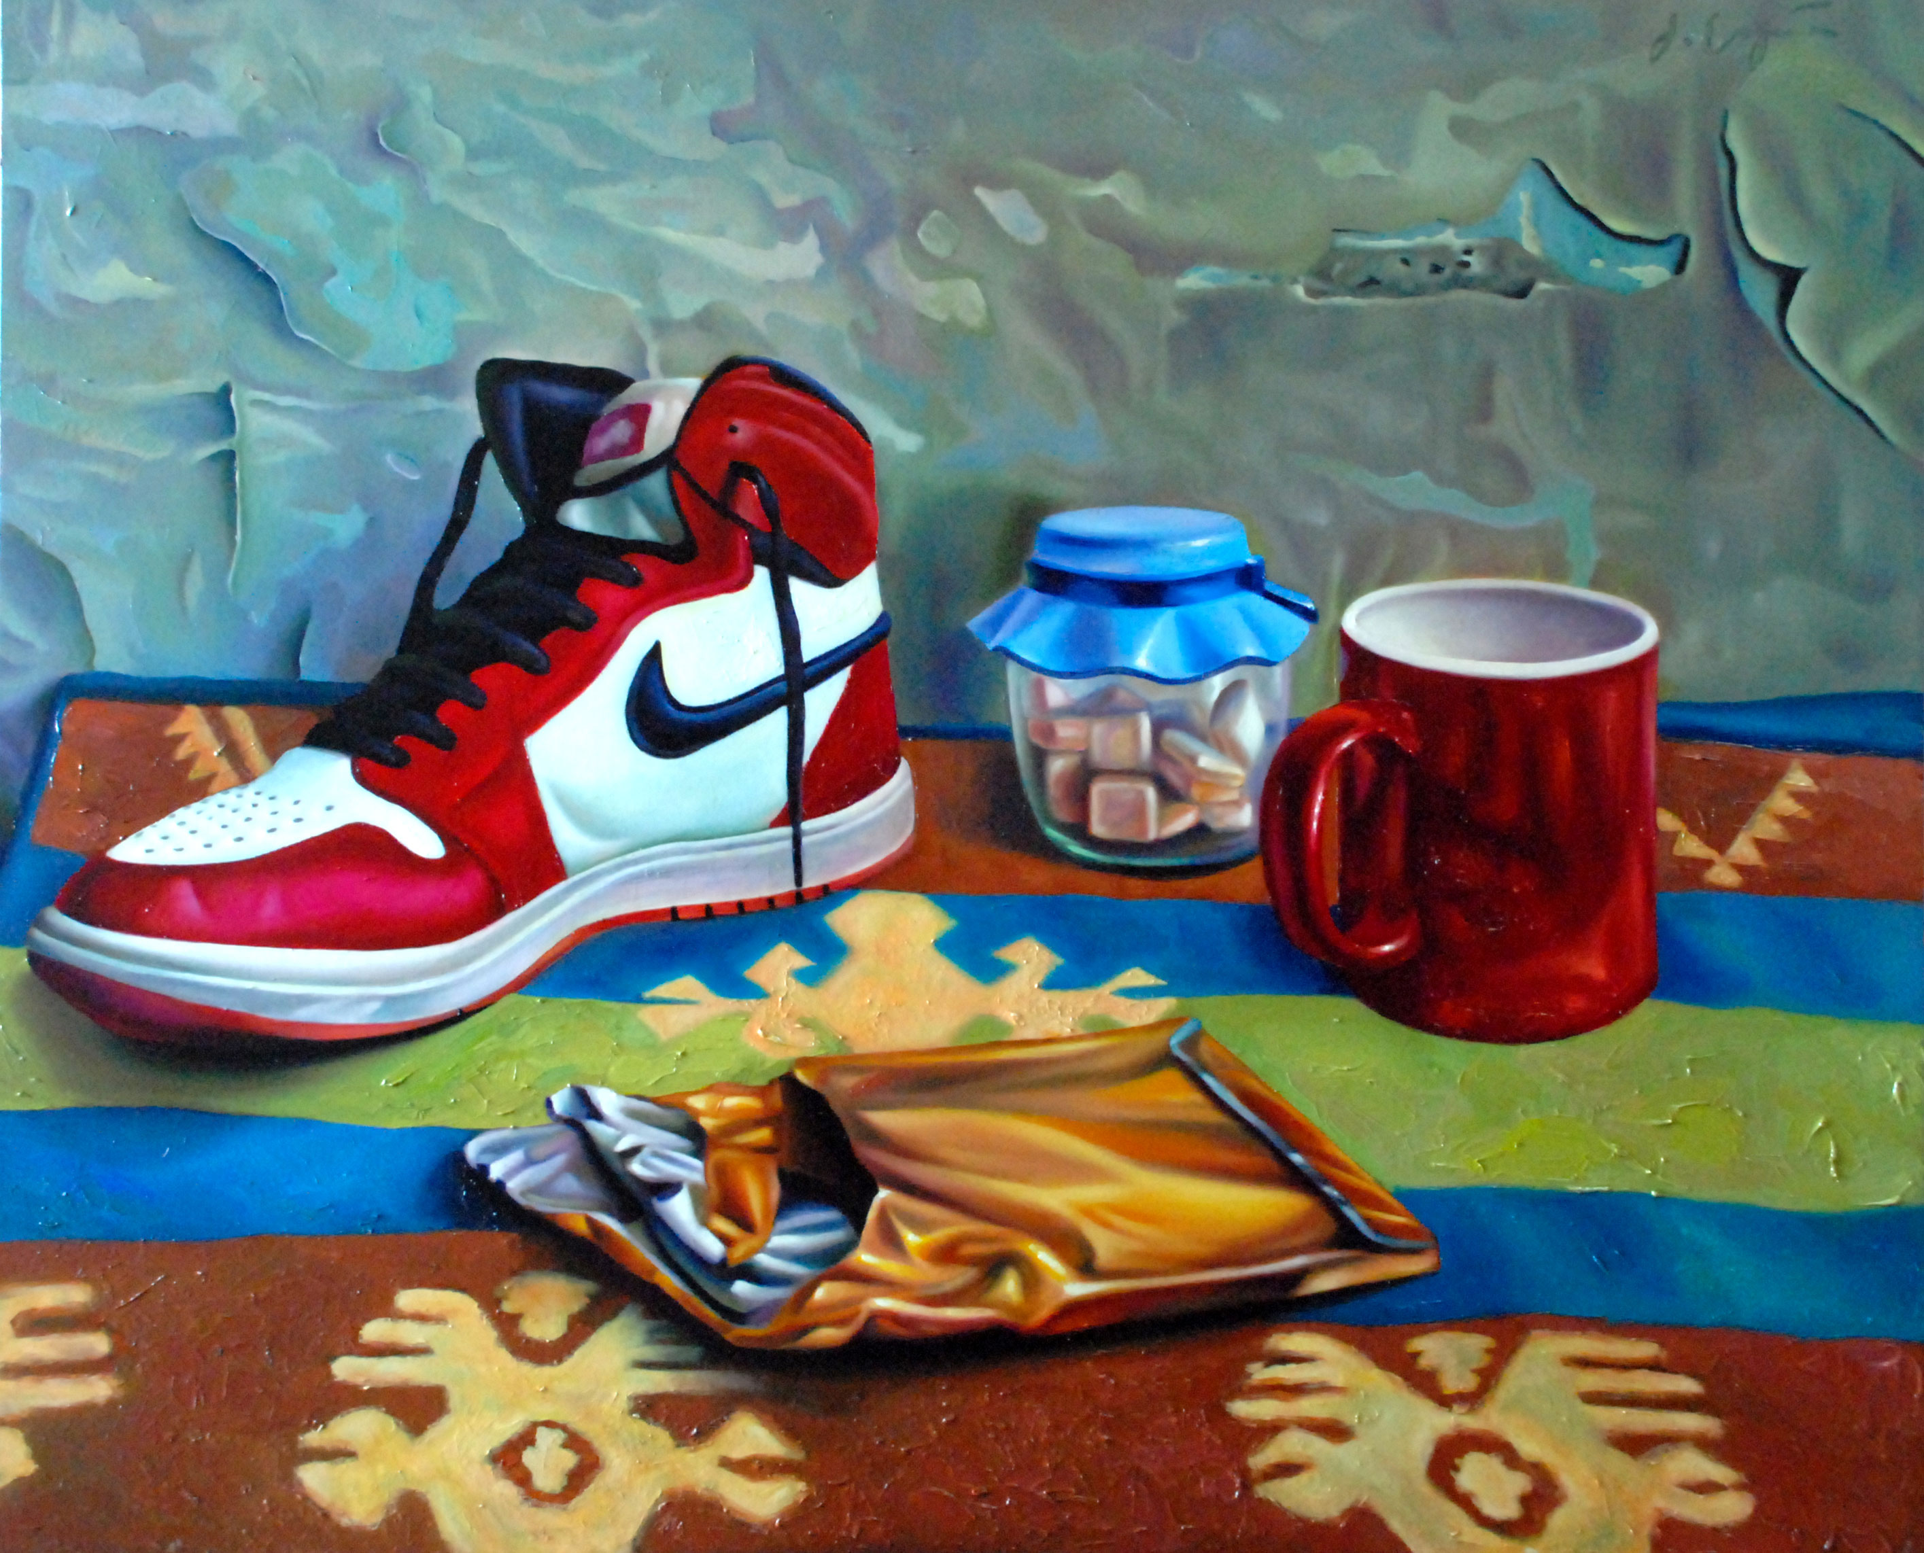
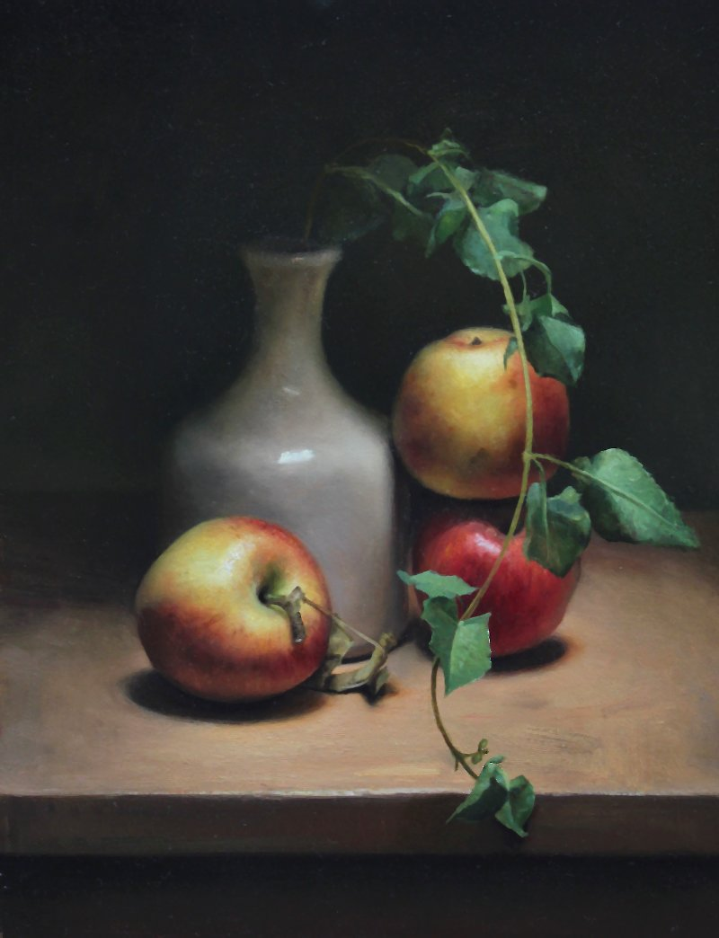

Slide 5
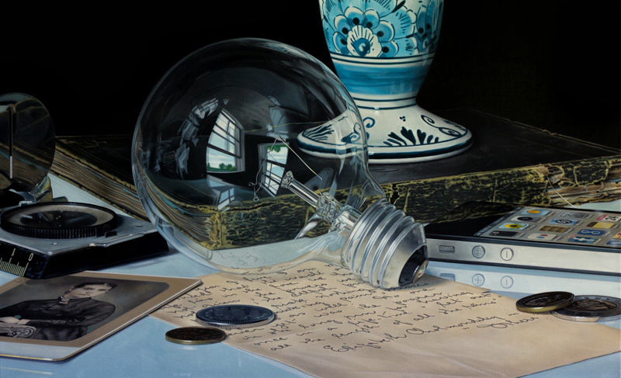

Slide 6
What's this assignment about?!
In art, our drawing and observational skills can be just as important as our painting/drawing technique. Now that we know so much about color and color mixing we need to begin applying it to an observational painting.
Composition, Value, and Observation

Slide 7
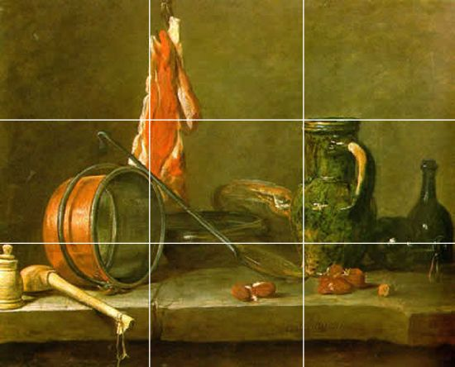
Composition
Successfully arranging the visual elements in a work of art.

Slide 8
GOOD VS. BAD

Slide 9
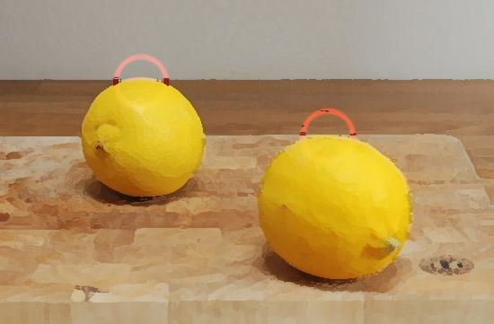
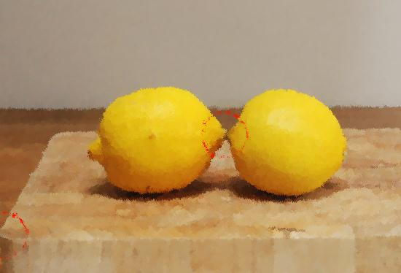
“Kissing” Edges

Slide 10
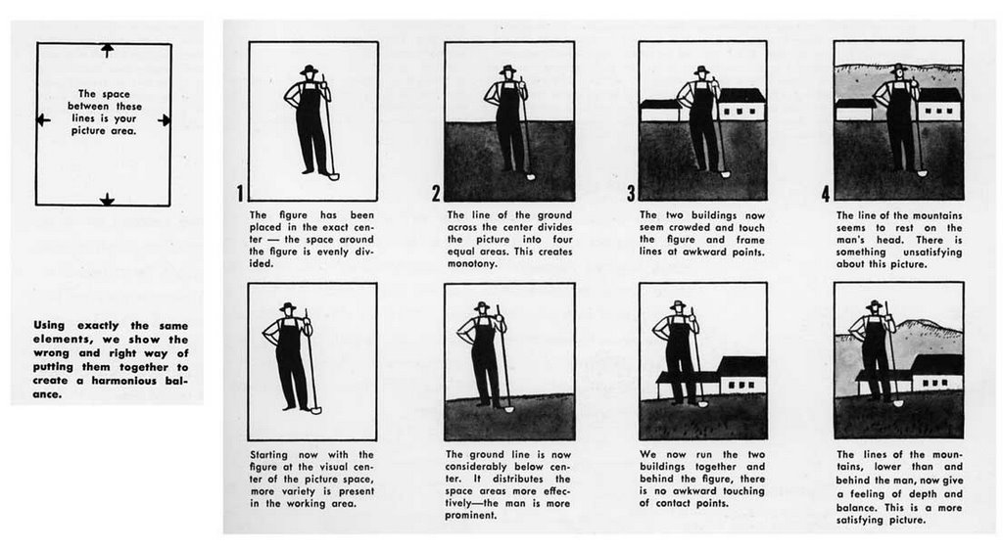
The Arrangement and Placement of your Elements within the frame.

Slide 11
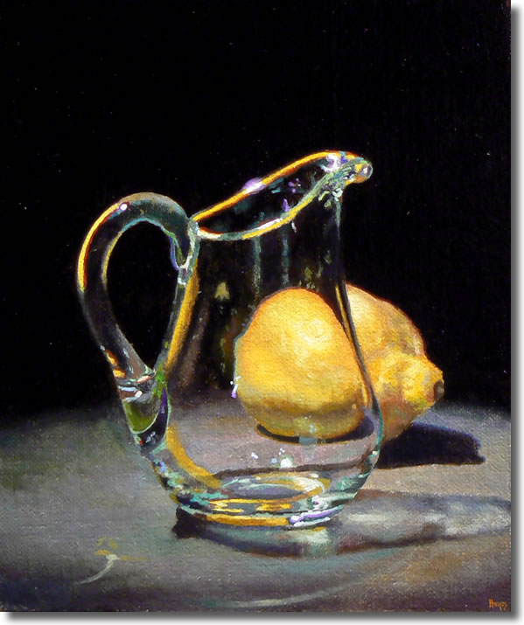
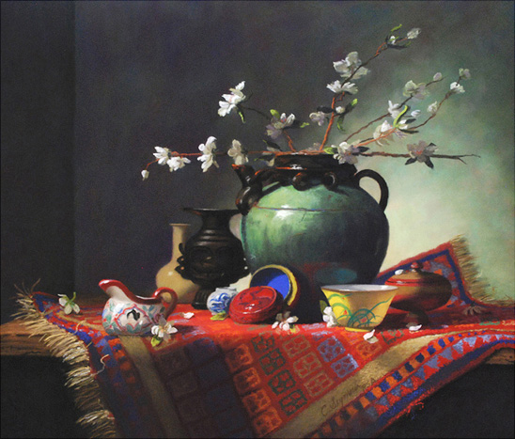

Slide 12
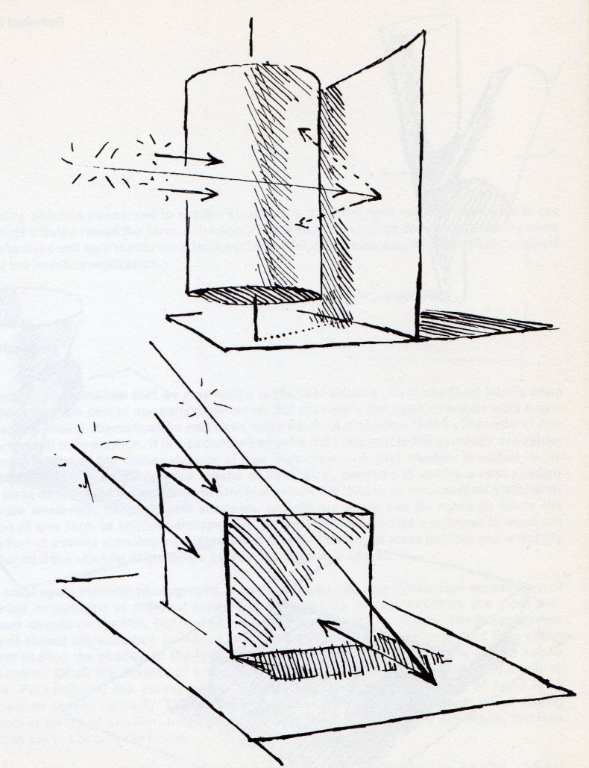
Reflected Light
The light bouncing off of the surface of the table or wall back onto the form.
This is most obvious if the table or background is white.
Images provided by: Grammer of Drawing By: Colin Hayes

Slide 13
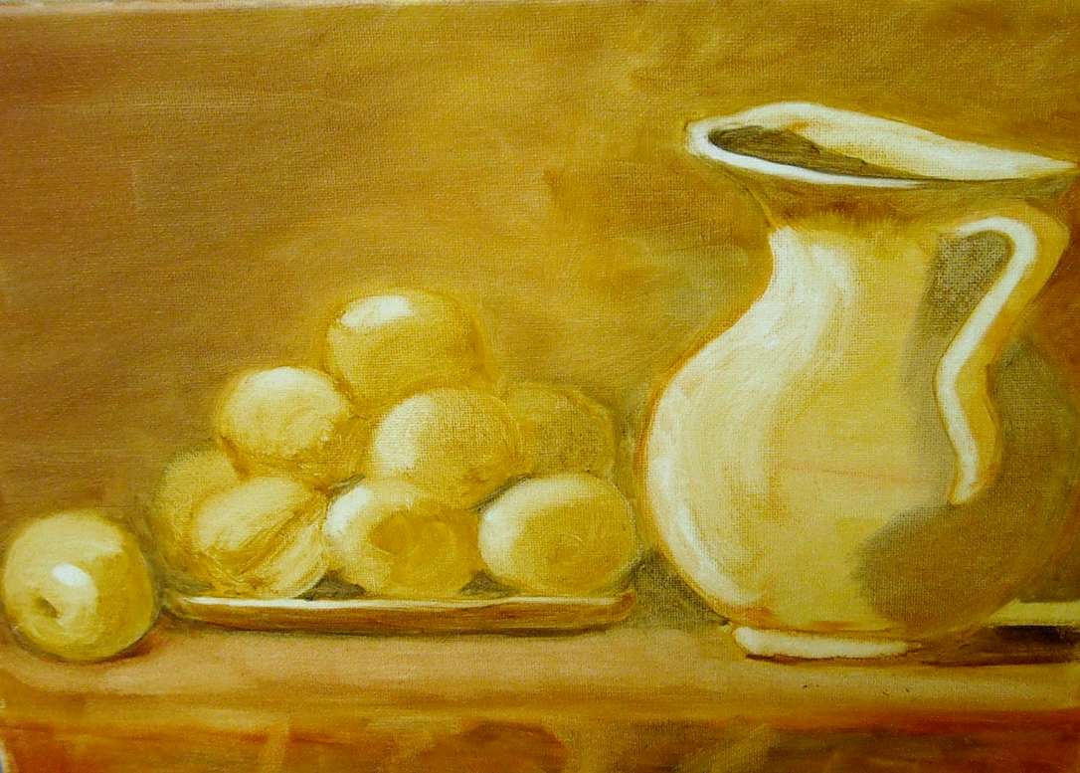
Monochromatic
Containing or using only one color.

Slide 14
