Slide 1
Surreal Composition
Creating effective, dreamlike compositions

Slide 2
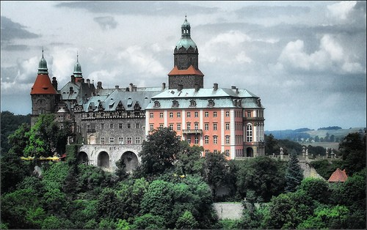
Setting
The place or type of surroundings where something is positioned or where an event takes place.
In works of narrative (especially fictional), the literary element setting includes the historical moment in time and geographic location in which a story takes place, and helps initiate the main backdrop and mood for a story.

Slide 3
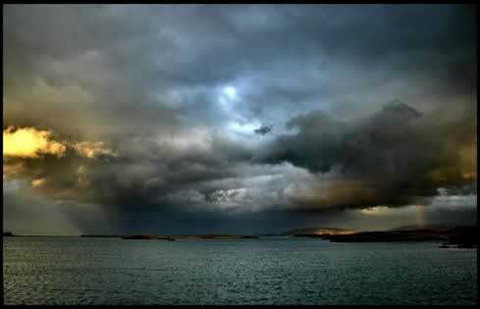
Atmosphere
The pervading tone or mood of a place, situation, or work of art.

Slide 4
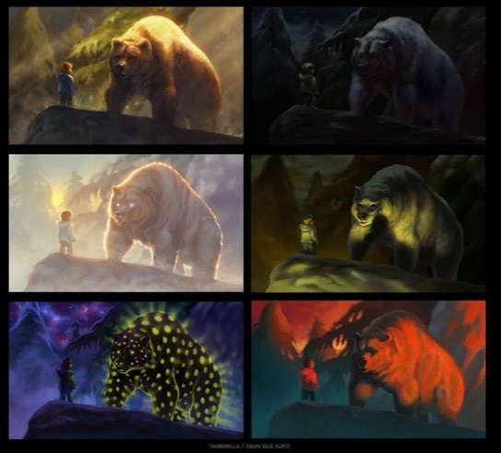

Slide 5
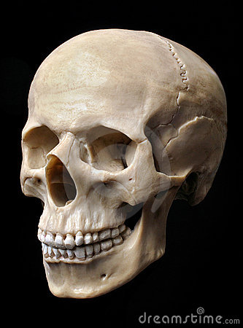
Symbol
A thing that represents or stands for something else, especially a material object representing something abstract.

Slide 6
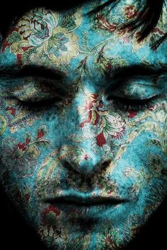
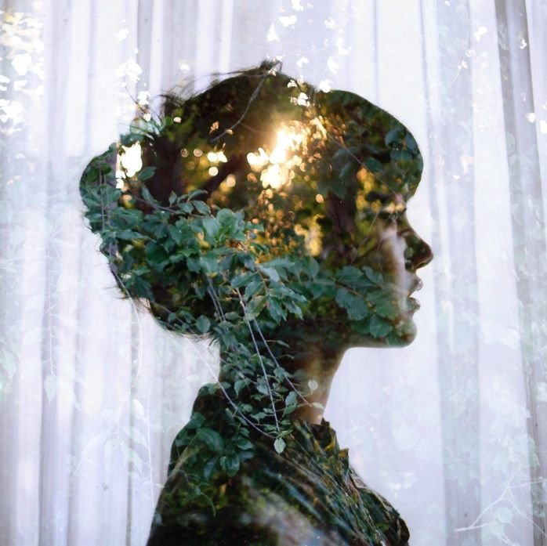
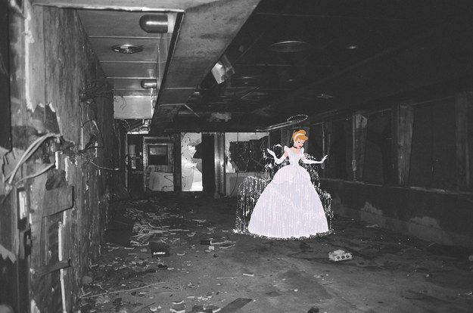
Superimpose
Place or lay (one thing) over another, typically so that both are still evident.

Slide 7
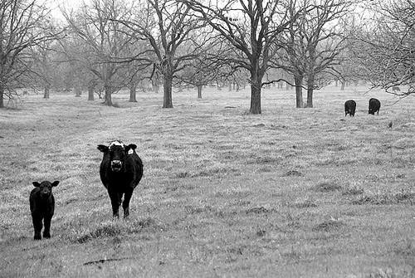
Balance
a condition in which different elements are equal or in the correct proportions.

Slide 8
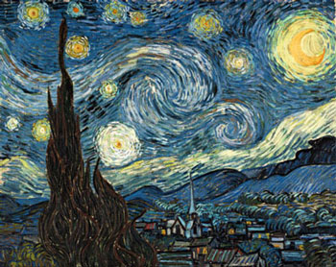
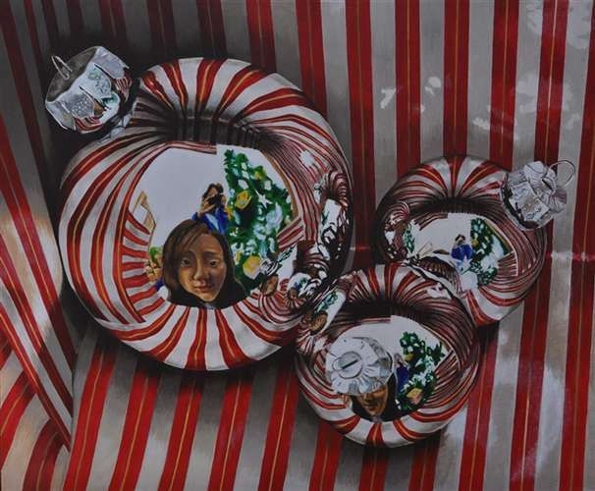
Unity
Unity is the relationship among the elements of a visual that helps all the elements function together. Unity gives a sense of oneness to a visual image. In other words, the images work together to create meaning.

Slide 9
Composition
In the world of the visual arts composition is the placement or arrangement of visual elements or the “ingredients” in a work of art. It is the way that an artist uses the Principles to arrange their chosen Elements.
The term composition means ‘putting together’ and can apply to any work of art, from music to writing to photography, that is put together using conscience thought.

Slide 10
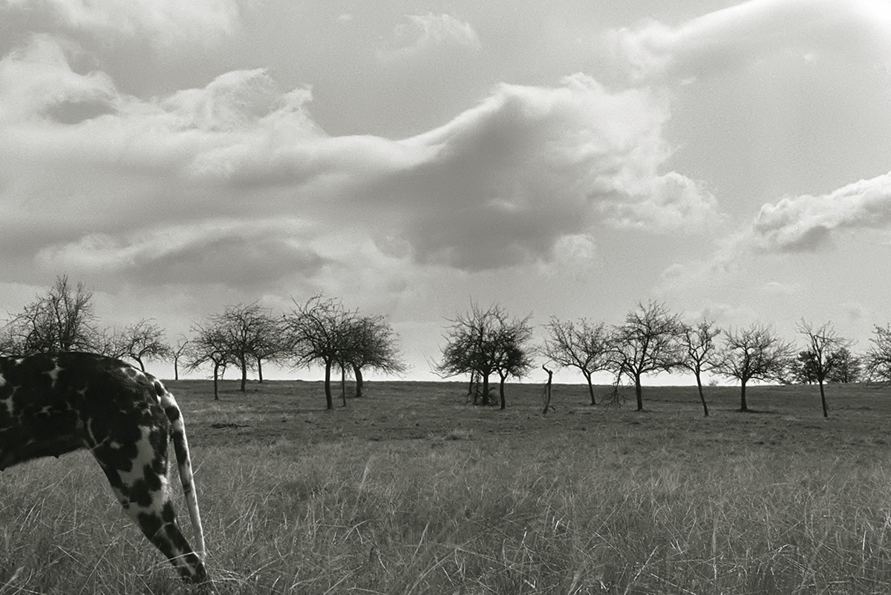

Slide 11
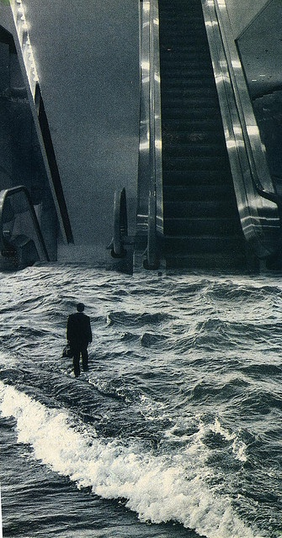
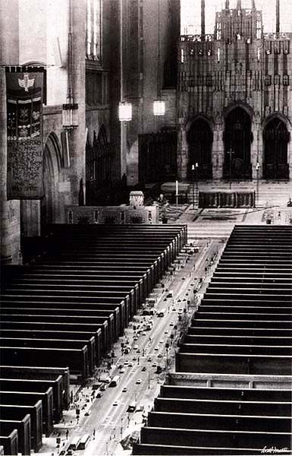

Slide 12
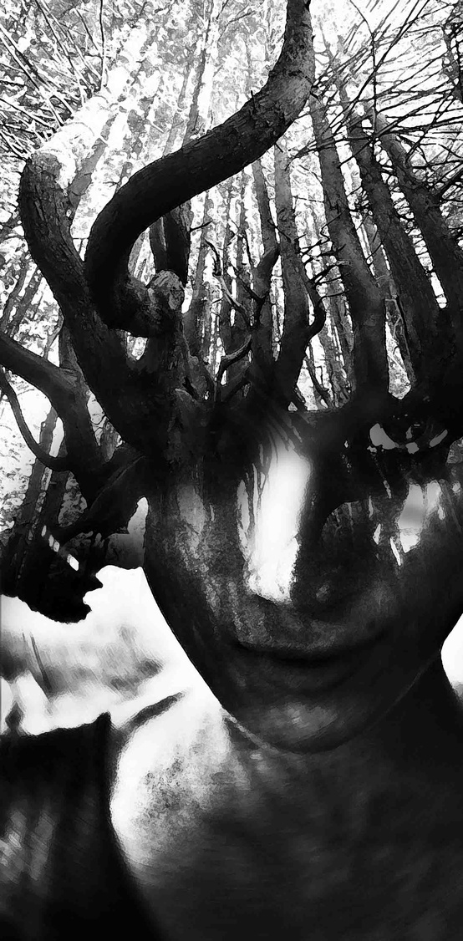
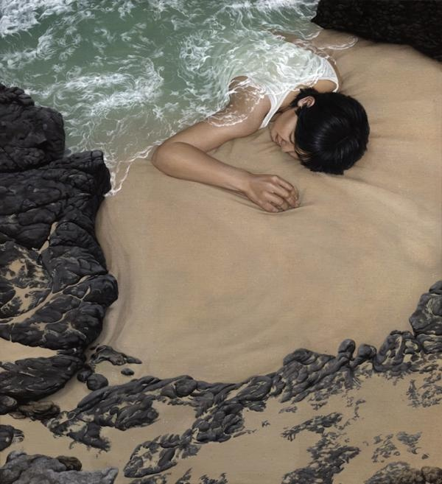

Slide 13
