Slide 1
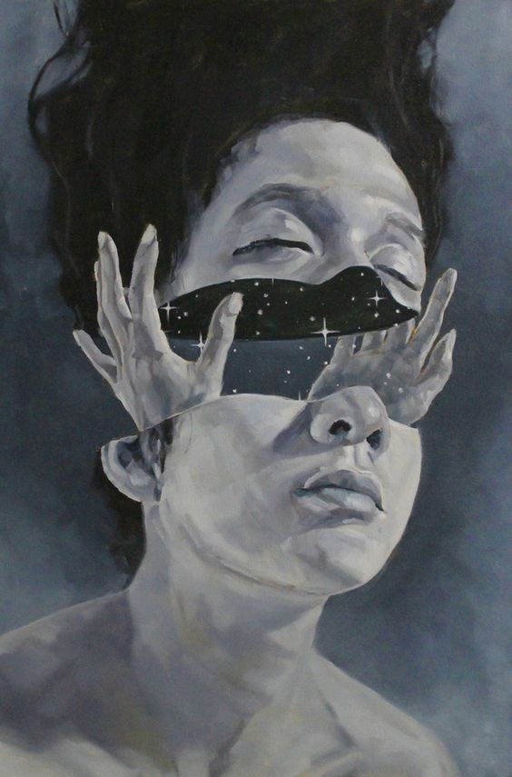
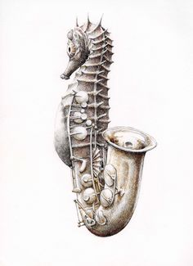
Surrealism/ Transformation
Fall 2017
Seahorse image. Retrieved November 27th, 2016. https://es.pinterest.com/pin/84231455503218542/; Split Face Image. Retrieved November 27th, 2016. http://www.darkbeautymag.com/2016/10/jefferson-muncy-visions/

Slide 2
Surrealism
- The principles, ideals, or practice of producing fantastic or incongruous imagery or effects in art, literature, film, or theater by means of unnatural or irrational juxtapositions and combinations.

Slide 3
Juxtaposition
- An act or instance of placing close together or
side by side, especially for comparison or contrast.

Slide 4
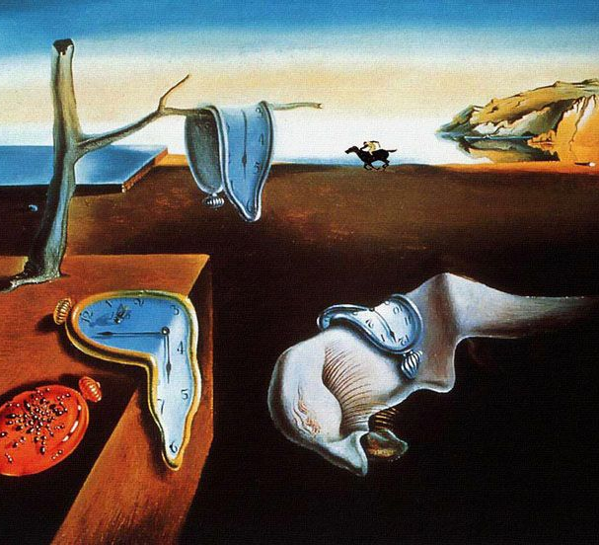
Salvador Dali
1904 -1989
Persistence of Memory. November 27th, 2016. http://mentalfloss.com/article/62725/15-things-you-didnt-know-about-persistence-memory.

Slide 5
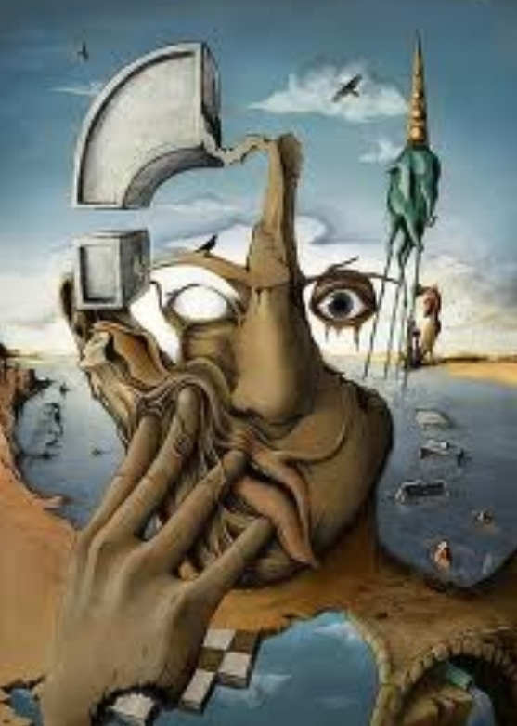
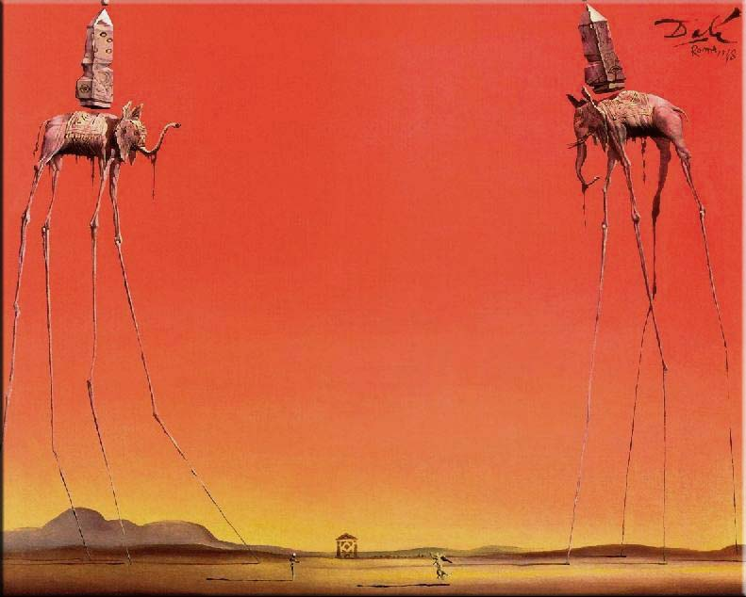
The Elephants. Retrieved November 27th, 2016. http://artanthologyinc.com/blog/?p=7911
Melting face photo. Retrieved November 27th, 2016. https://www.pinterest.com/pin/432556739193322548/.

Slide 6
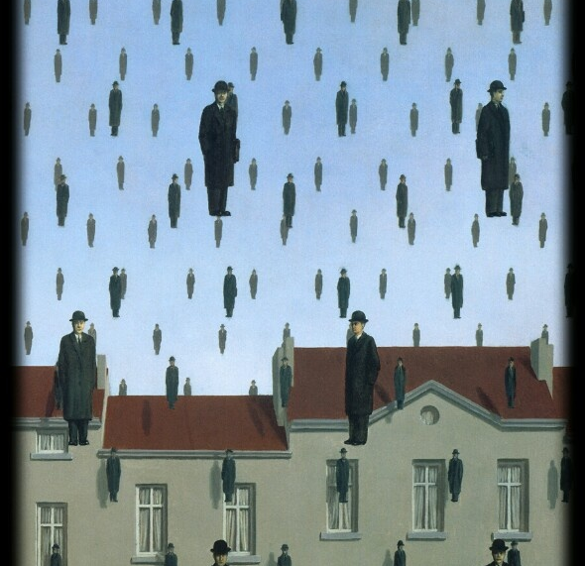
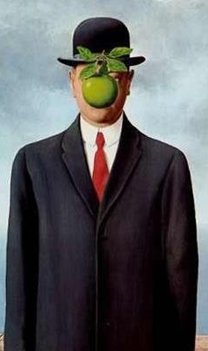
Rene Magritte
It’s Raining Men. November 27th, 2016. http://www.renemagritte.org/
1898 - 1967
Son of Man. November 27th, 2016. http://www.renemagritte.org/.

Slide 7
The Project

Slide 8
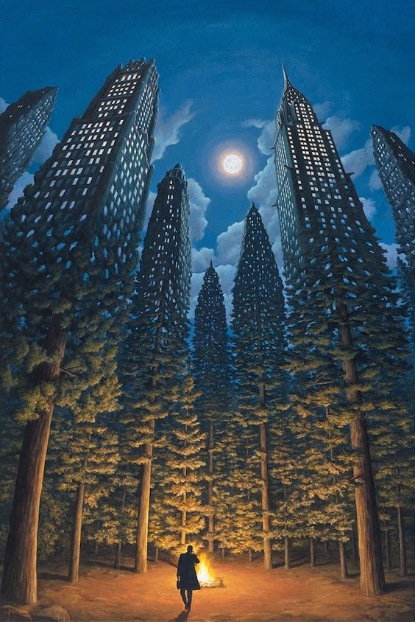
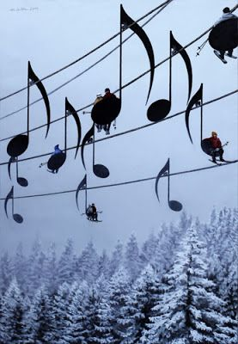

Slide 9
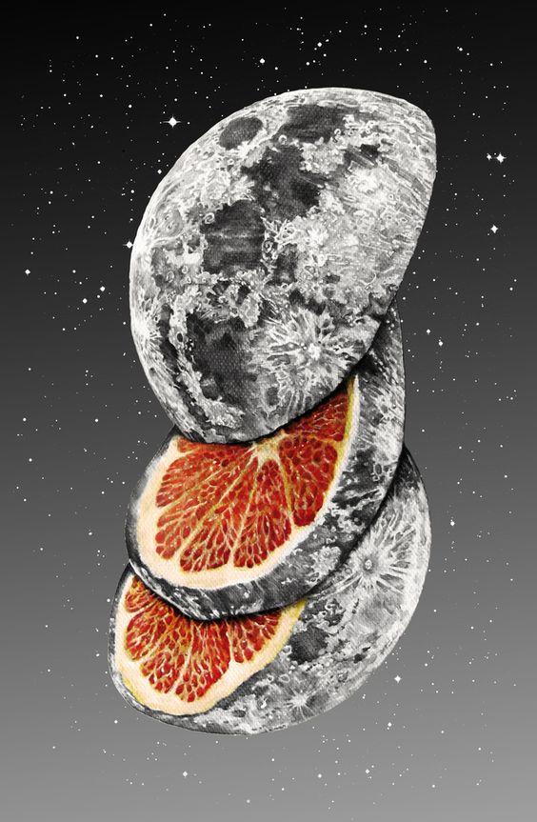
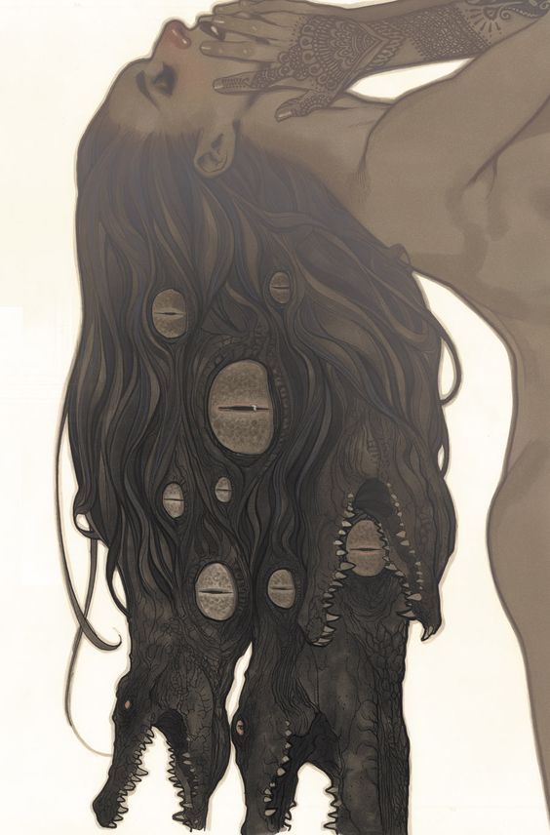

Slide 10
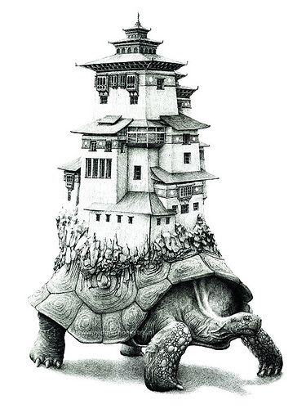
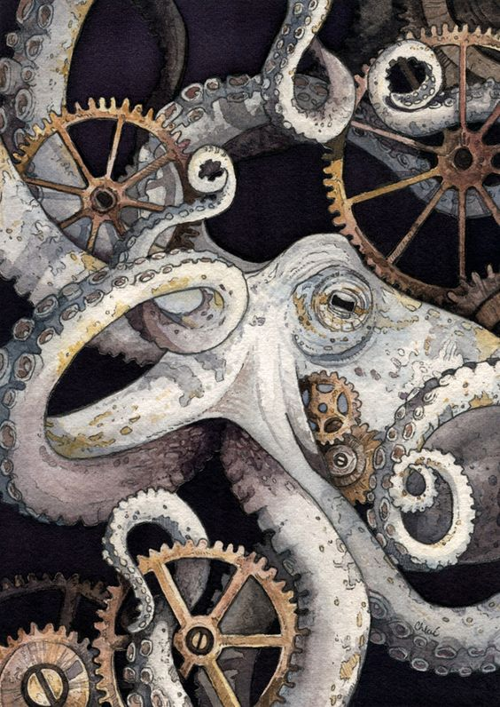

Slide 11
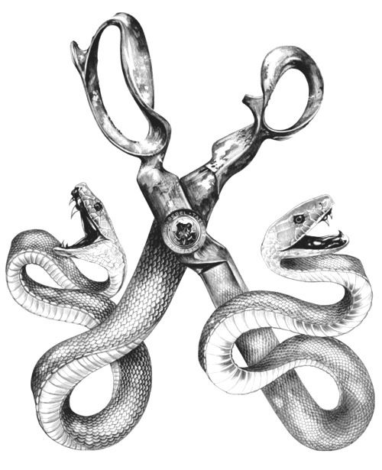

Slide 12
