Slide 1
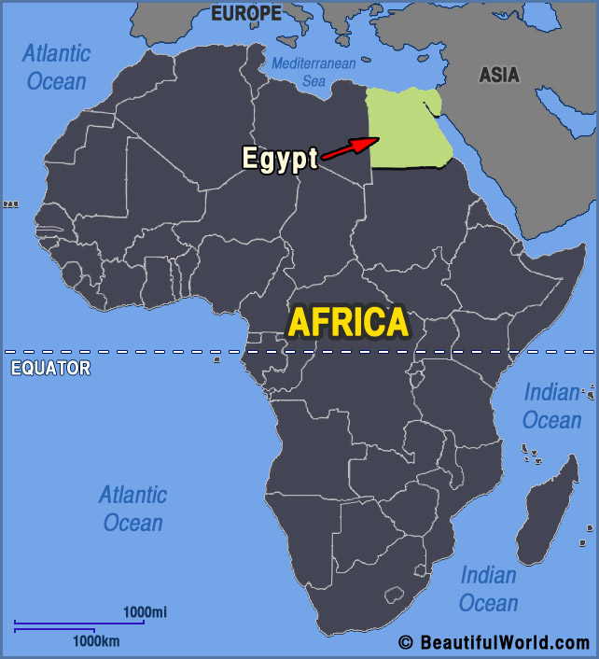
The Egyptian Gods and Goddess

Slide 2
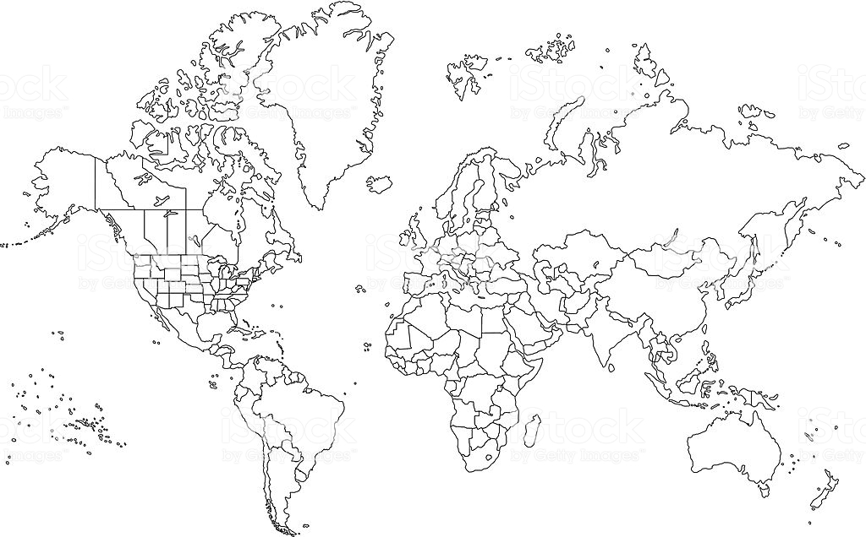

Slide 3
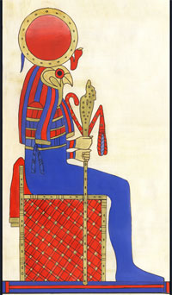
Ra (God of the Sun)
The first pharaoh of the world, back when gods inhabited Egypt.
Believed that when the sun was gone, he was in the underworld fighting off monsters.
Each day the sun rose was a sign that he was victorious and a new day would start again.
When he became to old he retreated to the heavens giving up his throne to Osiris.

Slide 4
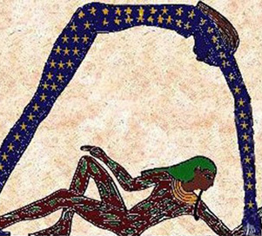
Geb and Nut (God of Earth and Goddess of the Sky)
He appears as a man made of earth, with rivers, forests and hills across his entire body.
She appeared as a woman with skin like a starry sky, dark blue and covered in constellations. She is often pictured stretching over Geb, as the sky stretches over the earth.

Slide 5
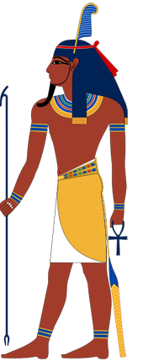
Shu (God of the Air)
He is given the job of keeping Nut and Geb apart.
This is why the sky is so far above the earth.
He stays between them, keeping his daughter from visiting her love the earth
He is usually not depicted because he is invisible like the wind.

Slide 6
Shu
Nut
Geb

Slide 7
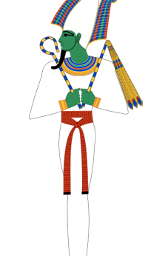
Osiris (God of the Underworld)
The first son of Geb and Nut, Osiris was a wise and good pharaoh when he took over the world from Ra
Osiris’s brother Set was jealous of him. Set tricked him into laying down in a golden coffin, then sealed the coffin and cut it into pieces. Set scattered the pieces all over Egypt.
Osiris’s wife Isis spent years searching for them. Eventually, Isis put her husband back together, binding him in cloth to make the first mummy, but Osiris only came partially back to life.
After that, he was the god of the underworld, sitting in judgment over the souls of the dead.

Slide 8
Isis (Goddess of Magic)
A clever and ambitious woman.
She tricked Ra into retiring by poisoning him with a magic snake, then encouraging the old sun god to reveal his secret name so Isis could cure him. Once Isis knew Ra’s secret name, she could force him to do just about anything. She encouraged him to retreat into the sky, opening the throne for Osiris.

Slide 9
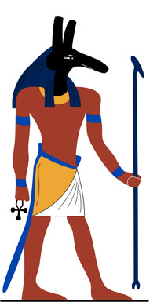
Set or Seth (God of the desert, storms and evil)
The strongest of the gods and very tricky.
He became pharaoh of Egypt after killing his brother, but was later overthrown by his nephew Horus.
He then fled to the desert, where he controlled all the evil harsh lands outside the Nile.

Slide 10
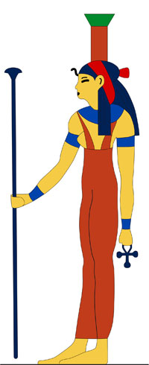
Nephthys (The River Goddess)
The wife of Set and the sister of Isis.
She didn’t like her husband very much, because after he killed Osiris, Nephthys helped Isis collect his pieces and bind them together.
She was kind and gentle and the mother of Anubis.

Slide 11
Shu
Nut
Geb
Nephthys
Set
Osirus
Isis

Slide 12
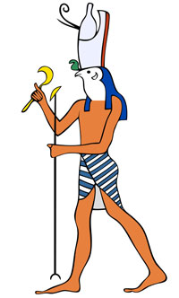
Horus (The Avenger God)
Son of Isis and Osiris.
He challenged Set and eventually defeated him, making him the pharaoh of Egypt.
Afterwards, all mortal pharaohs considered themselves to be the descendants of Horus.
His symbol was the falcon.

Slide 13
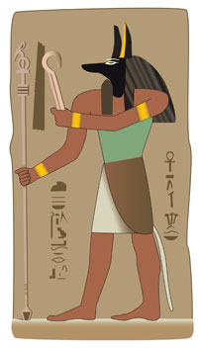
Anubis (God of Funerals)
Was one of the most important gods, because he helped prepare the soul for the Afterlife and escorted the dead to the hall of judgment.
The Egyptians noticed jackals hanging around their graveyards, so they decided jackals must be Anubis’s sacred animals.
Priests even wore jackal masks when they made the pharaoh’s body into a mummy.
Anubis helped Isis make Osiris into the first mummy.

Slide 14
Shu
Nut
Geb
Nephthys
Set
Osirus
Isis
Anubis
Horus

Slide 15
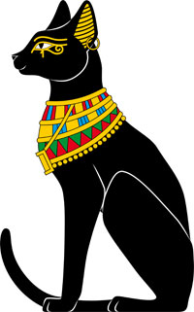
Bast (Goddess of Cats)
A very popular goddess.
Bast was a protective goddess, and people would wear amulets with her likeness for good luck, especially during the bad luck Demon Days at the end of each year.
She was also Ra’s faithful cat.

Slide 16
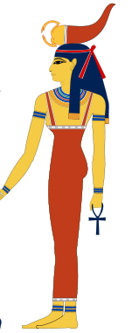
Serqet (Goddess of Scorpions)
She was both good and bad.
She could send scorpions after her enemies, and a single scorpion bite could kill you.
You could pray to Serqet for protection from poison, and sometimes she was seen as a guardian of children.

Slide 17
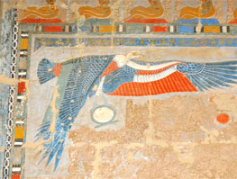
Nekhbet (Goddess of Vultures)
One of the oldest goddesses of Egypt, Nekhbet was a patron of the pharaoh, and is often pictured with her wings spread over the king.
Like all vultures, she preyed on the dead and dying. If you see Nekhbet hovering over you, start dancing! Let her know you’re still alive!

Slide 18
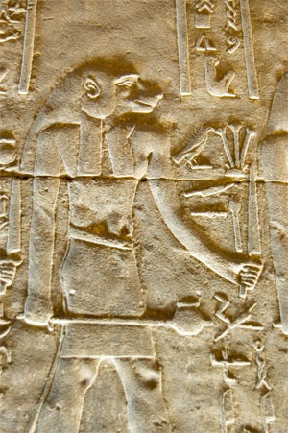
Babi (God of Wild Baboons)
He was aggressive and bloodthirsty, and was given the job of eating the wicked dead in the Underworld.
He especially loved entrails. Yum! Babi is definitely not a primate you want to fight.

Slide 19
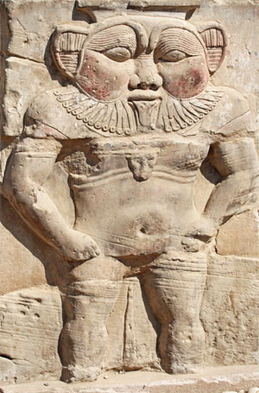
Bes (God of Dwarves, protector of households, mothers and children)
One of the ugliest and most popular gods in Ancient Egypt, Bes had the power to scare off evil spirits.
He often appeared on amulets and in sculpture as a hairy little man with a lion-like mane and a pug nose.
Egyptians believed that dwarves (and other people who were born different) were inherently magical.
Bes was considered extremely good luck. He watched over the common man, children, women in childbirth, and anyone else who needed protection from evil.

Slide 20
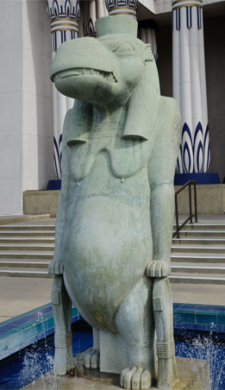
Tawaret (Goddess of Hippos)
While the Egyptians were scared of male hippos, they saw the female hippo goddess Tawaret as a gentle protector.
She looked after pregnant women especially, and is often depicted with a swollen belly.
Like Bes, she could scare off evil spirits. In fact, in many stories Tawaret is the girlfriend of Bes. What a cute couple!

