Slide 1
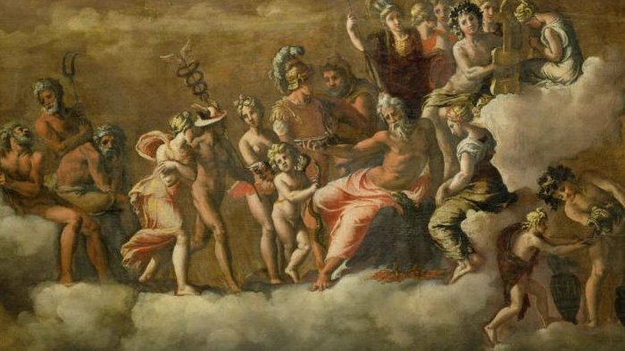
The Greek Gods and Goddesses

Slide 2
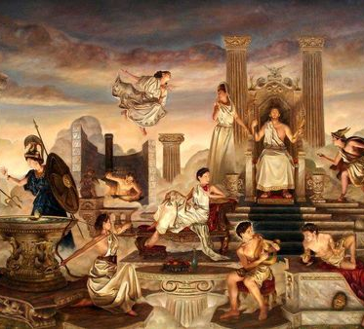
How they differed from the Egyptian Deities
For the Greeks, humanity is what mattered.
In the words of the philosopher Protagoras, humans were “the measure of all things.”
Greek Gods assumed human forms whose grandeur and nobility were not free from human frailty.
It has been said that the Greeks made their gods into humans and their humans into gods.

Slide 3
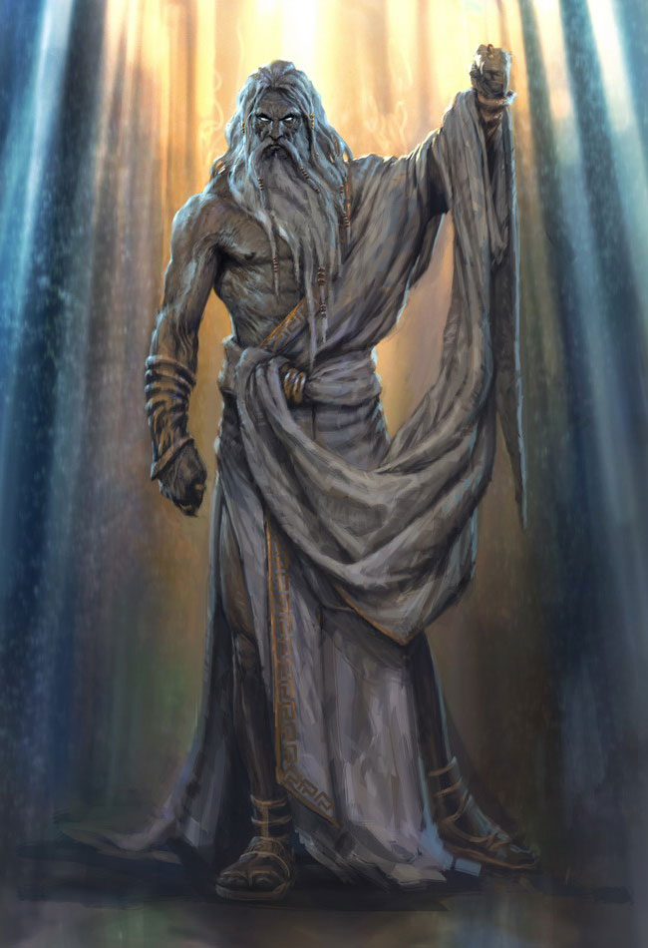
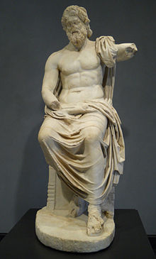
Zeus (Jupiter) King of the gods
Ruled the Sky
Also the ruler of weather, thunder, lightning, law, order, and justice.
He is the youngest son of Cronus and Rhea.
His weapon was the thunderbolt, and with it he lead the other gods to victory over the giants.
His sacred animals include the eagle and the bull.

Slide 4
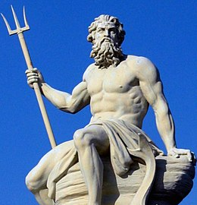
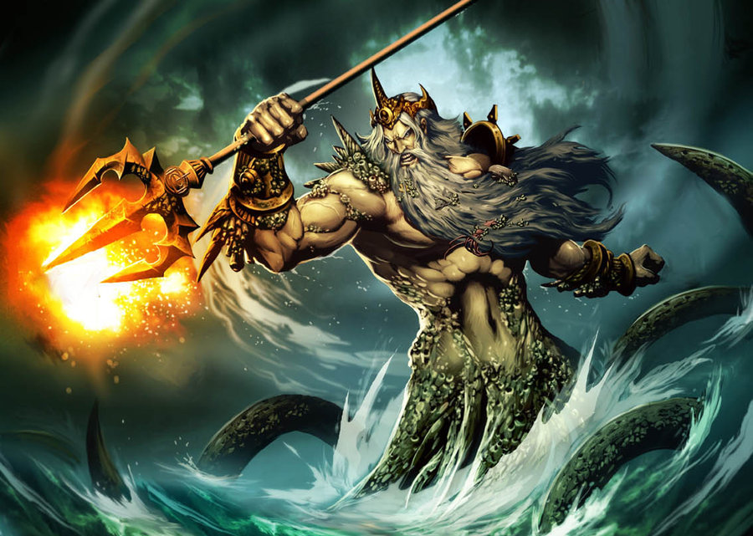
Poseidon (Neptune) God of the Sea
Brother of Zeus (Son of Cronus and Rhea)
He is usually depicted a mature man of sturdy build, often with a luxuriant beard, and holding a trident.
His sacred animals include the horse and the dolphin.
In some stories he rapes Medusa, leading to her transformation into a hideous Gorgon.

Slide 5
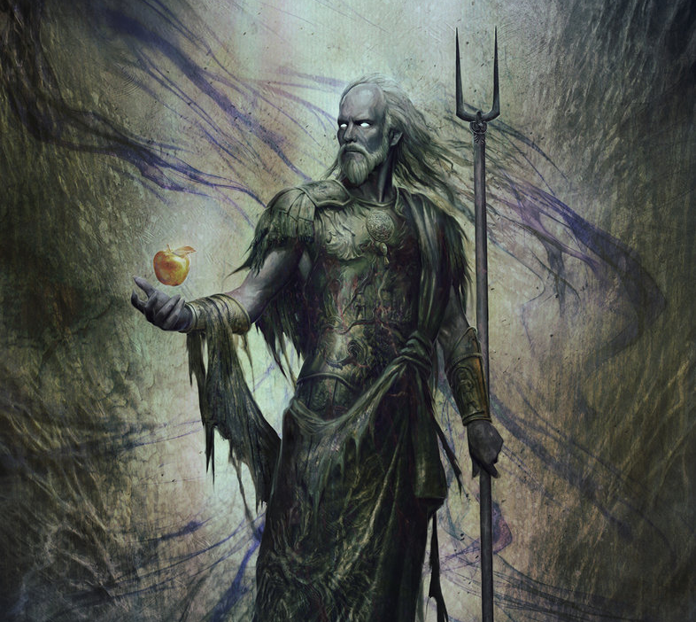
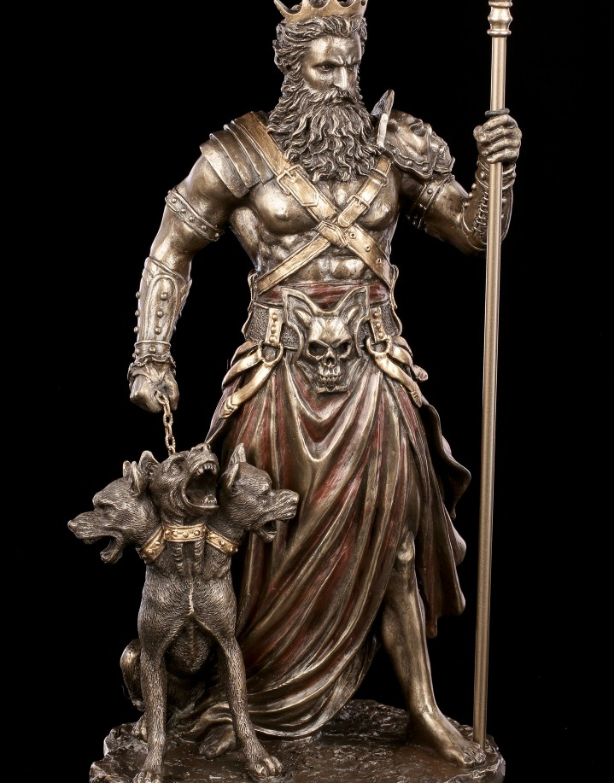
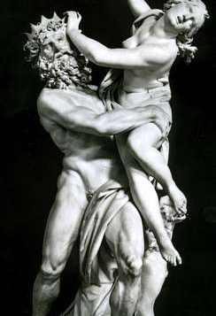
Hades (Pluto) king of the Underworld and Dead
God of wealth. The last of the 3 brothers and rules one of the 3 realms.
Married to Persephone. (Not by her choice)
His attributes are the drinking horn or cornucopia and the 3-headed dog Cerberus.
His sacred animal is the screech owl.
He has a very chilly demeanor and is VERY CUNNING.

Slide 6
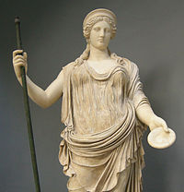
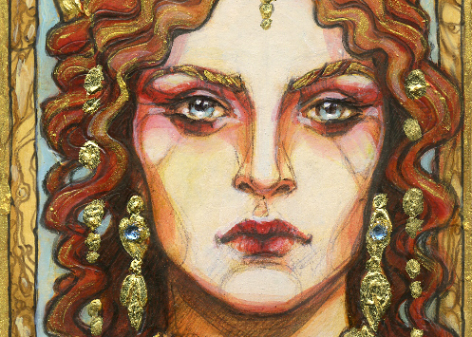
Hera (Juno) Queen of the gods
Goddess of marriage, women, childbirth, heirs, kings, and empires.
The wife and sister of Zeus.
Zeus had many affairs which deeply angered her and drive her to jealously and vengefulness.
Usually depicted in a diadem and a veil.
Her sacred animals include the heifer, the peacock, and the cuckoo.

Slide 7
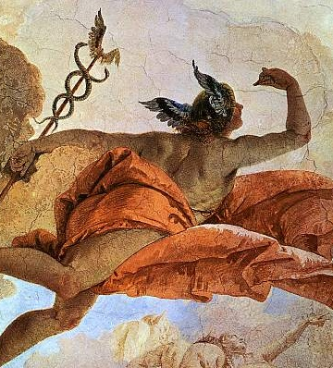
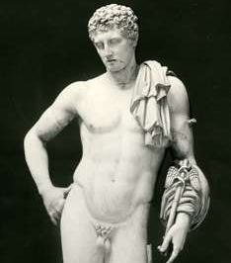
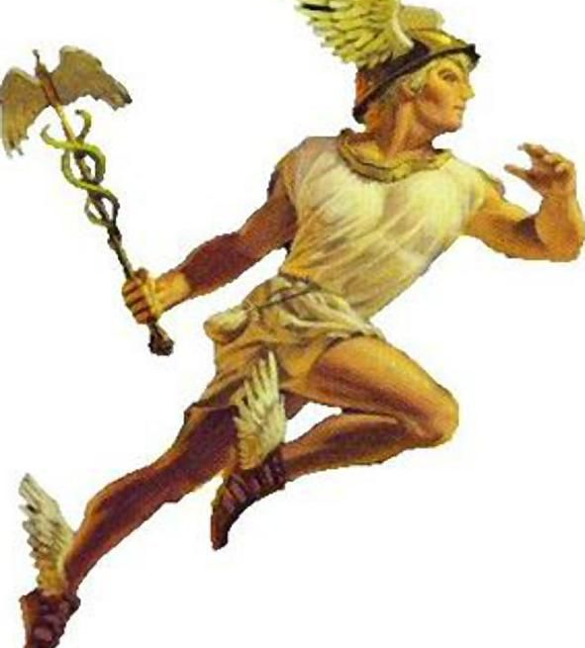
Hermes (Mercury) messenger of the gods
God of boundaries, travel, communication and trade.
He also was a guide for the dead traveling to the underworld.
Son of Zeus and a nymph named Maia.
One of Zeus’s many affairs.
He was depicted either as a handsome and athletic beardless youth, or as an older bearded man.
His attributes include the Herald’s Wand, winged sandals, and a travelers cap.
His sacred animal is the tortoise.

Slide 8
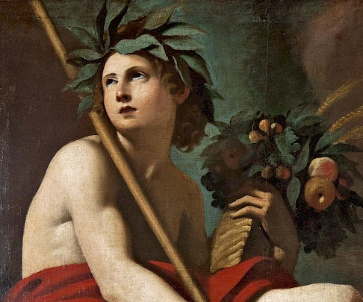
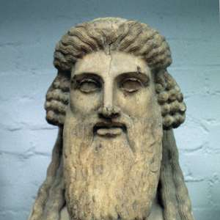
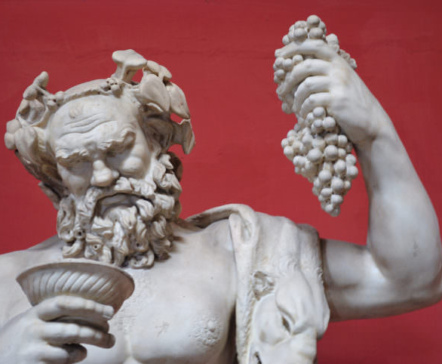
Dionysus (Bacchus) God of Wine
Also the god of fruitfulness, parties, festivals, madness, chaos.
He is the twice-born son of Zeus and the human Semele, in that Zeus snatched him from his mother's womb when she died and stitched Dionysius into his own thigh and carried him until he was ready to be born.
In art he is depicted as either an older bearded god or an effeminate, long-haired youth.
His attributes include the thyrsus, a drinking cup, the grape vine, and a crown of ivy.
Often surrounded by attendants of satyrs and maenads.

Slide 9
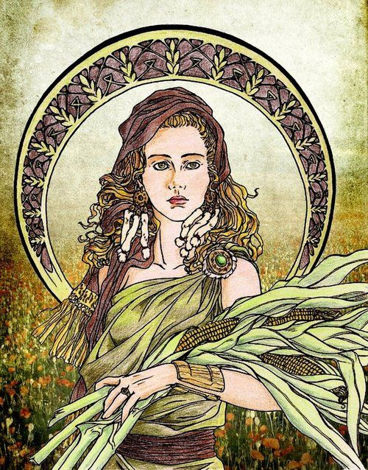
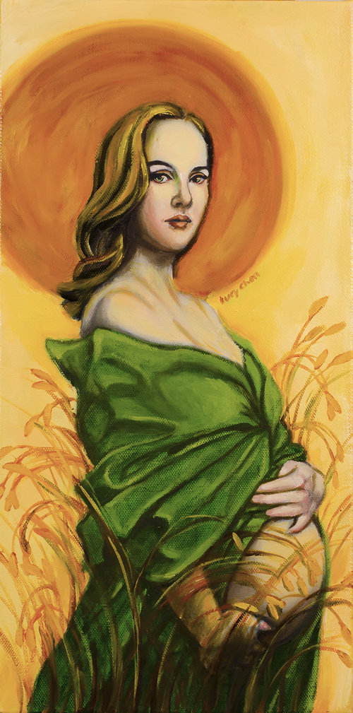
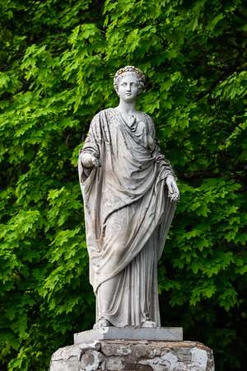
Demeter (Ceres) Goddess of the Harvest
Daughter of Cronus and Rhea.
Sister of Zeus, Poseidon and Hades
Her daughter is Persephone.
Hades kidnaps her and Demeter’s search for her explain the winter and summer seasons.
She is depicted as a mature woman, often crowned and holding sheaf's of wheat and a torch.
Her symbols are the cornucopia, wheat-ears, the winged serpent.
And her sacred animals are pigs and snakes.
She is the integral deity of one of the most important religious rites in ancient Greece called the Eleusinian Mysteries.

Slide 10
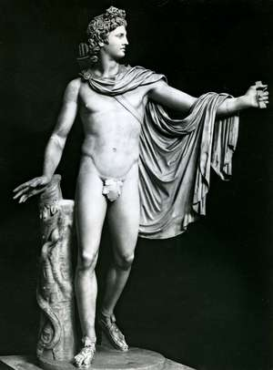
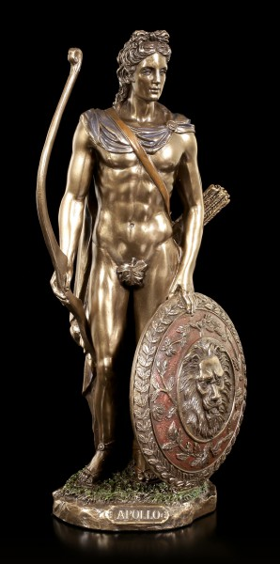
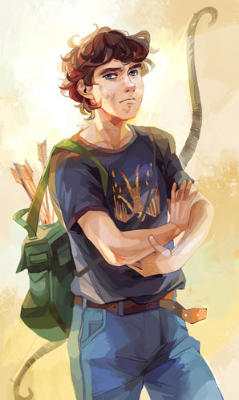
Apollo (Apollo) God of music
Also god of arts, knowledge, healing and archery.
Son of Zeus and twin brother of Artemis.
In myth, he can be cruel and destructive, and his love affairs are rarely happy.
Apollo is depicted as young, beardless, handsome and athletic.
His signs and symbols include the laurel wreath, bow and arrow, and lyre.
His animals are deer, swans and pythons.

Slide 11
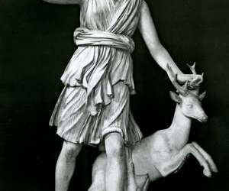
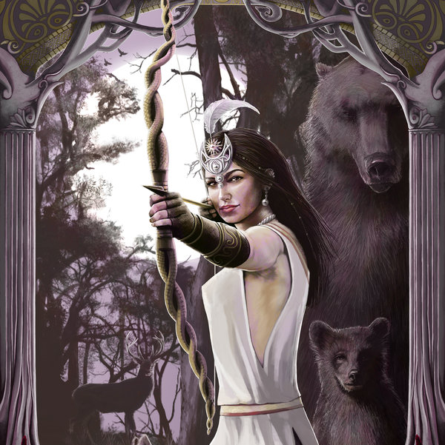
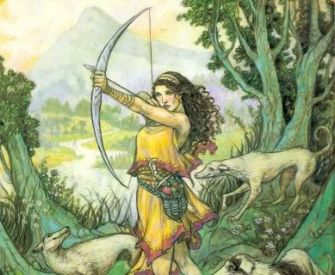
Artemis (Diana) Goddess of the hunt
Also the goddess of wilderness, animals, young girls, childbirth, and plague.
Both huntress and protector of the living world.
Like her brother she is associated with bows and arrows.
She is often depicted as a young woman dressed in a short knee-length chiton and equipped with a hunting bow and a quiver of arrows.
Her attributes include hunting spears, animal pelts, deer and other wild animals.
Her sacred animals include deer, bears, and wild boars.

Slide 12
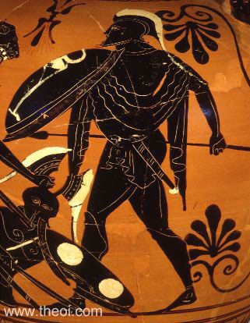
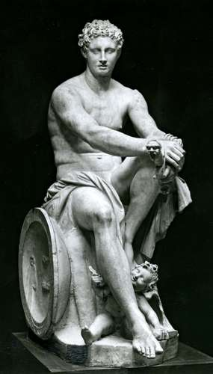
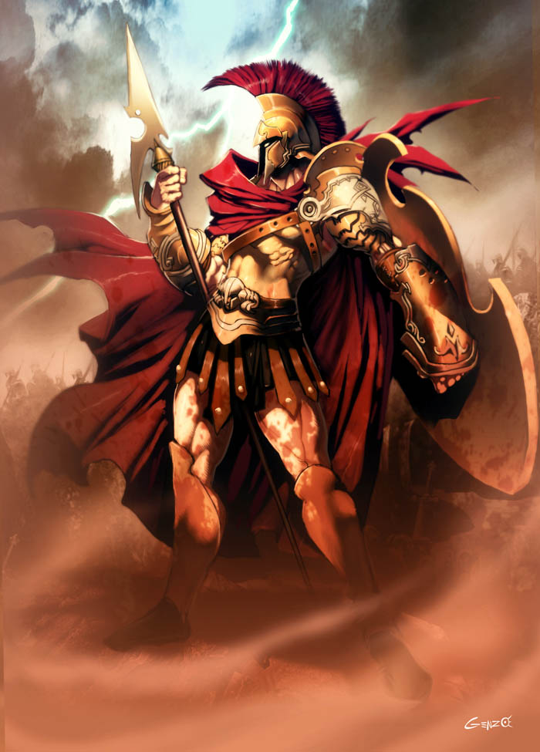
Ares (Mars) God of War
The son of Zeus and Hera.
His half sister is Athena.
He was depicted as a beardless youth, either nude with a helmet and spear or sword, or as an armed warrior.
His sacred animals include vultures, venomous snakes, dogs, and boars.
Is portrayed as moody and unreliable, and as being the most unpopular god on earth and Olympus

Slide 13
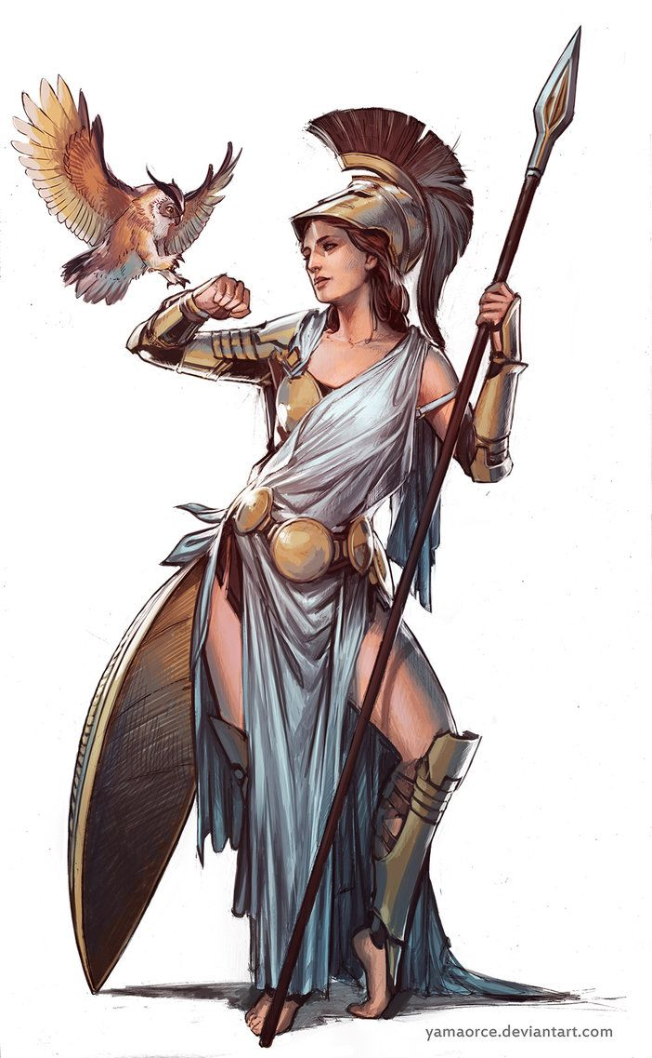
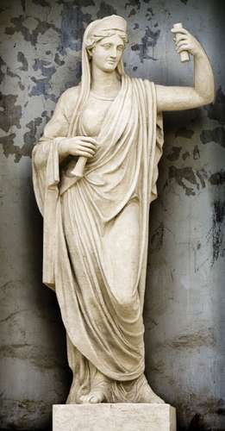
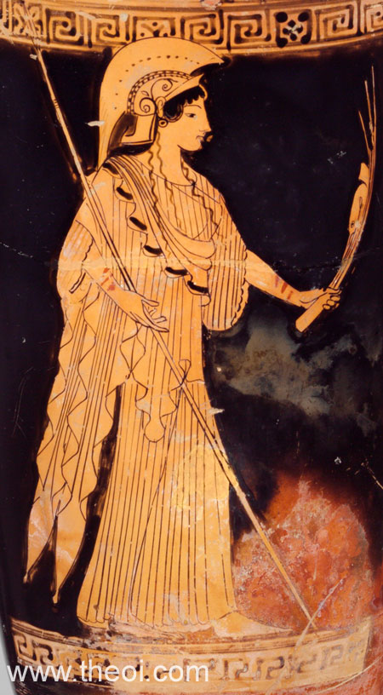
Athena(Minerva) Goddess of Reason
Also the goddess of wisdom and war.
According to most traditions, she was born from Zeus's forehead, fully formed and armored.
She is depicted as being crowned with a crested helm, armed with shield and spear, and wearing the aegis over a long dress.
She is a special patron of heroes and Athens.
Her symbol is the olive tree.
Her sacred animal is, the owl.

Slide 14
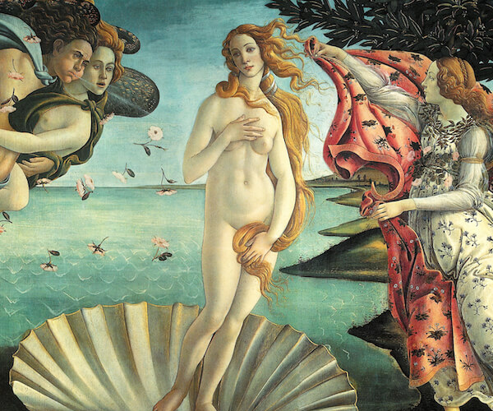
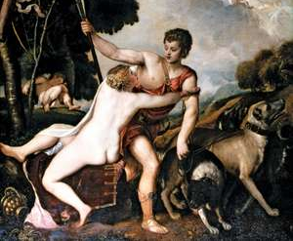
Aphrodite (Venus) Goddess of beauty
She is the daughter of Zeus and Dione.
Married to Hephaestus, but bore him no children.
Had affairs with Ares and had 3 kids with him.
She is usually depicted as a naked or semi-nude beautiful woman.
Her symbols include myrtle, roses, and the scallop shell.
Sacred animals include doves and sparrows.

Slide 15
“Cruel and fickle, passionate and vindictive, jealous and insecure, petty and insane: the inhabitants of Mount Olympus represent an attempt by the ancient Greeks to explain the chaos of the universe through human nature. Thus, like every deity invented before and since, these gods and goddesses are embodiments of human solipsism. The stories of their battles, bickering, and sexual conquests have indelibly influenced the course of Western language and narrative. “

