Slide 1
VALUE AND TEXTURE WITH INK

Slide 2
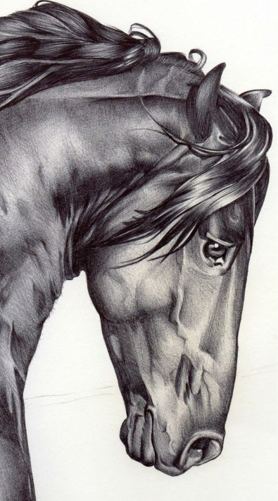

Slide 3
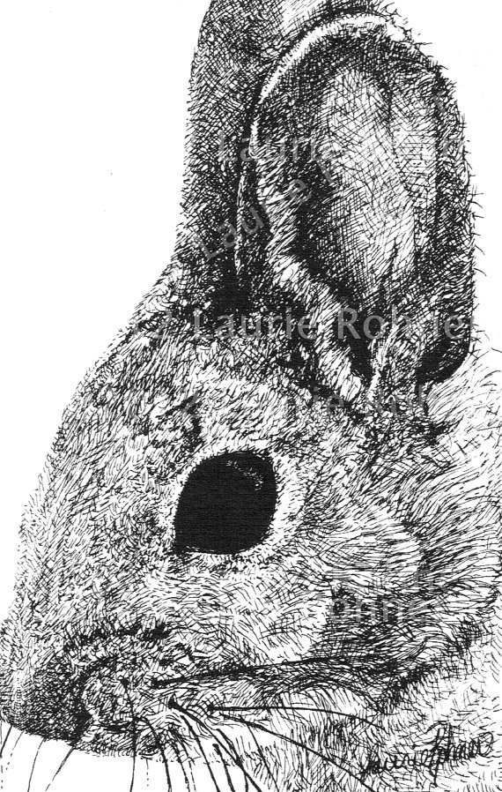
Texture:
*Texture is the way that something feels.
* The feel, appearance, or consistency of a surface or a substance.
Implied Texture:
*Texture that is created to look like something it is not, is called visual or implied texture.
*Using different pen and ink techniques to
create the illusion of texture.

Slide 4
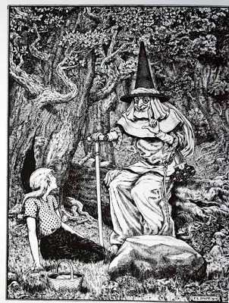
What is Illustration?
An illustration is a decoration, interpretation or visual explanation of a text, concept or process, designed for integration in published media, such as posters, flyers, magazines, books, teaching materials, animations, video games and films.

Slide 5
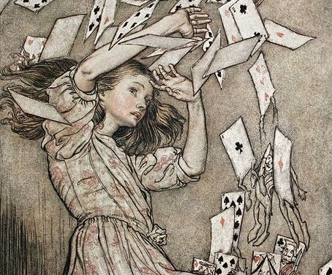
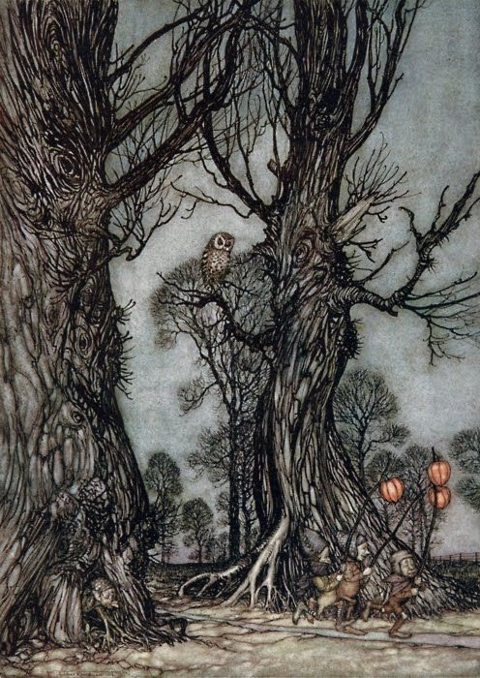
Arthur Rackham 1867 – 1939
By the turn of the century Rackham had developed a reputation for pen and ink fantasy illustration.

Slide 6
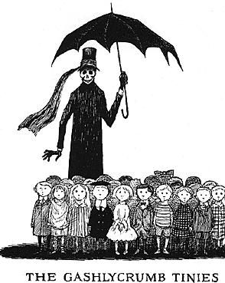
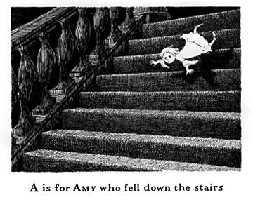
From 1953 to 1960, he lived in Manhattan and worked for the Art Department of Doubleday Anchor, illustrating book covers and in some cases, adding illustrations to the text. He illustrated works as diverse as Bram Stoker's Dracula, H. G. Wells' The War of the Worlds, and T. S. Eliot's Old Possum's Book of Practical Cats.
Edward Gorey

Slide 7
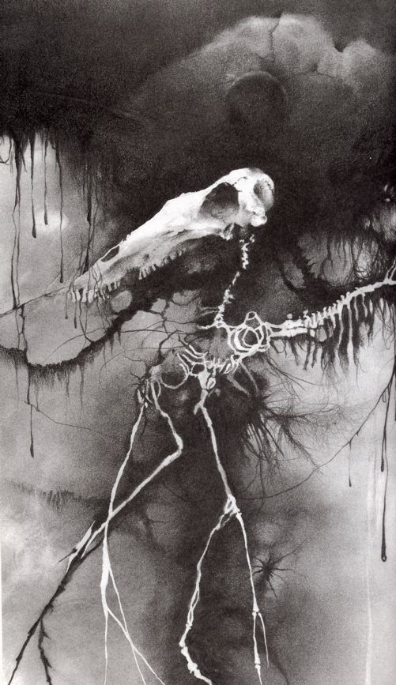
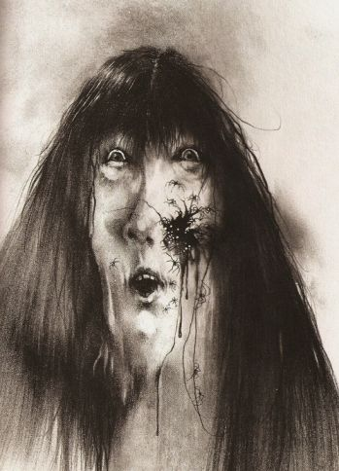
Stephen Gammell
Gammell is particularly well known for the surreal, unsettling illustrations he provided for Scary Stories to Tell in the Dark, a series of horror short stories by Alvin Schwartz that is still an adolescent favorite.

Slide 8
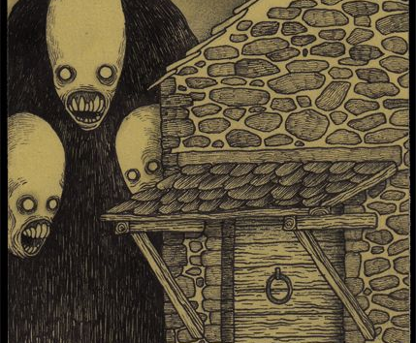
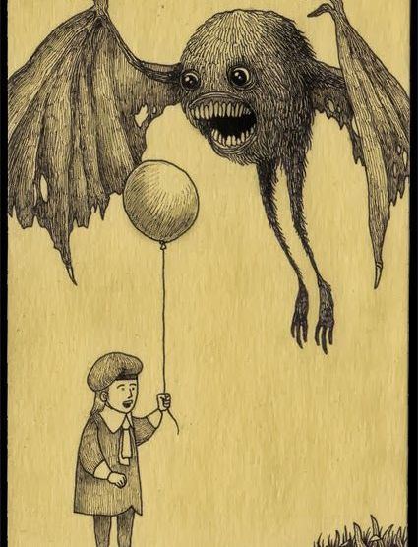
John Kenn mortensen
@johnkennmortensen
John Kenn is a Danish artist who draws his spooky pen and ink drawings on Post-It notes

Slide 9
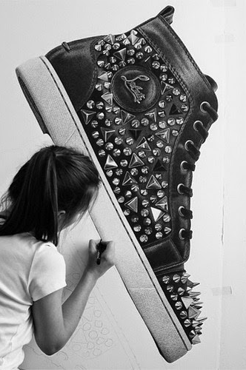
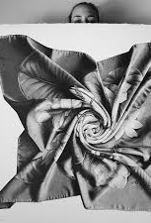
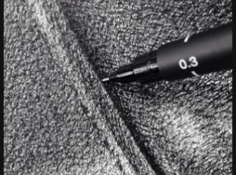
CJ Hendry @cj_hendry
CJ Hendry is from Austraila. She has no formal art training and considers herself "not very creative.“ Her works are primarily hyper-realistic, large scale ink drawings of luxury objects that sometimes take 200 hours to complete. Working with ink on paper her pieces are achieved through layers of what she refers to as scribbles. She uses photographs with edited saturated lighting, a ruler and a pen as a guide for their placement.

Slide 10
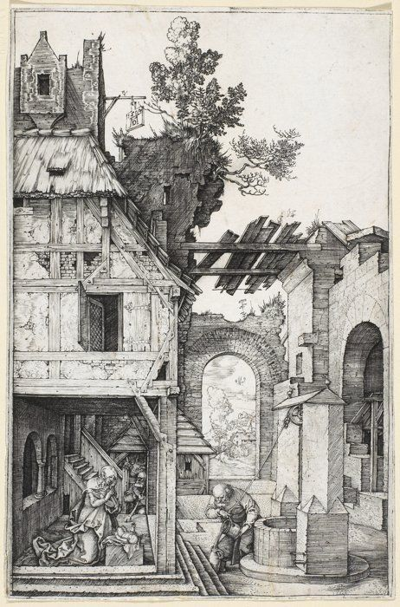
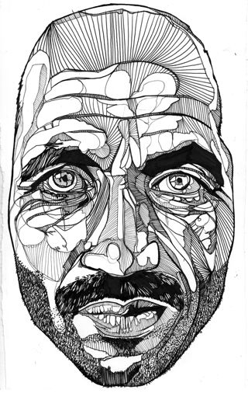

Slide 11
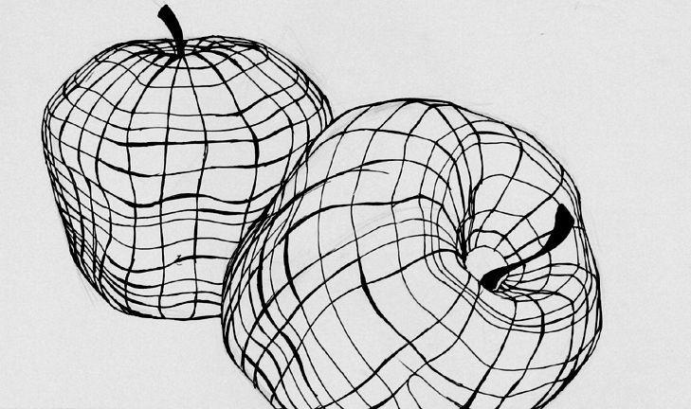
Cross Contour: They are the lines that reflect the movement of your eye in and around what you see. Imagine creating a grid on the object using string.

Slide 12
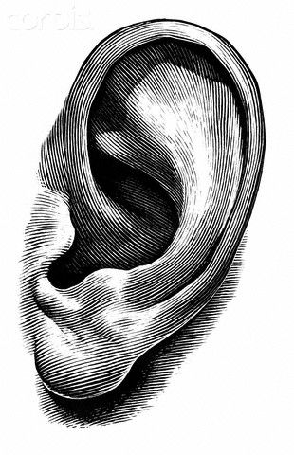
Hatching

Slide 13
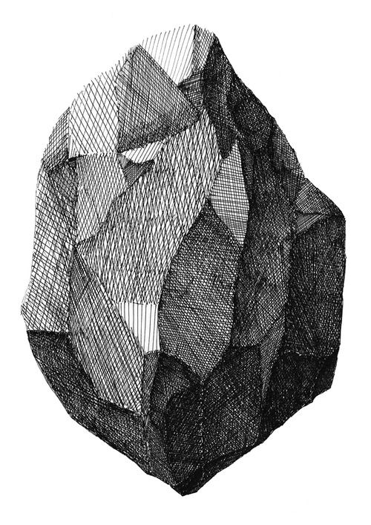
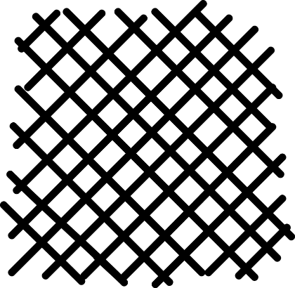
Cross Hatching

Slide 14
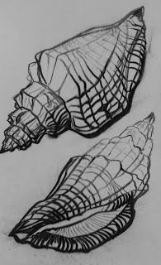
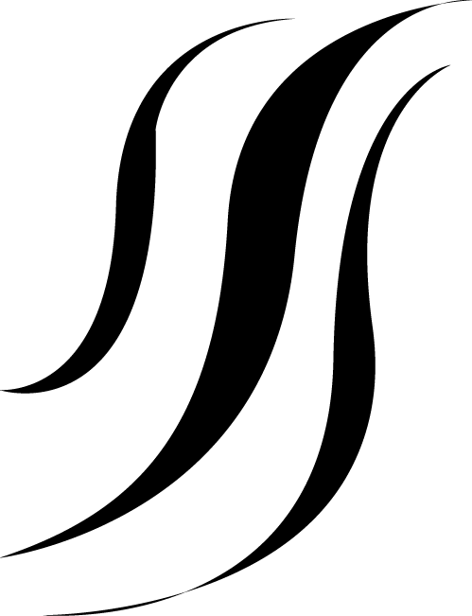
Line Weight

Slide 15
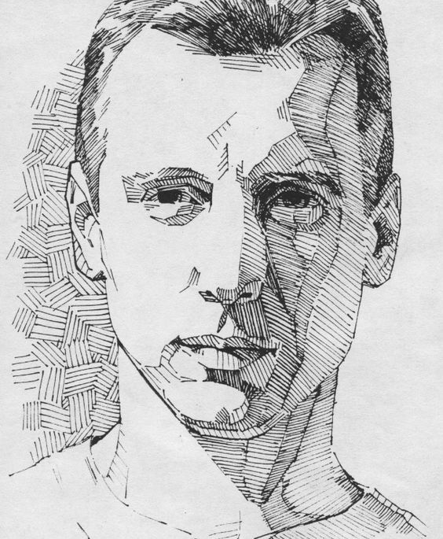
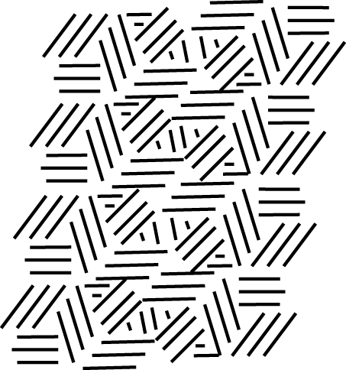
Multi directional lines

Slide 16
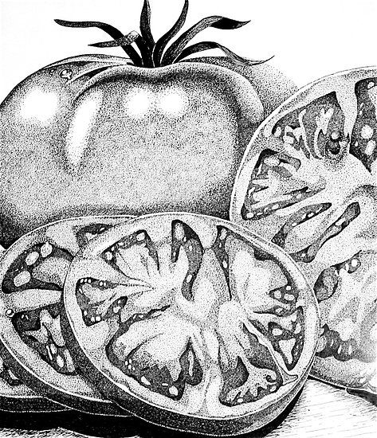
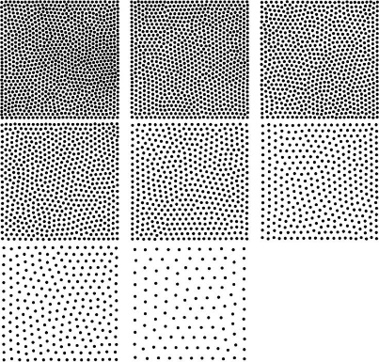
stippling

