Slide 1
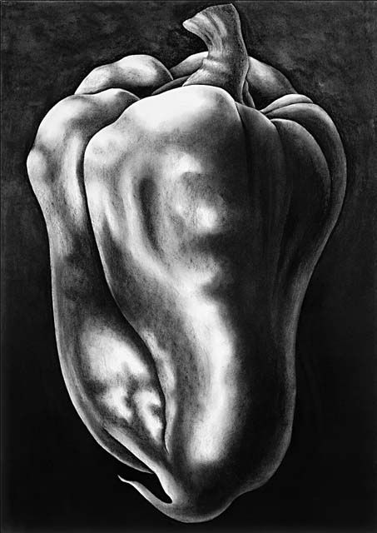
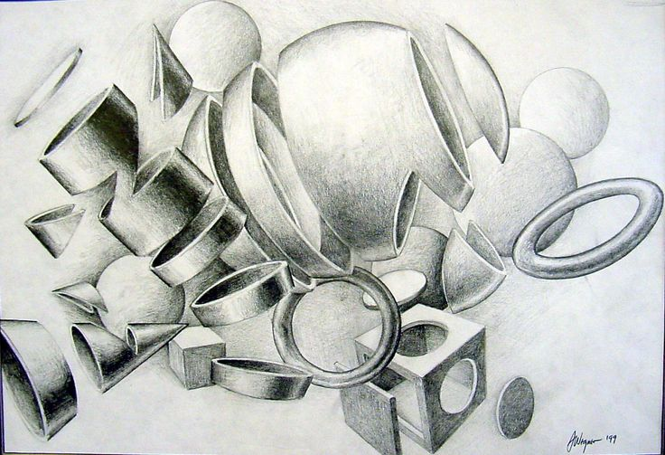
Value terms and techniques
FALL 2015

Slide 2
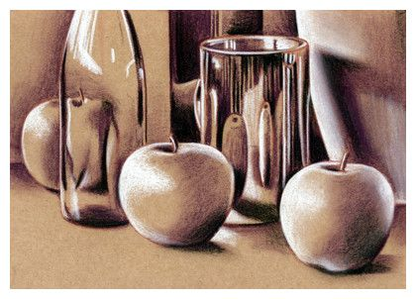
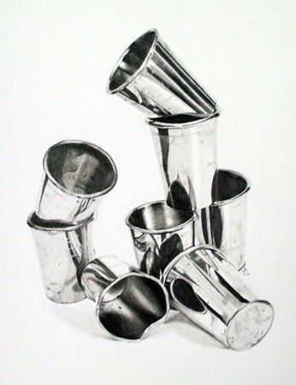
Value: The range of light and dark within a drawing.

Slide 3
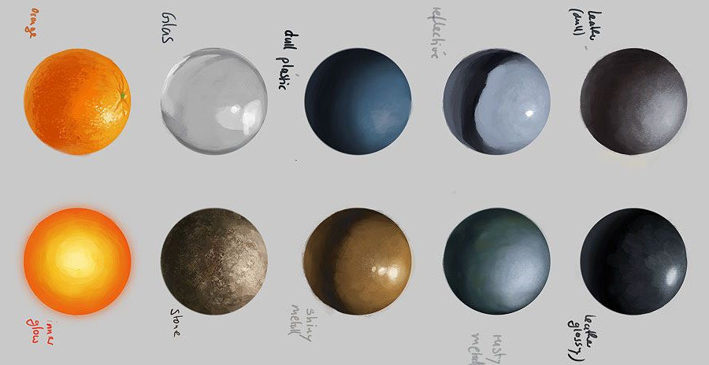
Highlight: The lightest value in a drawing. Is closest to the light source. Is often white.

Slide 4
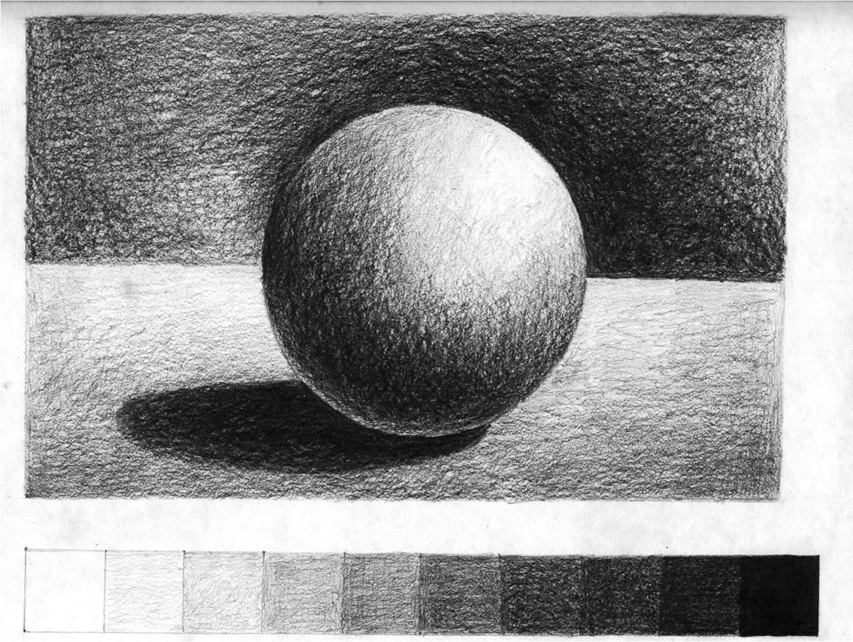
Back shading: shading the negative space behind an object darker in order to create contrast and to make the object appear to come forward.

Slide 5
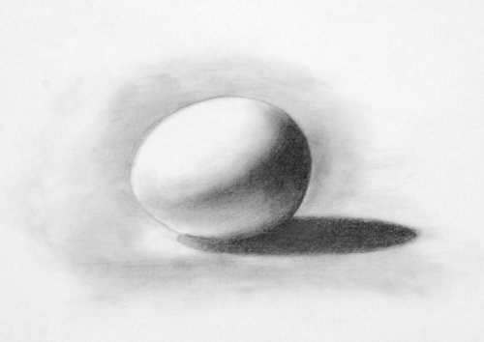
Cast Shadow: The dark area on an adjacent surface where the light is blocked by the solid object.

Slide 6
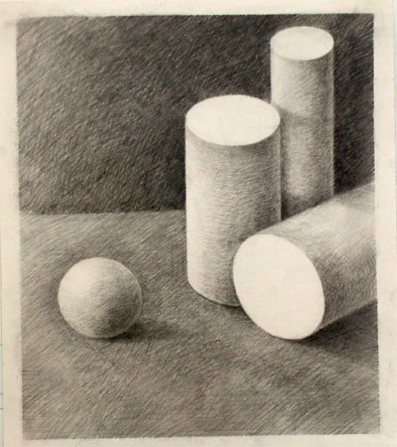
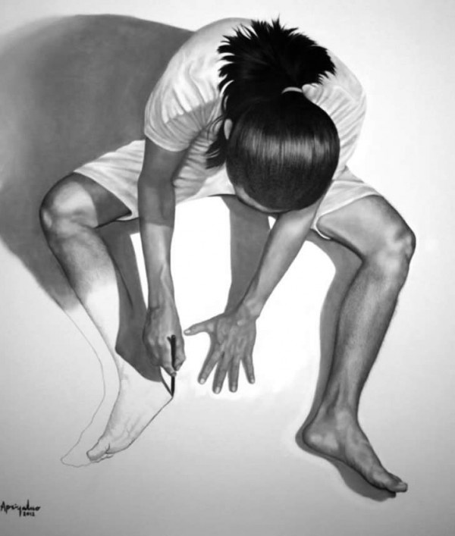
Form: The 3-dimensional quality of an object.

Slide 7
Graded: a method of shading that emphasizes edges and sharp transitions between value changes.

Slide 8
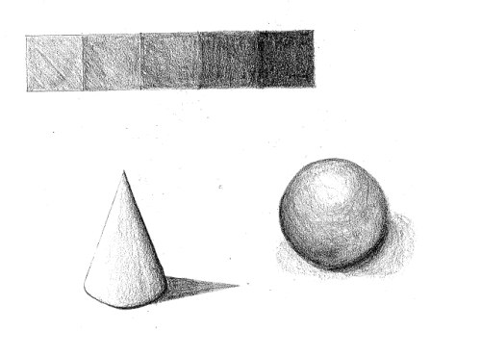
Tonal: method of shading that uses smooth transitions, normally used to create a rounded form.

Slide 9
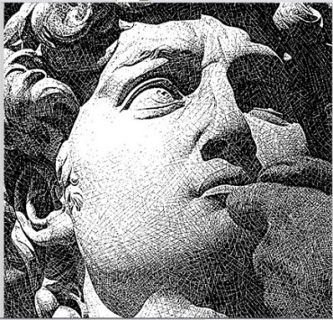
Half-Tone: A tonal value midway between highlight and dark shading

Slide 10
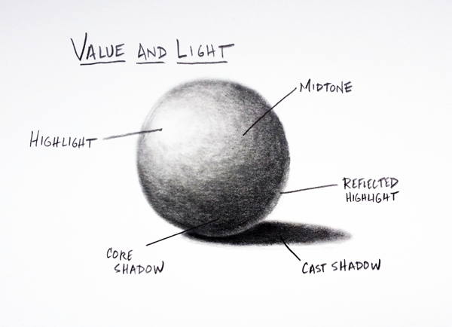
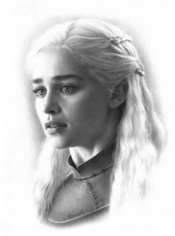
Light Source: The direction from which a dominant light originates. The placement of this light source affects every aspect of a drawing.

Slide 11
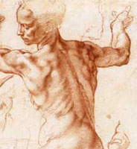
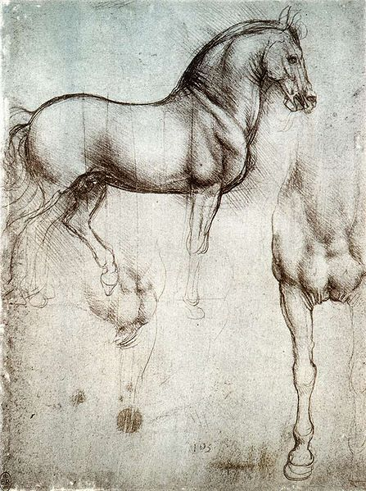
Modeling: The three-dimensional quality of such a form is emphasized by means of light, shadow, and color. Reproducing the effect of light, shadow, and color in a drawing of such a form makes it seem more realistic.

Slide 12
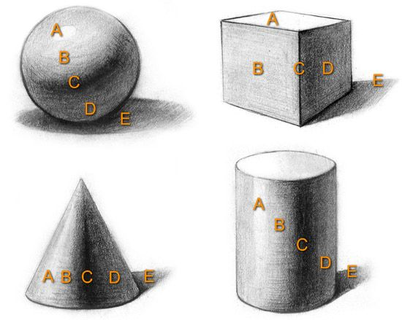
Reflected Light: refers to the “bounce” of light from the surface back ONTO an object. This is shaded LIGHTER than the area around it.

Slide 13
DESIGN AND COMPOSITION CONCEPTS:

Slide 14
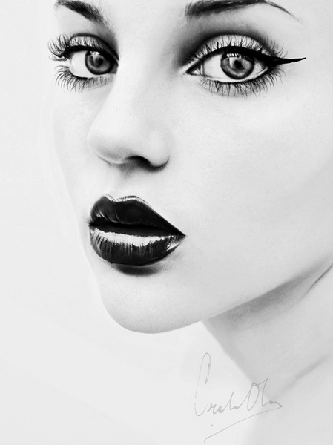
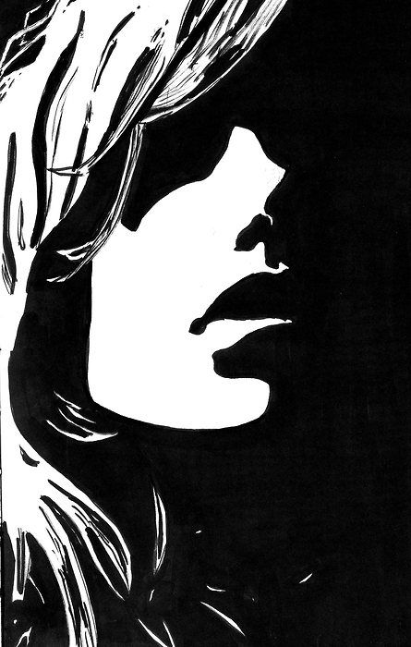
Contrast: “Opposites side by side.” Contrast can be used to make your drawings more three-dimensional by accentuating the light and shadows. By using extremes in values (more light and dark values than middle values) you create a high-contrast drawing. For a really powerful, strong, and dynamic drawing, you can draw very dark shading right next to the light areas.

Slide 15
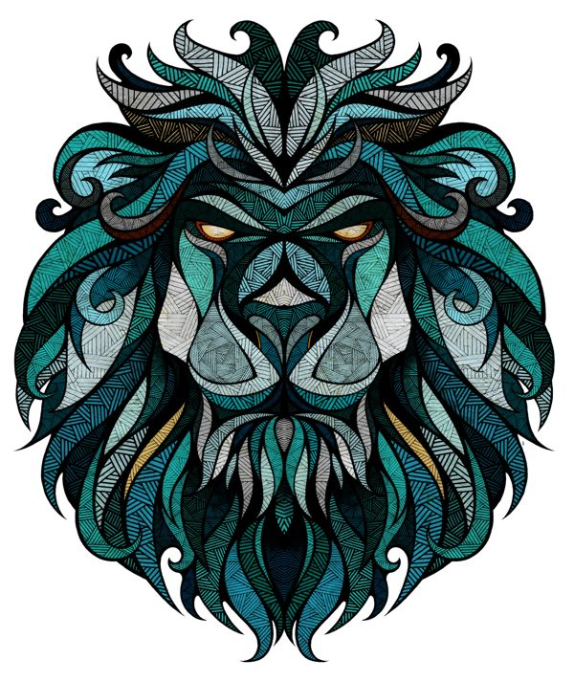
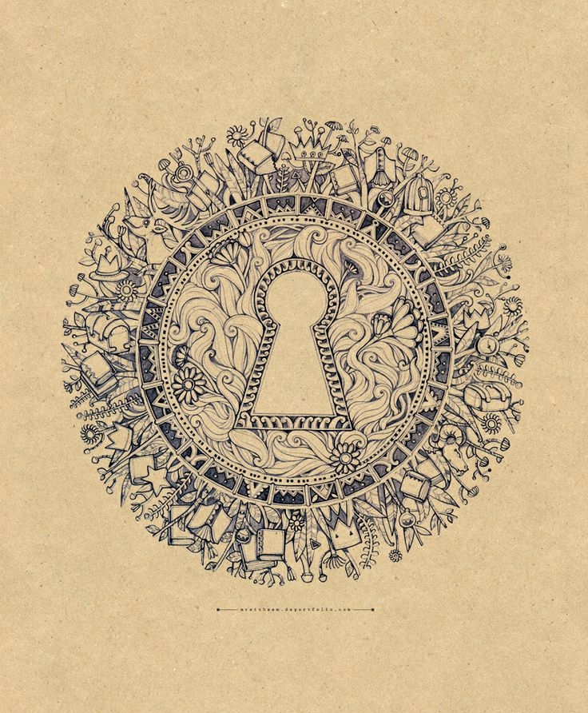
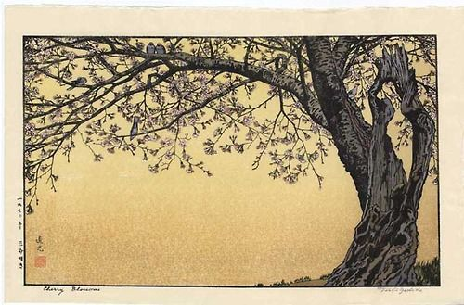
Balance: A stable arrangement of subjects within a composition that create visual harmony.
1. Asymmetrical (Informal)
2. Symmetrical (Formal)
3. Radial

Slide 16
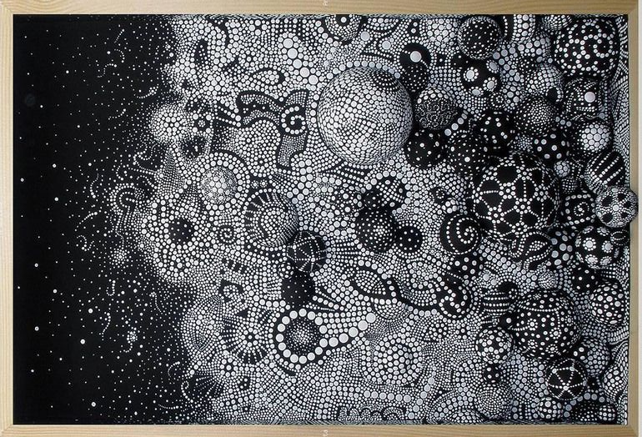
Repetition: refers to one object, shape, or VALUE repeated within the composition.

Slide 17
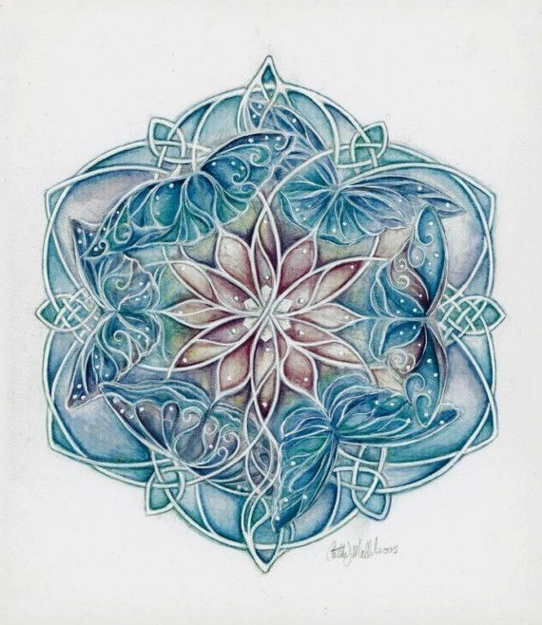
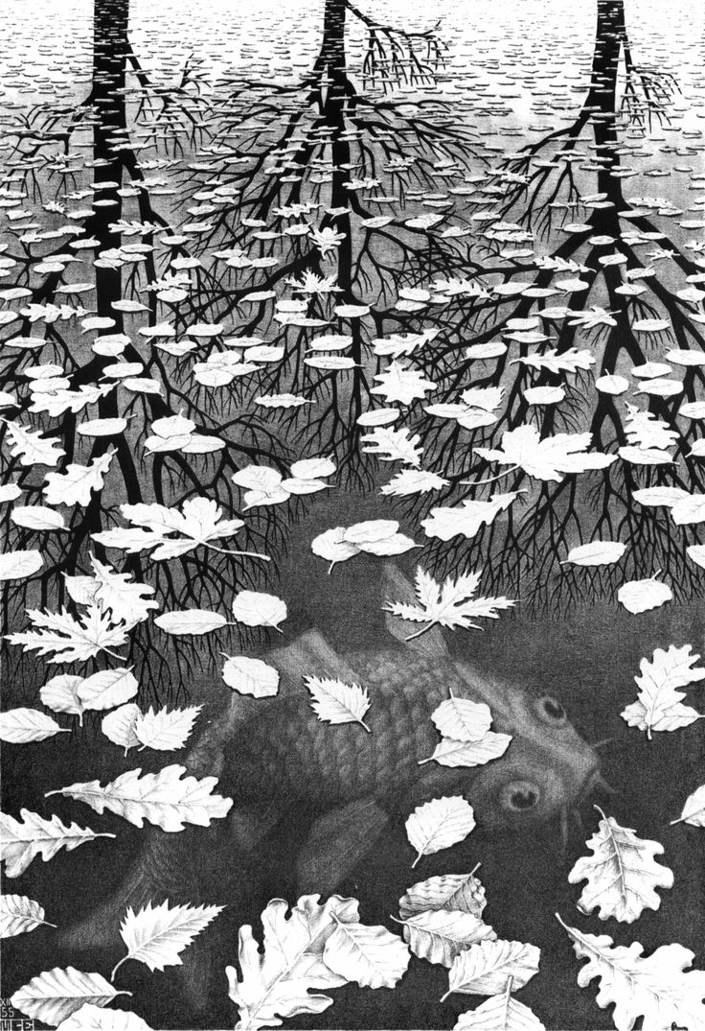
Unity: All parts of the whole go together

Slide 18
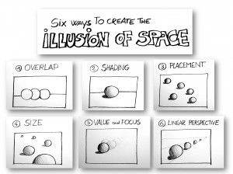
Space: Refers to the illusion of depth created within a drawing, as well as the arrangement of objects (positive shapes) within a composition to create a balance of negative and positive space.

